Slide 1

Agents for the Treatment of MRSA: Pharmakokinetics &Pharmacodynamics
Pamela A. Lipsett, MD, MHPE
Warfield M Firor Endowed Professor
Departments of Surgery, Anesthesiology, Critical Care Medicine, Nursing.
Johns Hopkins University Schools of Medicine and Nursing
Baltimore, MD

Slide 2
Disclosures
No pharmaceutical disclosures
Drug dosing based on scientific literature some of which is non-FDA approved.

Slide 3
Objectives
Recall the definition of pharmackokinetics and pharmacodynamics
Compare and contrast gram positive therapeutic agents pK/pD
Recognize PK changes in critical illness
Identify what YOU will do to use these principles to improve antibiotic prescribing

Slide 4
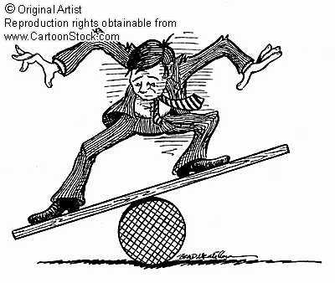
Antimicrobial Use
Clinical Benefit IF:
Infection is present.
Right Drug
Right dose
Right duration
Clinical Harm IF:
Infection is NOT present.
Wrong Drug
Wrong dose
Too long duration
Adverse drug events
Resistance

Slide 5
Reminder:
Pharmacokinetics (PK)
Absorption, distribution, metabolism, and elimination of the drug
Relationship between the dose and concentrations observed in the body
PK parameters determine concentration-time course
Critical Values
  C Max = Peak /Max concentration
  AUC= Area Under the serum-concentration-time curve
  C Min= trough concentration
  T1/2=half life
  Tissue penetration

Slide 6
Reminder:
Pharmacodynamics (PD)
Relationship between the antimicrobial concentration and the observed effect on the target pathogen in the body
MIC, duration of bactericidal effects, post antibiotic effects (PAE), rate of killing, and rate of development of resistance.

Slide 7
Time-Dependent
Cumulative % of time that free drug exceeds the MIC fT _{>MIC}
  Concentration above MIC does not kill more but MAY suppress resistance
Example: Beta lactams, cephalosporins

Slide 8
Concentration-dependent
Peak concentration in the dosing interval divided by the MIC ( C_{max}/MIC)
Aminoglycosides and daptomycin examples
Usual target for C max/ MIC that exceeds 8-10

Slide 9
Concentration-dependent with time dependence
Antimicrobial effect is defined by AUC of free drug over 24 hr divided by the MIC
= AUC 0-24/MIC
Example: Fluroquinolones, daptomycin, tigecycline, linezolid, glycopeptides

Slide 10
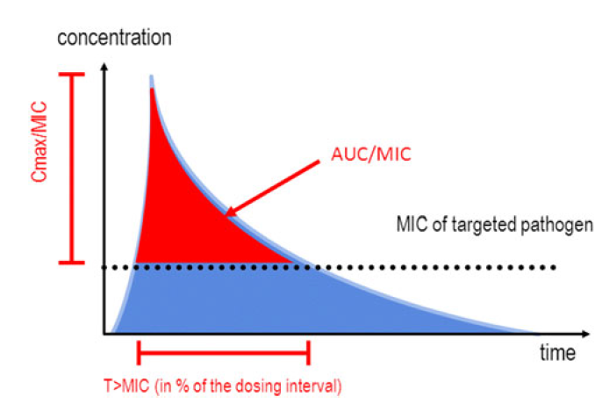
PK/PD Indices

Slide 11
Goals Based on pK/pD
 | Concentration dependent | Time-dependent | Concentration dependent with time-dependence
Objective | MAXIMIZE Concentration | MAXIMIZE duration of exposure | MAXIMIZE amount of drug exposure
Optimal PK/PD index | Cmax/MIC | T>MIC | AUC 0-24/MIC
Agents | Daptomycin | Linezolid | Linezolid
 | Quinpristin/ dalfopristin | Cephalosporins | Quinpristin/ dalfopristin
 |  |  | Vancomycin

Slide 12
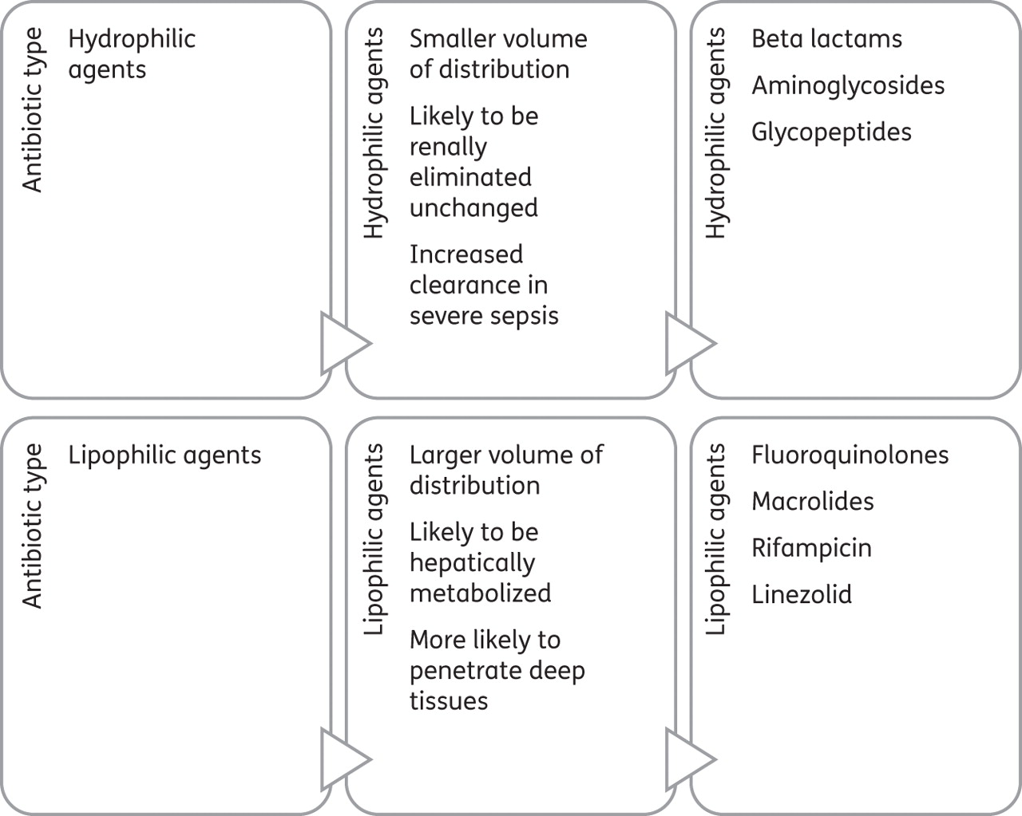

Partition into fat or water?.
Cathrine McKenzie J. Antimicrob. Chemother. 2011;66:ii25-ii31
© The Author 2011. Published by Oxford University Press on behalf of the British Society for Antimicrobial Chemotherapy. All rights reserved. For Permissions, please e-mail: journals.permissions@oup.com
Notes:
Classification of antibiotics in terms of their propensity to partition into fat or water.

Slide 13
Critical illness: Antimicrobials
Hydrophilic vs Lipophilic
Glycopeptides
Lipopeptides
Tissue distribution : extravascular space
Renal Clearance
Increased loading dose
Maintenance dose changes
Glycycline
Intracellular distribution
Hepatic clearance
No need for increased loading dose
No need for dose changes

Slide 14
IV Agents for MRSA:[skin and soft tissue]
Agent | Usual Adult Dose (70 kg person) | FDA approved duration | Cost ($)
Lipoglycopeptide
Vancomycin | 15 mg/kg q 12 |  | 16.50
Dalbavancin | 1000mg, x1, 500mg 1 week later | 14 days | 2980.00
Oritavancin | 1200 mg | Once | 2900.00
Televancin | 10 mg/kg q 24 | 7-14 days | 309.50
Oxazolidinone
Linezolid | 600 mg q 12 | 10-14 days | 278.90
Tedizolid | 200mg/day | 6 days | 235.00
Other
Ceftataroline fosamil | 600 mg q 12 | 5-14 days | 252.70
Daptomycin | 4mg/kg q 24 hrs | 7-14 days | 354.70
Medical Letter 1/5/2015

Slide 15
Ceftaroline: Time Dependent
Bacteria | MIC [mg/L] | %fT>MIC
 |  | Bacteriostatic effect | 1-log killing | 2-log killing
Strep pneumonia | 0.008-0.12 | 39 + 9 | 43+ 9 | 50 + 10
Staph aureus | 0.12-1.0 | 26 + 8 | 33 + 9 | 45 + 13
Staph aureus | 0.125-4.0 | 9.3 | 19.3 | 70.5
MSSA | 0.12-1.0 | 26.8 + 9.6 | 30.9 + 11.7 | 28.2 + 6.2
MRSA | 0.25-2.0 | 22.4 + 8.9 | 24.8 +6.8 | 27.4 + 6.2
Gram negative bacilli | 1.0-2.0 | 28.9 + 9 | 41 + 11 | 54 + 3
Merker A et al. Expert Opin.Drug Metab Toxicol 2014; 10 (12): 1741-1750

Slide 16
Dalbavancin (Dalvance)
Long-acting IV lipoglycopeptide
  Similar to telavancin
High degree of protein binding (93%)
Single IV dose of 1000 mg, serum concentrations remain above MIC for MRSA for 8 days.
Terminal half-life 14 days
No accumulation in normal renal function after 8 weeks (once/week)
Clinical trials DISCOVER 1 and DISCOVER 2

Slide 17
Dalbavancin: Concentration over time
FDA Presentation 3/31/2014

Slide 18
Oritavancin (Orbactiv)
Long acting lipoglycopeptide
Protein bound 85%
Not metabolized
Terminal half-life : 10 days
Concentration dependent bactericidal activity
SOLO 1 and SOLO2 registration trials (1200 mg once)

Slide 19
Plasma Concentration: Oritivancin
Bhavnani SM et al. Diagnostic Microbbiol Infect Dis 2004:50-95-102

Slide 20
Comparison of the Lipoglycopeptides
Parameter | Oritavancin | Dalbavancin | Televancin | Vancomycin
Peak concentration (mg/L) | 31 | 279 | 186 | 60
Protein binding (%) | 90 | >99 | 93 | 10-50
Vd | 1.08/L/kg | 9.75-15.5 L | 0.12 L/kg | 0.4- 1 L/kg
Terminal half-life (hrs) | 195 | 257 | 7.5 | 6-12
Renal excretion (%) | <5 in 14 days | 42 | 72 | >80-90
Calculated AUC (mg;hr/L) | 152 | 10,577 | 1282 | 636
Glusky et al. Pharmacoptherapy 2010; 30 (1): 80-94

Slide 21
TEDIZOLID PHOSPHATE (Sivextro)
IV and Oral oxazolidinone
  Similar to linezolid
Cmax 2.5 hrs oral, 1 hr IV
Terminal half life: 12 hours
70-90% protein bound
Prodrug rapidly converted to tedizolid
ESTABLISH 1 and ESTABLISH 2 approval trials

Slide 22
Tedizolid PK-PD
Lodise TP and Drusano GL. CID 2014-58 S28-34

Slide 23
Vancomycin
Large molecule
Complex concentration-time profile
Elimination via kidney’s correlates almost linearly with creatinine clearance
Distributes throughout the body but poor tissue penetration
  Meninges (uninflamed)- 0-18% serum
  Meninges (inflamed)- 36-48%
  Lung- 41-51%
  Skin and soft tissue- 10-30%

Slide 24
Vancomycin
108 patients with S aureus lower respiratory tract infections
No correlation with T> MIC (100% in all patients)
High association with clinical cure and AUC/MIC >400
High association with bacteriological cure and AUC/MIC > 859

Slide 25
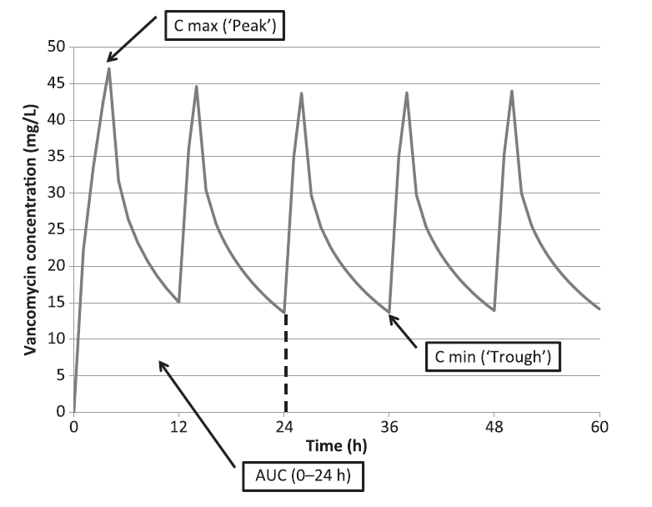
Vancomycin

Slide 26
Vancomycin Dosing: Complicated Infection AUC/MIC>400; C_{trough} 15-20
CR Cl ml/min | High-dose regimen | Projected AUC/MIC
175 | 1250 mg q6 | <671
135-174 | 1000 mg q6 | 539-670
100-134 | 750 q6 | 520-690
85-99 | 750 mg q8 | 622-603
65-94 | 500 mg q6 | 542-690
45-64 | 500 mg q8 | 524-721
30-44 | 500 mg q12 | 492-685
Brown D et al. Ther Drug Monit :2013; 35 (4); 443

Slide 27
Probability of AUC/MIC > 400
Pai et al. Adv Drug Delivery Reviews 2014; 77:50-57

Slide 28
Nephrotoxicity and AUC 0-24
Pai et al. Adv Drug Delivery Reviews 2014; 77:50-57

Slide 29
AUC/MIC and Critical Illness
Blot S et al. Critical Care 2014, 18: R99

Slide 30
Dosing in Critical Illness
Blot S et al. Critical Care 2014, 18: R99

Slide 31
Conclusions
New gram positive antimicrobial agents have dramatic differences in pK/pD parameters that change dosing intervals
Vancomycin dosing and levels remain poorly understood
Understanding pK/pD in critically ill patients alters loading dose and frequency is lipophilic antibiotics.

