Slide 1

Year in Review: Translational Research to Care About
April E. Mendoza MD, MPH
Division of Trauma, Emergency Surgery and Surgical Critical Care
Massachusetts General Hospital

Slide 2
Disclosures
None

Slide 3
Translational research
Hot topics
Practice changing
On the horizon

Slide 4
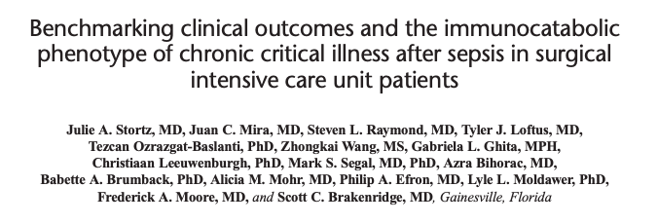

Persistent Inflammation, ImmunosuppressionCatabolism Syndrome

Slide 5

Who? How? Why?→ Surgical Chronic Critically Ill
Aim(s):
  Epidemiology of CCI
  Explain CCI
3 year prospective, observational cohort study
N= 145 patients
Chronic Critical Illness:
ICU LOS> 14 days
Evidence of persistent organ dysfunction
Notes:
The aim of the study was to describe the epidemiology of the chronic critical illness and provide a glimpse of the biologic processes that cause CCI.
This study was a 3 year prospsective observational cohort study involving 145 patients from a single institution.
They defined CCI as a surgical critically ill patient that requires over 14 days of an ICU stay with evidence of persistent organ dysfunction.

Slide 6
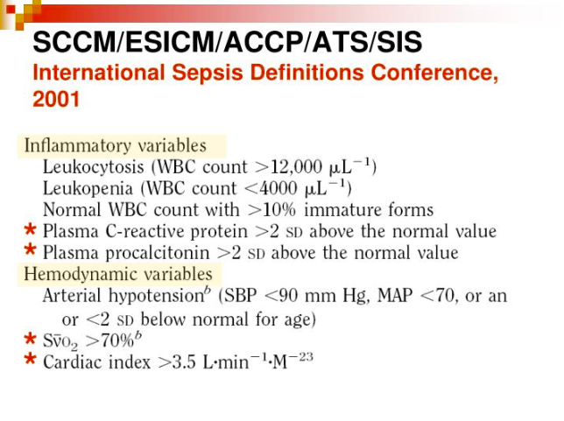
Over half of SICU →
Chronic Critically Ill
Inclusion criteria:
Adult SICU → sepsis, severe sepsis, or septic shock
  19/145 died
  71/126 (56%) →CCI

Slide 7
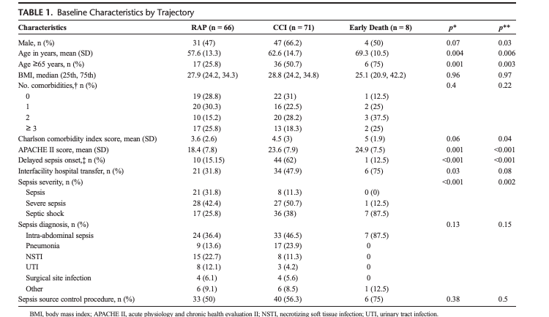
Study Groups Differed
*Gender
*Age
*Charlson Comorbidity Index
*APACHE II scores
*Interfacility transfers
*Sepsis Severity
Similarities
Number of co-morbidities
Sepsis source
Sepsis source control procedure
Notes:
So the study showed clear differences in study populations. Whereas those patients who rapidly improved included more women, were younger, had lower Charlson comorbidity index→( risk of death 1 year post hospitalization); were less likely to be an interfacilty transfer, and less severe sepsis.
There were important similarities which included similar BMI and co-morbidities as well as cause of sepsis and sepsis source control.

Slide 8
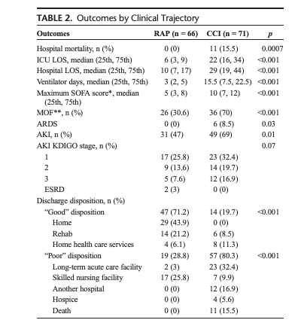
CCI risk factors and outcomes
Delayed-onset sepsis
Transfers
Vasopressor-dependent
Longer LOS (3x)
MOF
Poor discharge dispo
Notes:
Not surprisingly, the chronically critically ill were more likely to die when compared to those who rapidly improved, but THIS was a minority.
By their nature the CCI had manifesations of multiorgan dysfunction which included prolonged ventilator days, et cetera.
But here they demonstrate that CCI also were morel likely to have a poor dispositions.
Poor disposition included LTAC, SNFs, another hospital transfer!! –which was the second largest group (??), hospice and death.

Slide 9
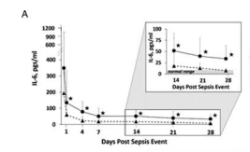
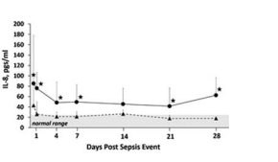
1 month post injury...
Pro-inflammatory (IL-6) markers → Elevated
Suppressive markers (IL-8, IL-10)→ Elevated
Notes:
Some of the interesting things the investigators found was up to a month into their illness inflammatory markers and suppressive markers remained elevated.
These included markers such as IL 6 an IL-8 and IL-10 which are potent anti-inflammatory cytokines important in angiogenesis and cytokine inhibition.

Slide 10
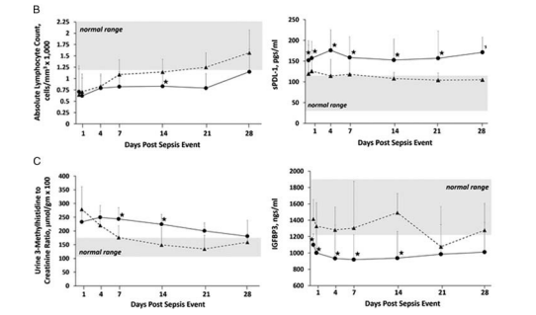
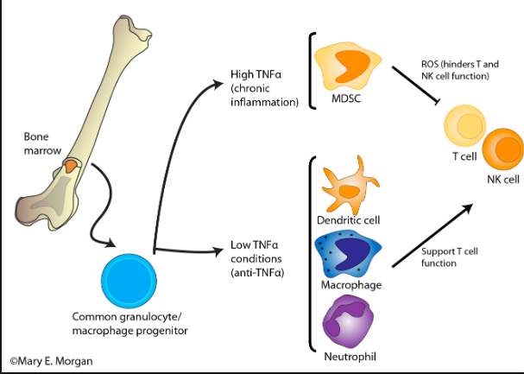
Immunosuppression
Lymphocyte counts →
Myeloid-derived suppressor cells?
Soluble programmed death-ligand 1:
  Oncology ->biomarker for suppression and worse survival
Nivolumab→ anti sPDL-1 ab for sepsis
Notes:
But there is overall immunosuppressive features with persistent decrease in absolute lymphocyte numbers out to 30 days with a corresponding increase in soluble programmed death-ligand 1.
These combination of findings are also found in the setting of elevated immature cell types of bone marrow origin that cause lymphocyte depletion and immunosuppression not unlike what has been described in oncology patients.
An oncololgy drug nivolumab is currently under study/ trial for septic ICU patients for this reason which happens to be a anti –sPDL-1 ligand

Slide 11
Urine-3-methyl histidine/creatinine & IGFBP-3
→ Skeletal Muscle breakdown
→Chronic Malnutrition
At 1 month: Catabolism
Persists after CCI
Notes:
Those who rapidly improve after sepsis achieve homestasis in regards to maintinaing skeletal muscle mass by the first week, but this remains a key feature up to a month for the CCI.
Insulin growth factor binding protein typically decreases in the setting of starvation and caloric deficits. Here the graph shows that at most time points IGFBP-3 is within the normal range for patients that rapidly recover.
Urine 3-methyl histidine to creatinine ratio and insulin growth binding protein-3: both confirm that there is a persistent, ongoing catabolic state→ remains the holy grail to treatment for these patients

Slide 12
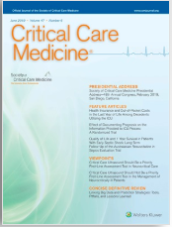
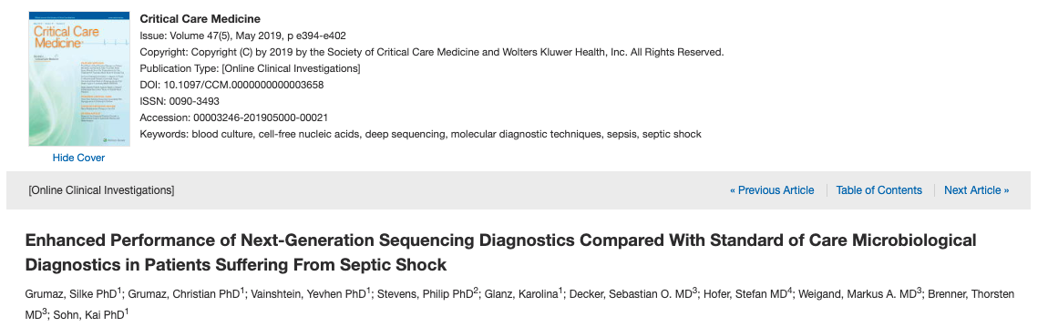
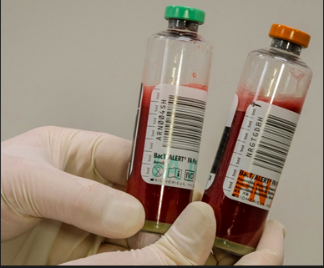
Aim: DNA sequencing (microbial circulating cell-free DNA) vs standard blood cultures
2 year prospective, observational cohort study
Notes:
Small cohort from a ongoing clinical trial

Slide 13
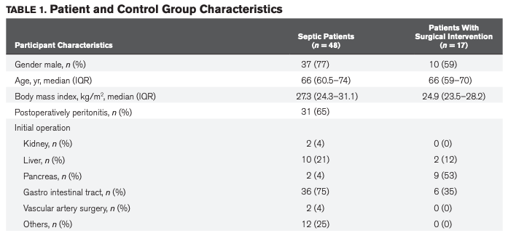
Septic patients and Post-Operative Controls: Similar Characteristics
48 patients (36 post-op)
  7 consecutive time points
17 elective surgery controls
  3 time points
Nucleic acid isolation
Blood cultures

Slide 14

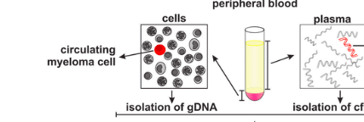
Hi-tech: Next Generation Sequencing & Bioinformatics
(2016) Microbial circulating cell-free DNA (cfDNA) →diagnose causative pathogens
cfDNA in septic patients
Bioinformatics: Sepsis indicating quantifier
(SIQ)→discriminate noise from contaminants
Notes:
This study combines two unique technologies: next generation sequencing and Bioinformatics. I am not going to go into terrific detail about the technology but I’ll say this:
Next gen sequencing uses fragments of free DNA as opposed to DNA extracted from whole cells. This tech is currently used in cancer research and as a diagnostic tool for screening for some liquid cancers.
A prior proof of concept study published in 2016 deomonstrated that this technology could be used to identify pathogens in septic patients when compared to postop and healthy controls. The prior study established a concept called a sepsis indicating quantifier which they call SIQ.
Think of this concept in distinguinshing normal flora that should be present from an increased presence of bacteria that wouldn’t be expected that correspond with infection or pathogenicity.

Slide 15


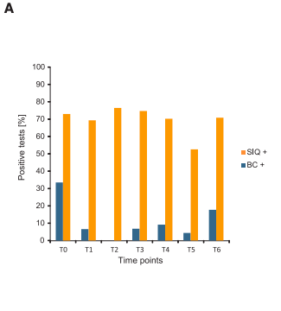
NGS has more positive results than BC
Notes:
IN general it is known that blood cultures aren’t very sensitive or specific and in general have a low positivity rate at around 10-30%.
This study is no different with similar positivity rate. Of septic patients → 30% had positive blood cutures whlle around 70% have positive Next Gen studies at multiple time points
Of the entire study period 11% of patients had positive blood cultures compared to 70% of septic patients had positive SIQ data
The authors postulate here that NGS may be helpful in detecting the effectiveness of therapy.

Slide 16
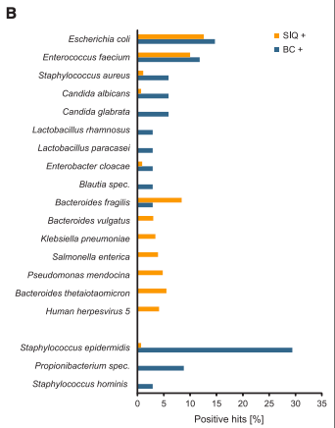
High concordance in GNR bacteremia
Blood cultures → CoN staph
  Contaminants
  Weakness in SIQ?
SIQ: probability that organism is pathogenic when compared to noninfected control
Notes:
IN general there was a high concordance of the NGS and Blood cx in detecting GNR bacteremia.
However, blood cx were more likely to grow likely contaminans like CoN staph. However, one could argue that possibly some legit CoN bacteremia was missed because of the weakness of the SIQ algorithm since this is based on controlling for organisms found in healthy subjects.
Interestingly, NGS did appear to identify for more enteric GPC and GNR than blood cultures. (more abdominal sepsis patients!)

Slide 17
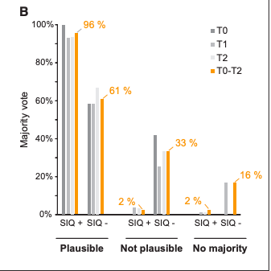
Expert Panel Reviewing Lab Data and Clinical Course
96% NGS → Plausible when positive
61% NGS→ Plausible when negative
Notes:
A panel of 8 clinicians who were not involved in the study but were experts in critical care, and clinical microbiology.
They were explained the concept of the SIQ and allowed to review the clinical course and NGS, and culture data. They were then asked to give their professional opinion on the plausibility of the NGS results at individual time points and the overall plausility
If someone cares: These times points were chosen because blood culture data tended to be more positive early in the course of sepsis.

Slide 18
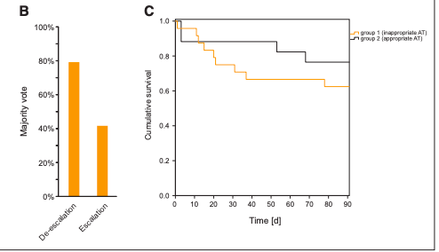
Would affect clinical decision-making
  80% would de-escalate
  Retrospectively → 2 groups emerged
Group 1: Wrong abx therapy→ Higher mortality
Group 2: Correct abx therapy → IMPROVED mortality
Notes:
Patients were retrospectively → two groups when the resuts of the NGS were taken into account. Those who received the ideal abx regimen and those who did not based on the results of the NGS.
The first group despite longer abx duration had higher mortality and higher RRT requirements.
The second group deemed w/ appropriate abx after reviewing the results of the NGS → improved mortality and shorter duration of abx

Slide 19
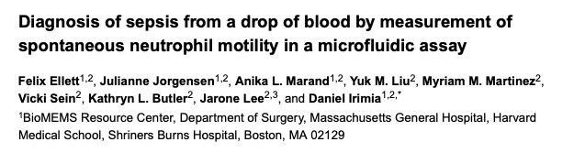

Drop of Blood Diagnostics???

Slide 20
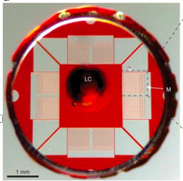
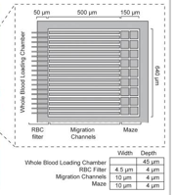
Detect Sepsis by Neutrophil Behavior
Testing a microfluidic device with channels and mazes
1 µL (!) diluted whole blood

Slide 21
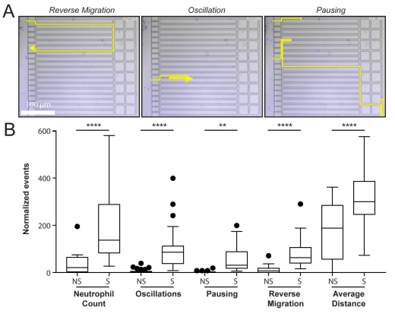

Defining the Sepsis Score
Pausing
Reverse Migration
Average Distance
Number of neutrophils

Slide 22
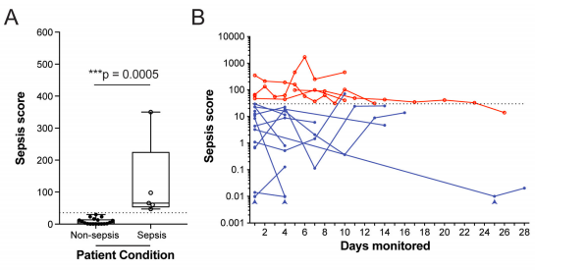
Derivation cohort
23 Trauma and Surgical ICU patients
  Septic and non-septic patients
  Machine learning : Parameters for Sepsis Score derivation
  AUC→ 0.98 discriminating sepsis
  96.8% sensitivity
  97.6% specificity
Notes:
Day 1 and every 3 days after. At day 1→ scores >30 were consistent with septic patients (research blinded)

Slide 23
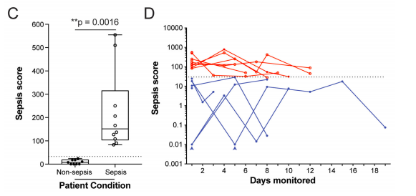
Validation cohort
19 Cardiac, Medical, and Surgical ICU patients
  Double-blinded case-control
  10 Sepsis
  9 Non-sepsis
96.3% sensitivity
100% specificity
Notes:
Day 1 and every 3 days after. At day 1→ scores >30 were consistent with septic patients (research blinded)

Slide 24
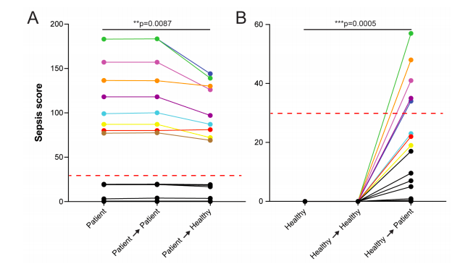
Plasma Drives Neutrophil Behavior
Septic Neutrophils once activated
→ Activated regardless
Healthy neutrophils
→ Activated in septic plasma

Slide 25
Summary
Chronically critical ill patients have a phenotype
→ Mitigating lymphocyte depletion and nutrition optimization remain challenges
Application of Next-Generation Sequencing → Guiding antimicrobial therapy ?
Microfluidic devices→ Diagnostic with minimal blood and quick turn around time?

Slide 26

Notes:
Muchas gracias por su atencion
Yo voy a intentar a responder a sus preguntas.

Slide 27
References
Stortz JA, Mira JC, Raymond SL, et al. Benchmarking clinical outcomes and the immnocatabolic phenotype of chronic critical illness after sepsis in surgical intensive care unit patients. J Trauma Acute Care Surg 84;2: 342-349 (2018).
Grumaz S, Grumaz C, Vainshtein Y, Stevens P, et al. Enhanced Performance of next-generation sequencing diagnostics compared with standard of care microbiological diagnostics in patients suffering from septic shock. Crit Care Med 47;5: e394-e402 (2019)
Ellett F, Jorgensen J, Marand AL, et al. Diagnosis of sepsis from a drop of blood by measurement of spontaneous neutrophil motility in a microfluidic assay. Nat Biomed Eng. 2(4):207-214 (2018)

