Slide 1


Surgery is the best treatment for acute cholecystitis
Soumitra R. Eachempati, MD, FACS, FCCM
Professor of Surgery
Professor of Medicine, Division of Medical Ethics
Division of Critical Care &
Trauma Surgery
Weill Cornell Medical College
Notes:
1

Slide 2
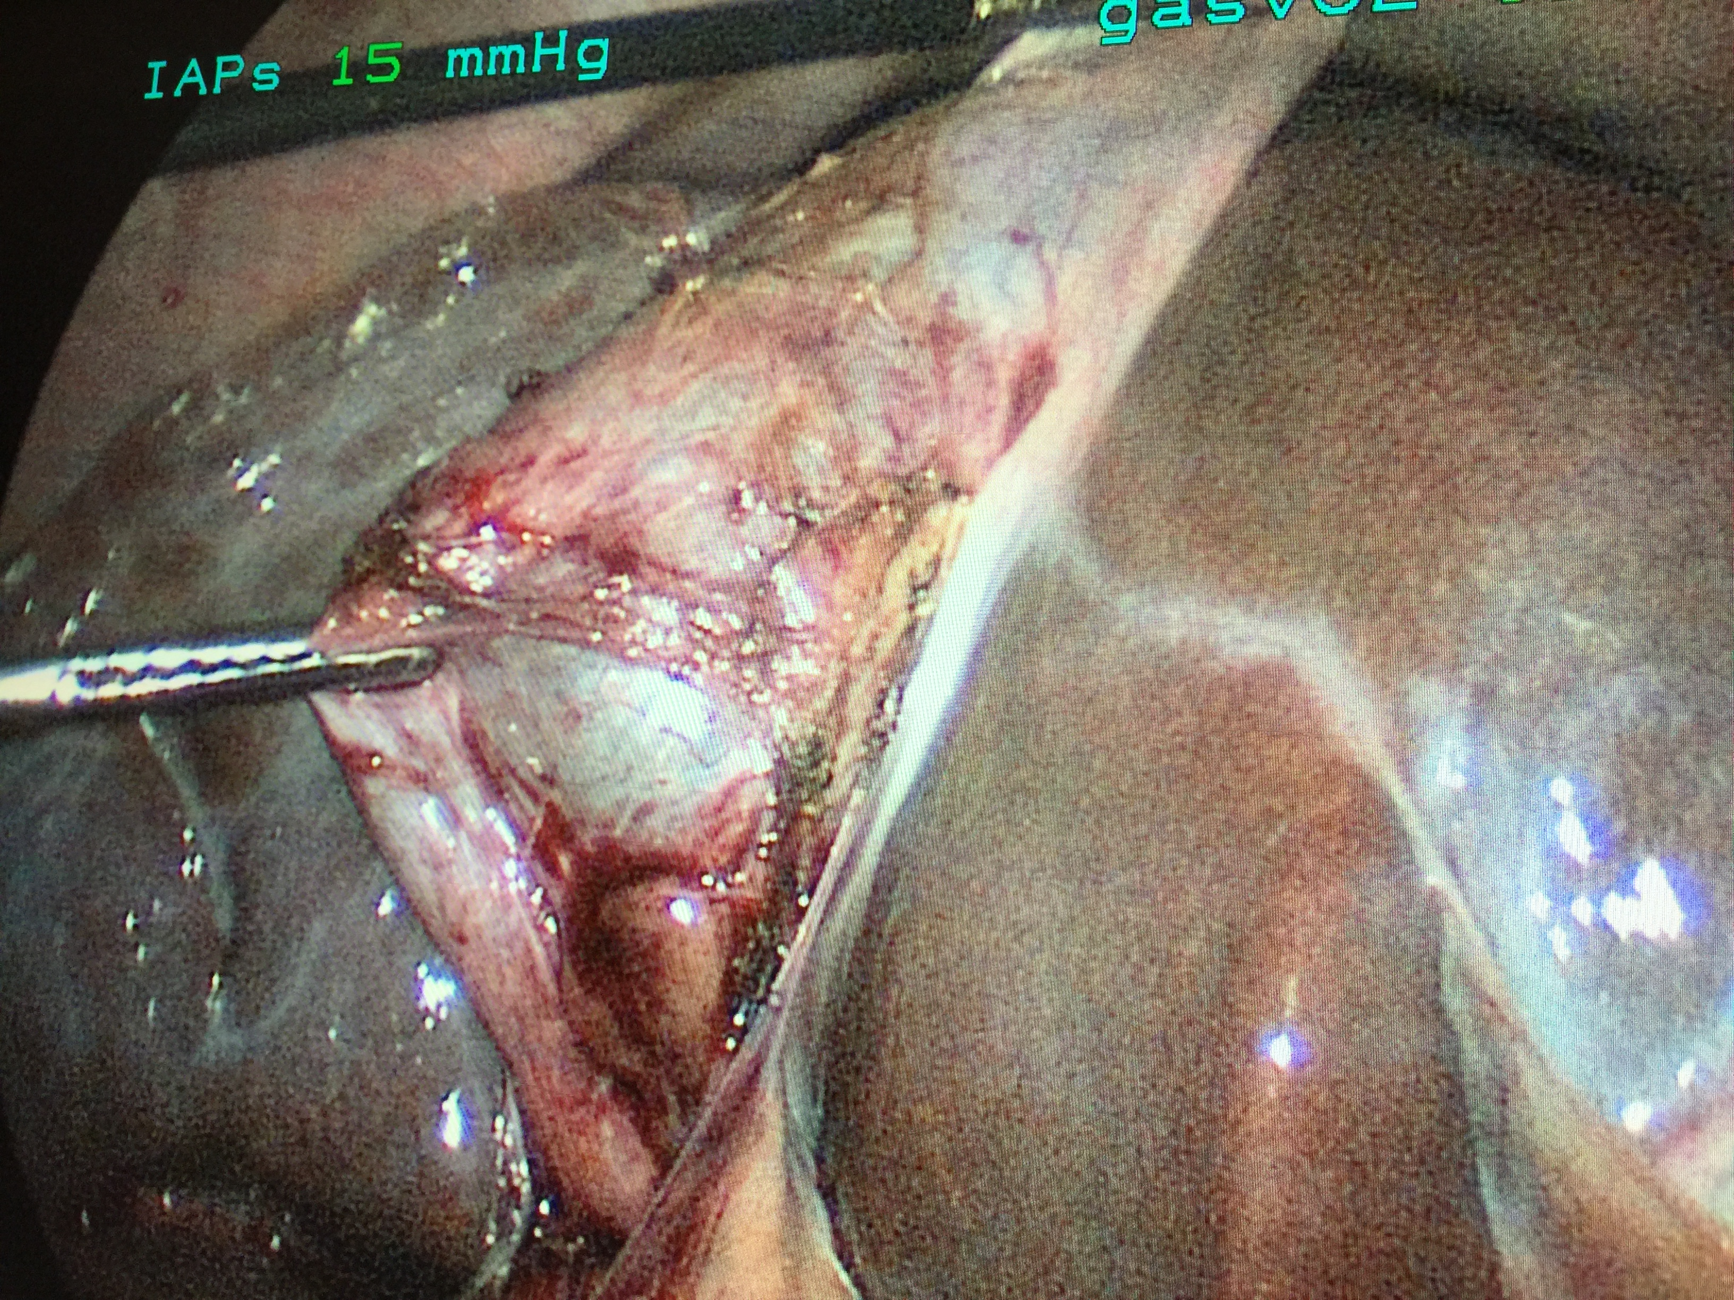

Slide 3
Treatment of cholecystitis
Standard biliary colic requires cholecystectomy in the majority of good-risk patients within a reasonable time frame
Controversy surrounds delaying surgery in others who may potentially have medical conditions that can be optimized in meantime
In complicated cases, options include same admission cholecystectomy or percutaneous drainage with or without delayed cholecystectomy

Slide 4
“Complicated acute cholecystitis”
Prolonged symptoms in duration or chronicity of attacks causing wall thickening and other denaturation of standard anatomy
Abscess
Gangrenous cholecystitis
Gallstone pancreatitis
Choledocholithiasis
High-risk patient

Slide 5
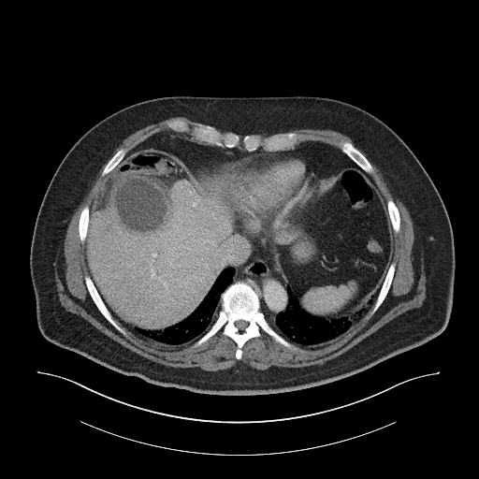

Slide 6
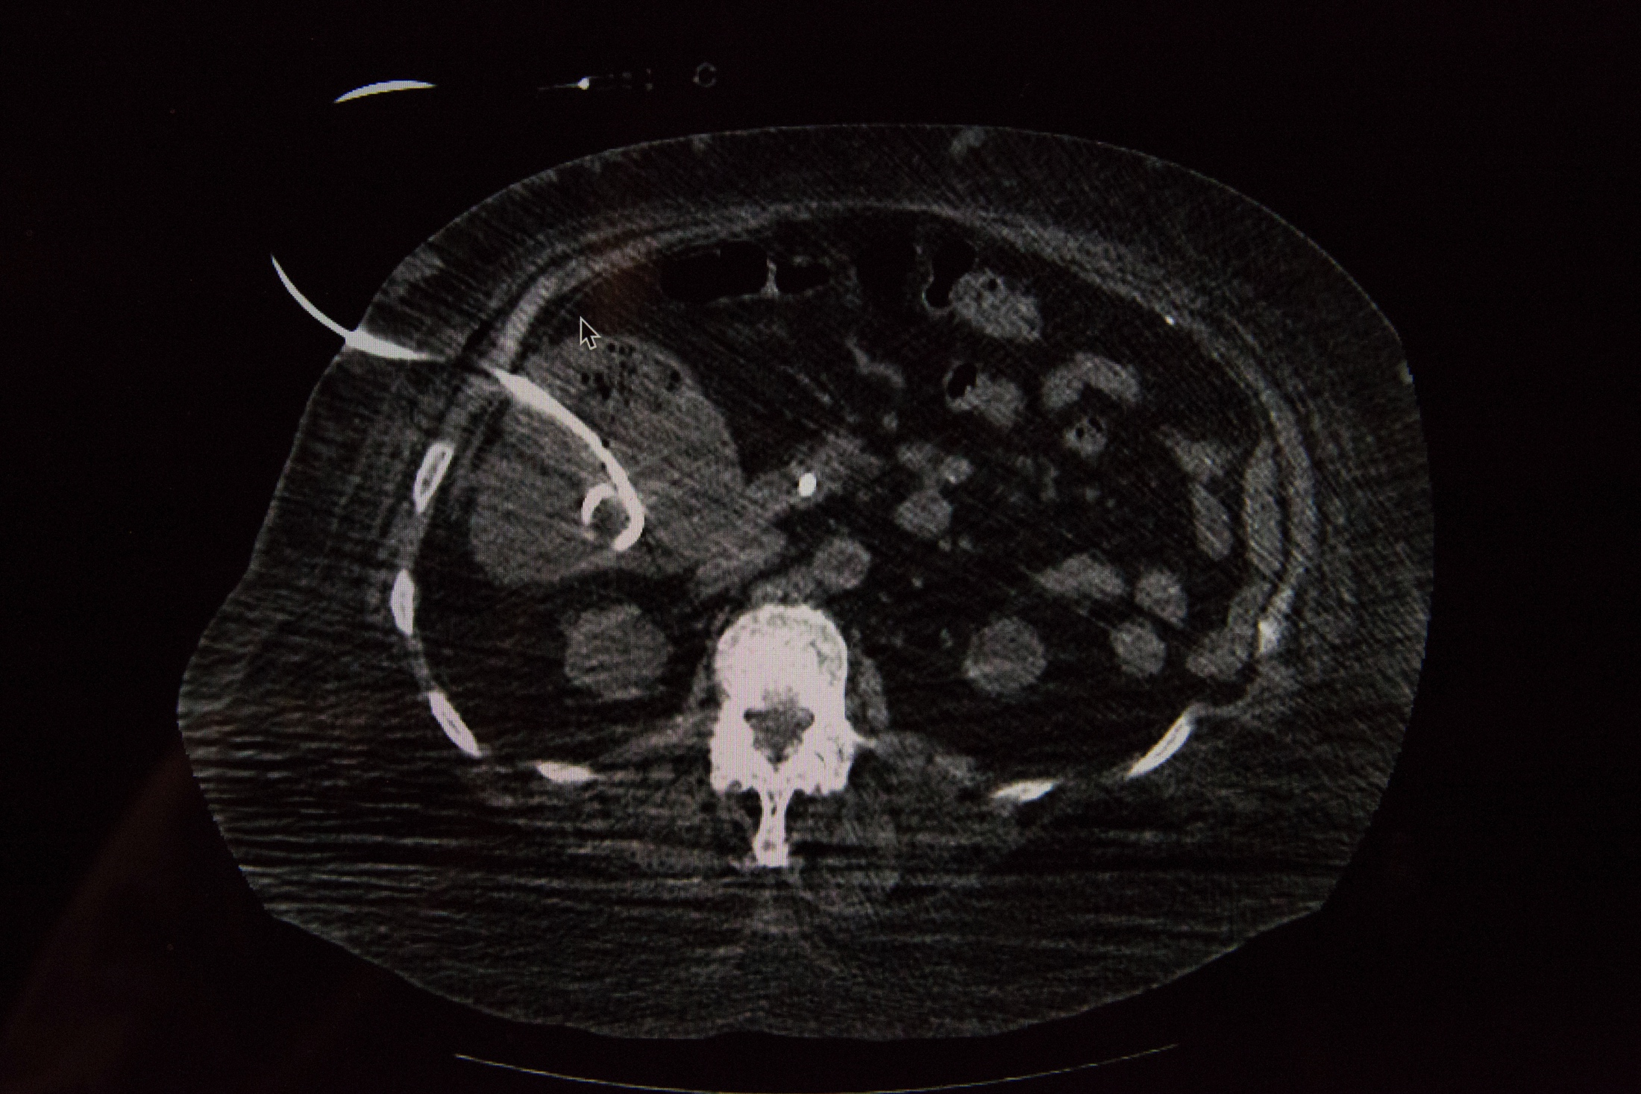

Slide 7
What happens to patients discharged with cholecystitis?

Slide 8
Medicare population study
29,818 Medicare patients admitted for acute cholecystitis from 1996 to 2005
Mean age was 77.7
Twenty-five percent of patients did not undergo cholecystectomy during the index admission.
Lack of definitive therapy was associated with a 27% subsequent cholecystectomy rate and a 38% gallstone-related readmission rate in the 2 years after discharge;
No cholecystectomy on initial hospitalization was associated with worse 2-year survival even after controlling for patient demographics and comorbidities
Readmissions led to an additional $7,000 in Medicare payments per readmission
Riall TS et al. J Am Coll Surg. 2010 May; 210(5):668-77

Slide 9
Toronto population study
Of 27,718 patients with acute cholecystitis, 890 (3.3%) underwent PC.
PC cohort had mean age of 75 years
14% were in the intensive care unit on the day of PC
In-hospital mortality 5%
Within 1 year after PC, only 40% had undergone cholecystectomy, while an additional 18% had died without cholecystectomy
The risk of a gallstone-related ED visit or hospital admission was 49% by 1 year after discharge
C de Mestral, D Gomez, B Haas, B Zagorski, O Rotstein, A Nathens. J Trauma 2013

Slide 10
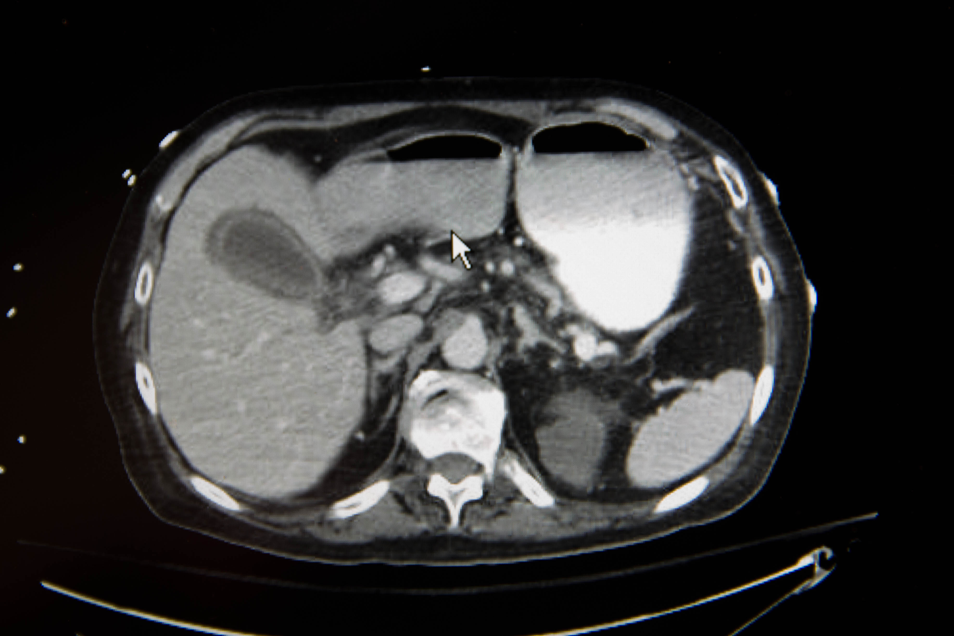

Slide 11
Source control
Defined as eliminating infection, controlling ongoing contamination, restoring function
Inadequate abscess drainage, residual necrotic tissue, and foreign bodies leave propensity for further infections
Debridement allows wound healing and bacterial identification
Schein and Marshall World J Surg 2004: 638-645

Slide 12
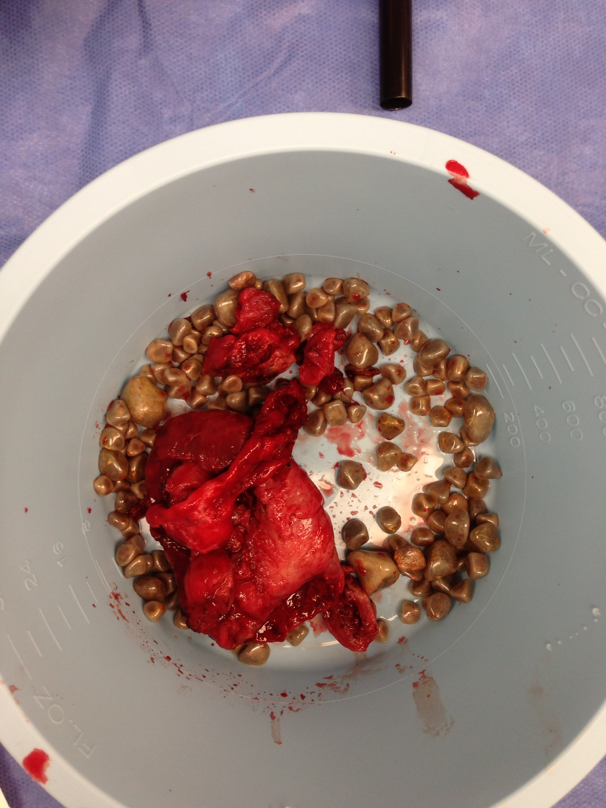

Slide 13
In which patients is cholecystectomy not safe?
Neutropenia
Sepsis
COPD
CHF
LVAD
Coagulopathy
ECMO
Cirrhosis
“Too sick”

Slide 14
In which patients is cholecystectomy not safe?
Neutropenia
Sepsis
COPD
CHF
LVAD
Coagulopathy
ECMO
Cirrhosis
“Too sick”

Slide 15
In which patients is cholecystectomy not safe?
Neutropenia
Sepsis
COPD
CHF
LVAD
Coagulopathy
ECMO
Cirrhosis
“Too sick”

Slide 16
In which patients is cholecystectomy not safe?
Neutropenia
Sepsis
COPD
CHF
LVAD
Coagulopathy
ECMO
Cirrhosis
“Too sick”

Slide 17
In which patients is cholecystectomy not safe?
Neutropenia
Sepsis
COPD
CHF
LVAD
Coagulopathy
ECMO
Cirrhosis
“Too sick”

Slide 18
Can octagenarians undergo cholecystectomy?
Control outpatients compared to emergently admitted patients
30% ASA 3 or more
No differences in conversions, ICU admission, LOS
No mortalities in either groups
Complication rates comparable (16% overall)
Marcari et al. JSLS 2013

Slide 19
Problems with Percutaneous drainage
Discomfort
Recurrence (cholecystitis, gallstone pancreatitis)
Tube complications (dislodgment, clotting)
Bleeding from transhepatic access
Infection of ascites
Pain from no stone removal
No pathology specimen
Lack of source control

Slide 20
Damage control surgery for gallbladder
“Partial” or “Subtotal”
“Abbreviated” cholecystectomy
Open or laparoscopic approaches
Majority of gallbladder removed
Gallbladder drained
Stones removed
ERCP can occur later if needed
Source control much more efficacious

Slide 21
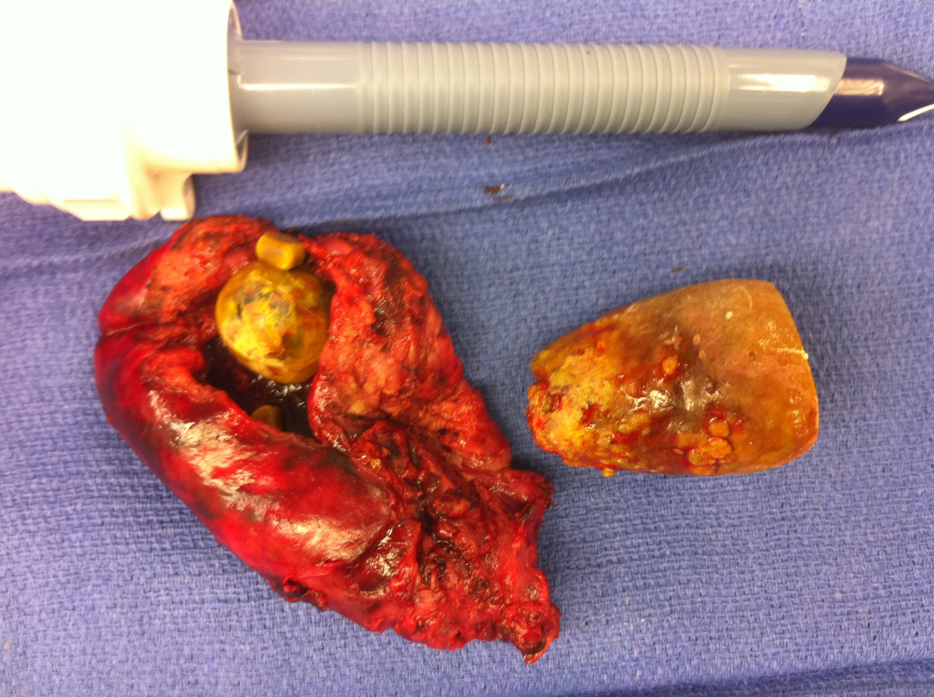

Slide 22
Conclusions
Cholecystectomy is more feasible than is highly regarded in critically ill patients
Difficult gallbladders do not necessarily become easier with delay
Source control, patient comfort, prevention of ED visits, and decreased costs mandate early cholecystectomy in acute cholecystitis

