Slide 1

Surgical Infection Society
Year in Review – Papers That Might Someday Change Your Practice:
Basic Science
Surgical Infection Society
Year in Review – Papers That Should Change Your Practice:
Elliot C. Williams MD
Department of Surgery
UC San Diego Health Sciences

Slide 2
Disclosures:
The speaker has no conflicts of interest to declare.

Slide 3
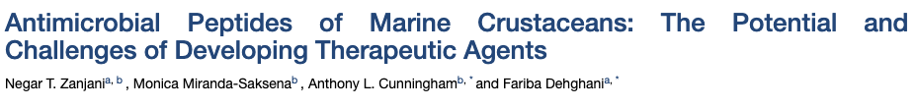
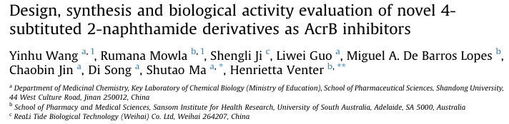
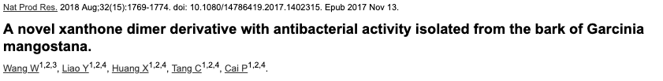
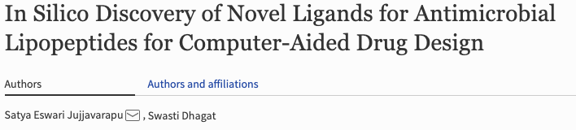
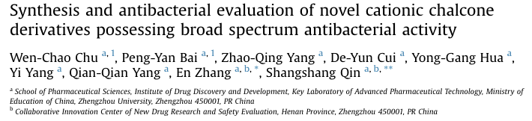
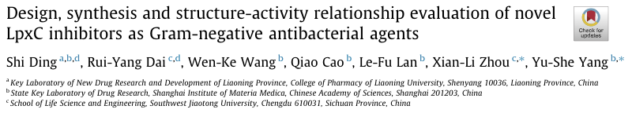
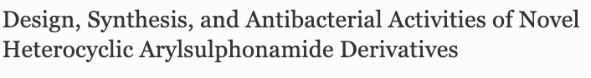

Slide 4
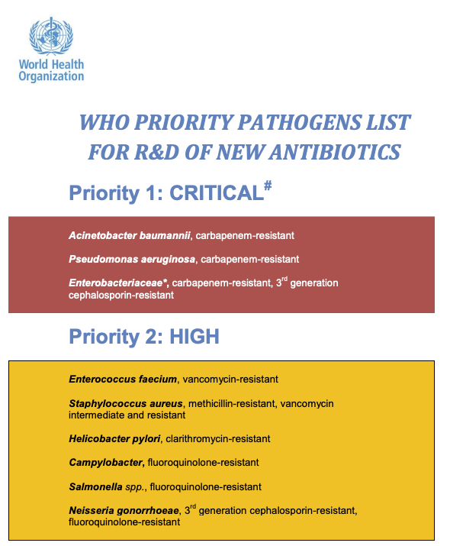
While novel compounds are important, better understanding of the mechanisms by which these pathogens continue to thwart our efforts to treat them is likely to result in greater changes in practice
https://www.who.int/medicines/publications/global-priority-list-antibiotic-resistant-bacteria/en/ Accessed 5.29.19

Slide 5

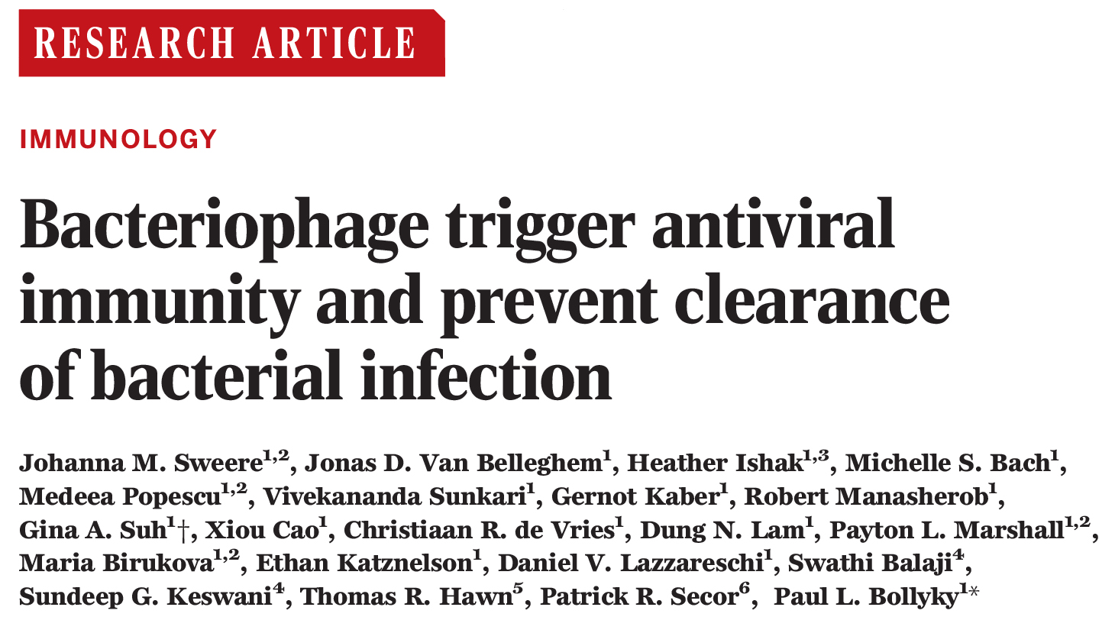
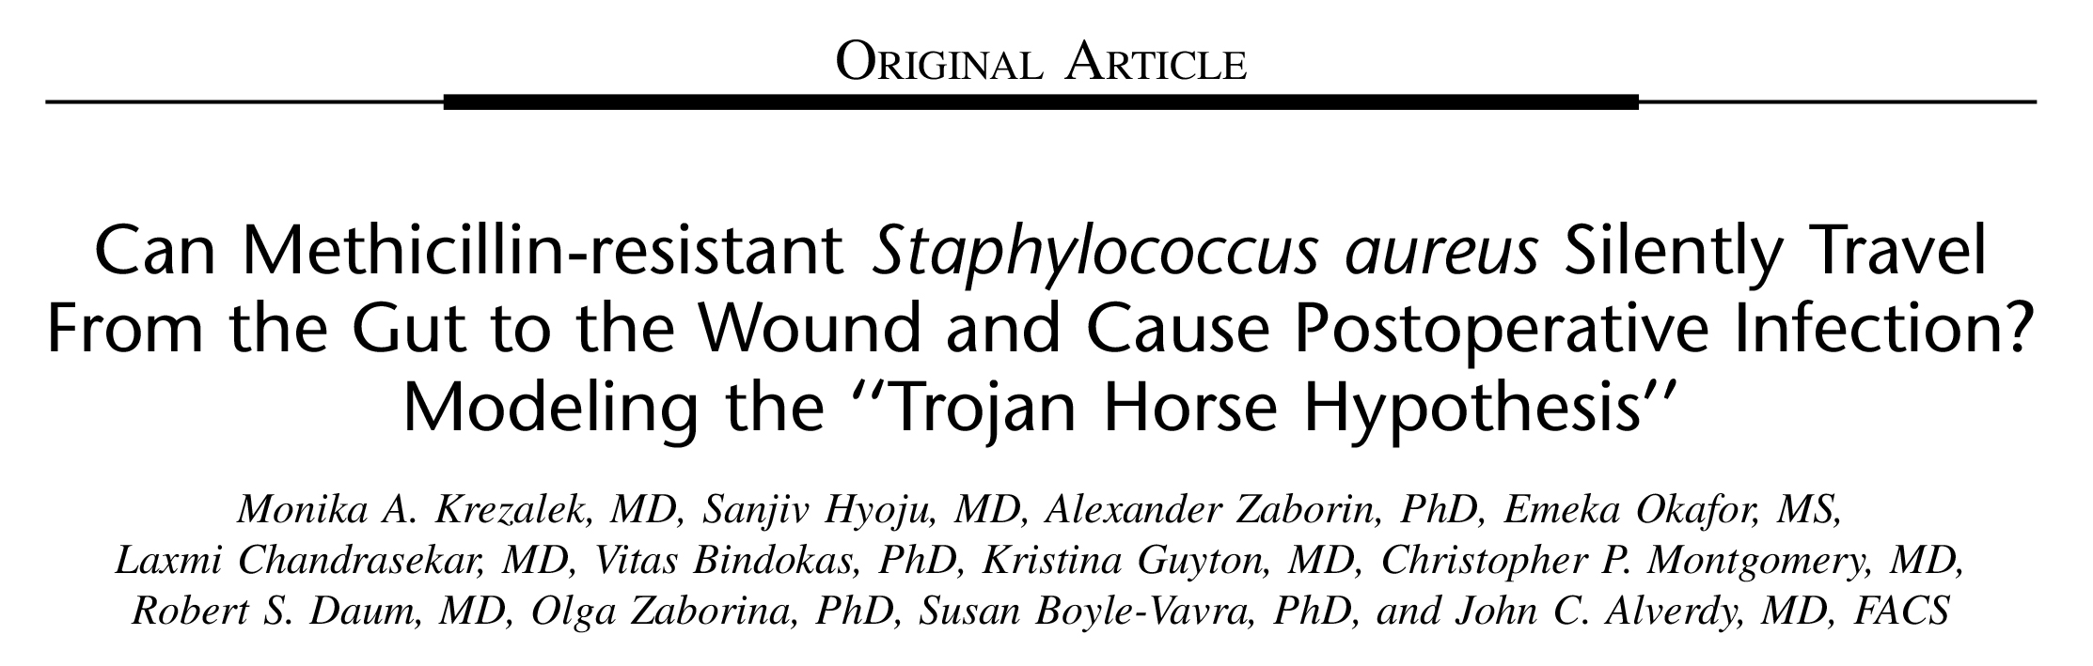
Science Volume 363(6434): March 29, 2019
Annals of Surgery. 267(4):749–758, APR 2018

Slide 6
Annals of Surgery. 267(4):749–758, APR 2018

Slide 7
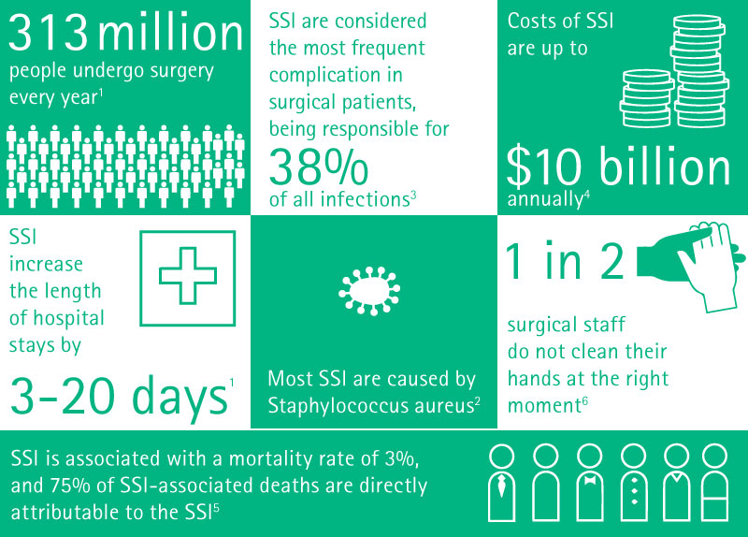
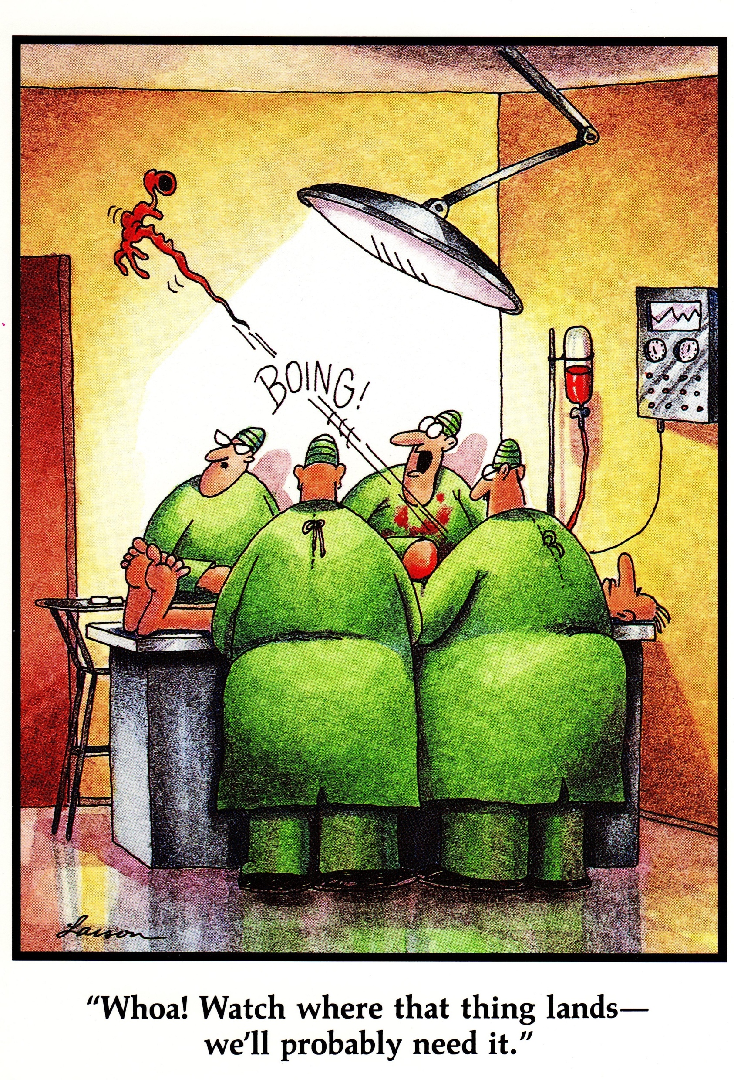
Background:
https://www.bbraunforsafety.com/en/surgical-site-infections.html#scientific-evidence. Accessed 5/29/19
Copyright Gary Larson

Slide 8
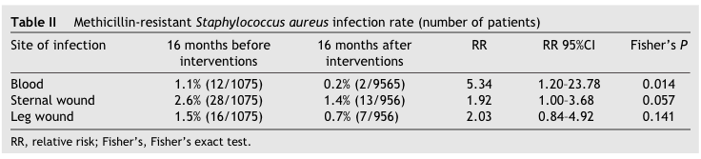
Reducing Superficial MRSA Colonization Isn’t Enough
All pre-operative patients screened prior to CT surgery
5 day course of:mupirocin 2% nasal ointment applied to each nostril three times daily [or, if the MRSA was known to be mupirocin resistant, chlorhexidine/neomycin (Naseptin) cream]
chlorhexidine gluconate (Hibiscrub) baths
hairwashing with chlorhex-idine gluconate shampoo (4%);
0.33% hexachlorophane dusting powder (Ster-Zac) applied to the axillae and perineum after bathing
Schelenz et al. J Hosp Infect. 2005 Jun;60(2):104-10

Slide 9
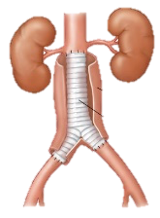





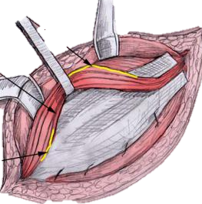
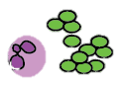
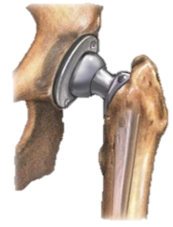
Background:
The Trojan Horse Hypothesis of MRSA Surgical Site Infection
Neutrophil carrying
dormant MRSA
MRSA colonization
Surgical site infection
Intestinal epithelium
Physiological stress
Anim
Animation courtesy of Dr. Krezalak

Slide 10
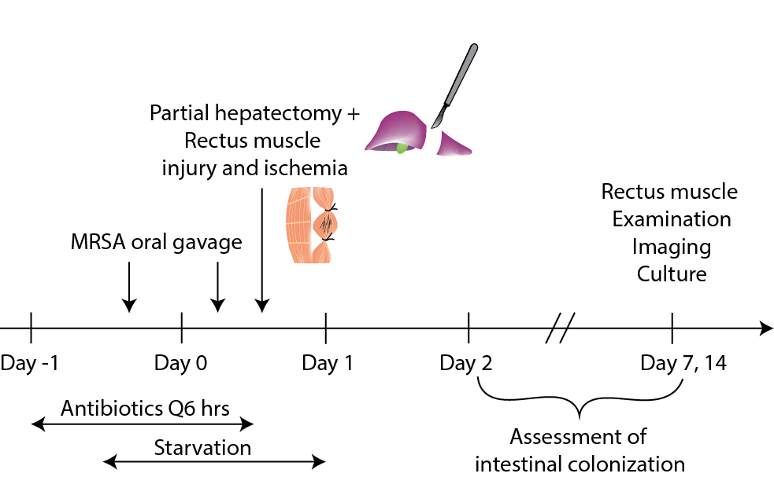
Methods
Mouse model of major surgery and tissue damage
Simulated “pre-op” period of antibiotics and NPO period
Bioluminescent MRSA oral gavage to colonize intestine
Virulence tested using Galleria mellonella killing assay
(Wounds swabbed for culture prior to closure)

Slide 11
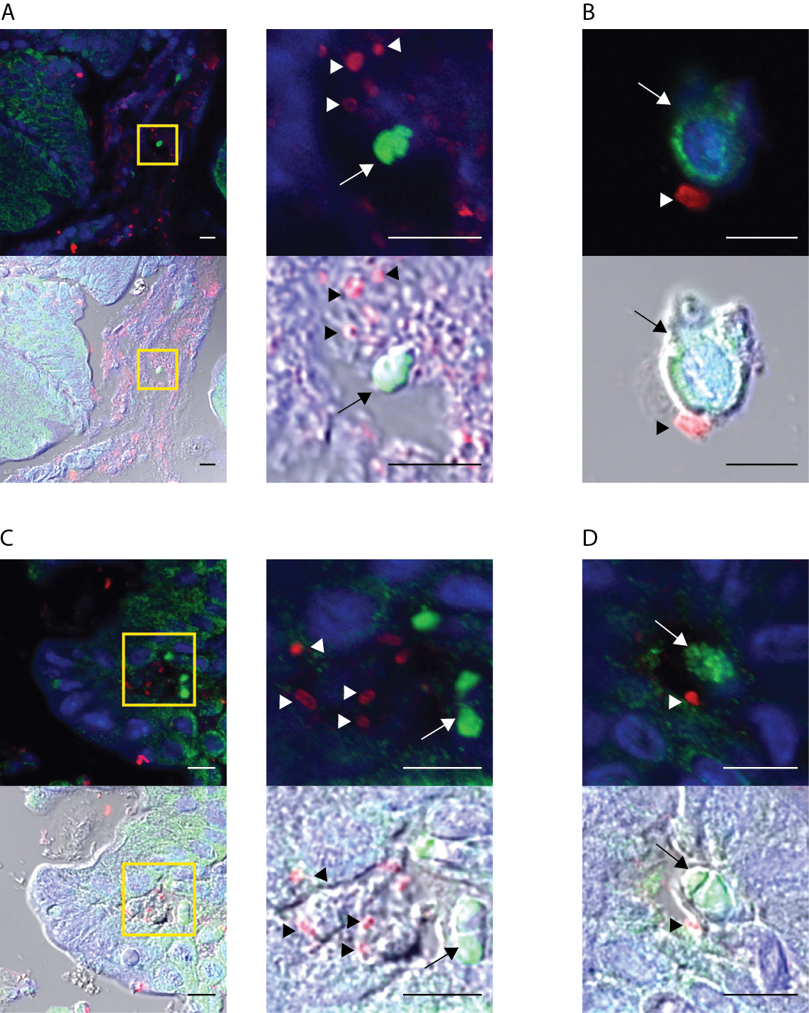
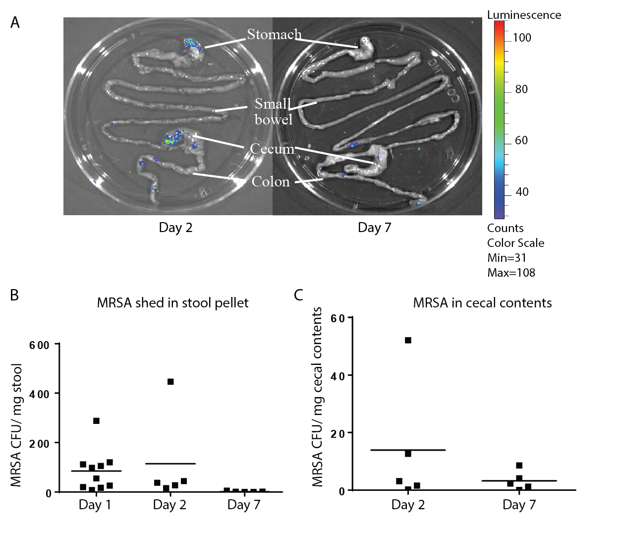
MRSA Successfully Colonizes the Mouse Intestine And Contacts Neutrophils
IHC Showing Neutrophils in Cecal Lumen
Bioluminescent MRSA Imaging Of Whole Intestine
IHC Showing MRSA Within Epithelium
S. Aureus = red / arrow heads
Neutrophils = green / arrows
Notes:
The model was able to show intestinal colonization with MRSA that remained on POD2 and to a lesser extent on POD7 as seen on the right via luminescence imaging. Via IHC they were also able to find MRSA and neutrophils in close contact in the intestine. They saw both Neutrophils that had entered the cecal lumen, and MRSA that had invaded the intestinal epithelium

Slide 12
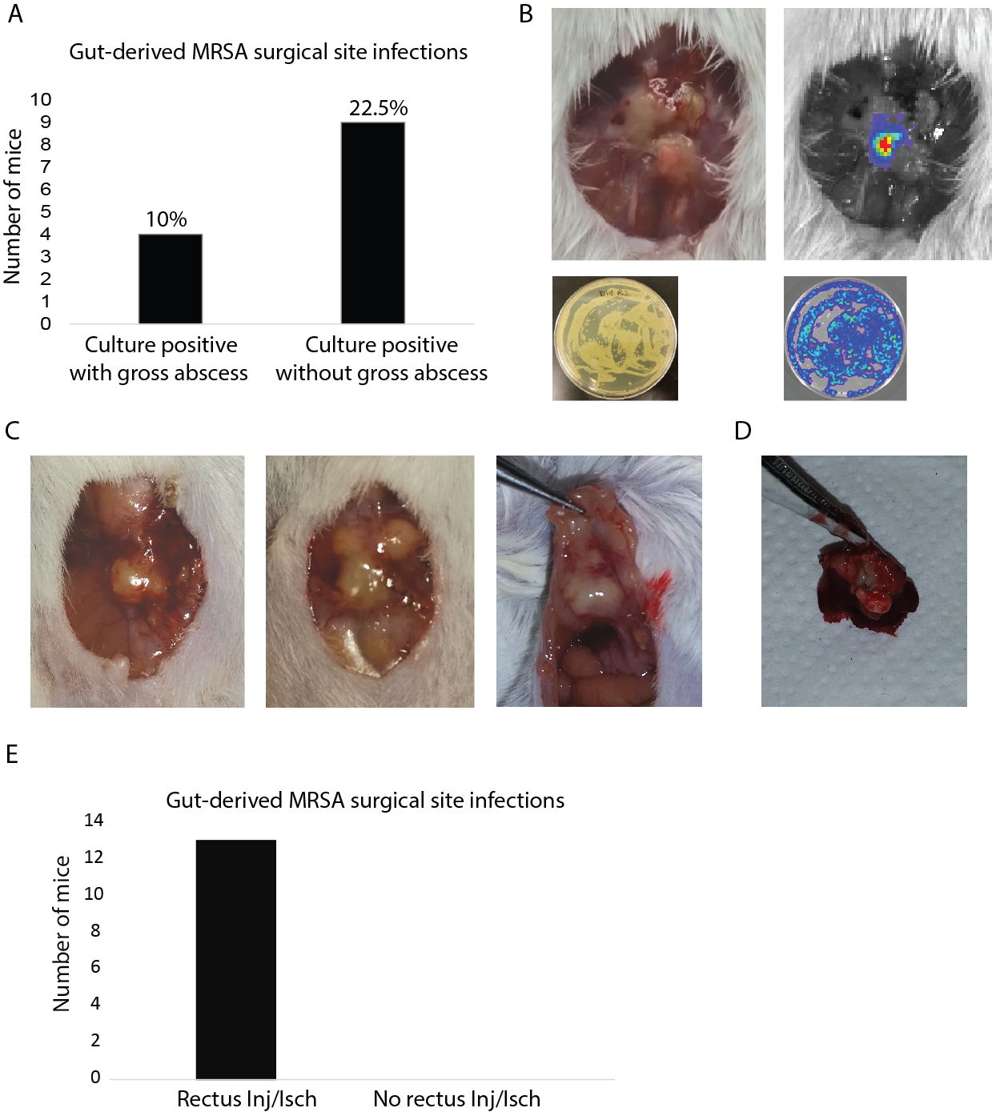
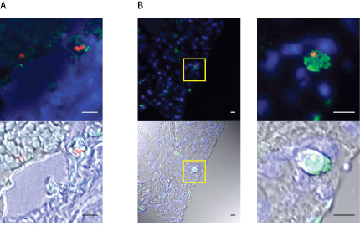
Intestinal MRSA Can Metastasize to Distant Sites
32.5% of those intestinally colonized developed MRSA positive cultures at the incision site
Cultures of blood, liver, and spleen from colonized mice (POD7) were all negative
Mice subjected to rectus injury/ischemia w/o hepatectomy or MRSA gavage but with IV MRSA injection did not develop positive wound cultures, but did have intact MRSA in circulating neutrophils
Direct application of MRSA to the wound on POD1 also did not result in SSI
MRSA (red) in rectus muscle and within neutrophil (green)

Slide 13
MRSA within the intestinal lumen is taken up by neutrophils
MRSA within neutrophils acquires a dormant phenotype
Neutrophils traffic to a site of injury/inflammation and release infectious payload
MRSA within the area of injury re-acquires a virulent phenotype, resulting in infection
Conclusions:
Indirect evidence supplied for many of these points
This early work is limited by a lack of rigorous controls

Slide 14
Significance
While substantial further work would be needed to prove and mechanistically explain this process, it describes a new mechanism by which “sterile” sites and wounds can become infected, and would further establish the importance of the gut microbiome in relation to human health and disease

Slide 15
Science Volume 363(6434): March 29, 2019

Slide 16
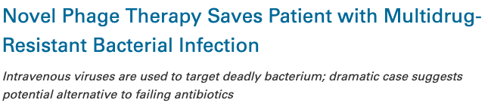
But I Thought Phages Were Our Friends?

Slide 17
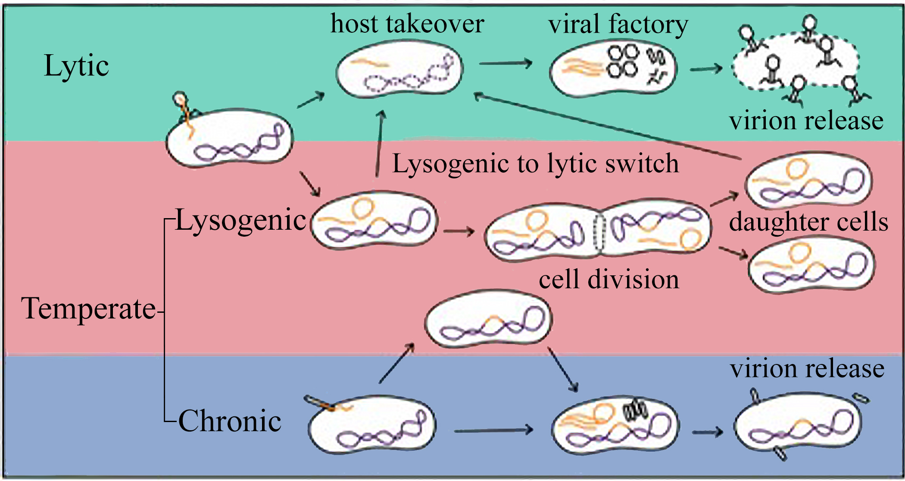
Background
Howard-Varona et al. ISME J. 2017;11(7):1511–1520.

Slide 18
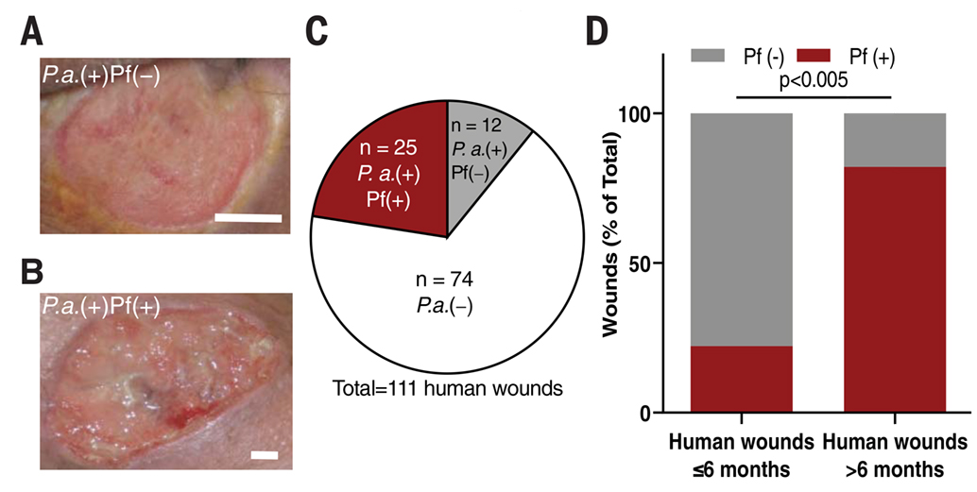
Pf Phages Are Common in Chronic Human Pseudomonas Infections
Sweere et al. Science 363(6434): 2019

Slide 19
Hypothesis
Pf temperate bacteriophages produced by Pseudomonas aeruginosa (Pa) promote Pseudomonal infections through direct effects on the mammalian immune system.

Slide 20
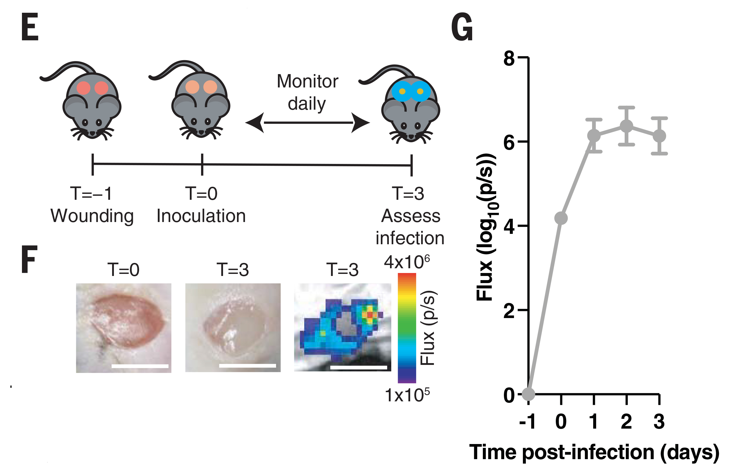
Methods
Mouse model of full-thickness excisional wounds
24 hours after wound inoculated with either Pf+ (PA01) or Pf- (PAO1ΔPf4) luminescent Pa
Analyzed luminescence, histology
Numerous ex vivo or in vitro additional experiments
Sweere et al. Science 363(6434): 2019

Slide 21
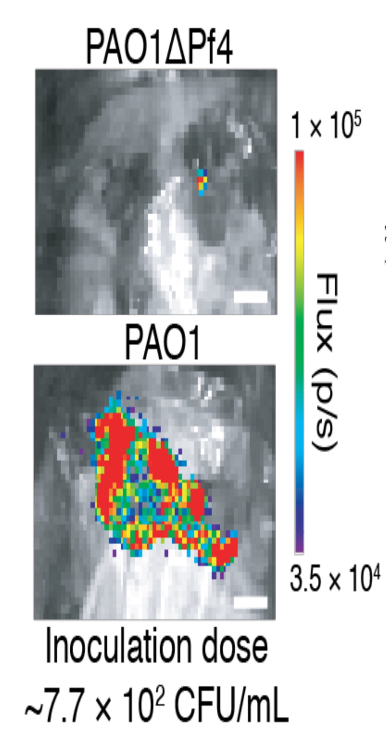
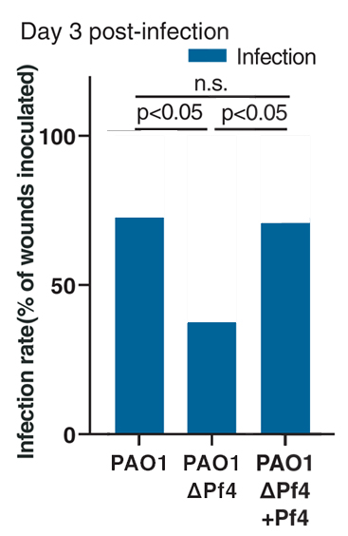
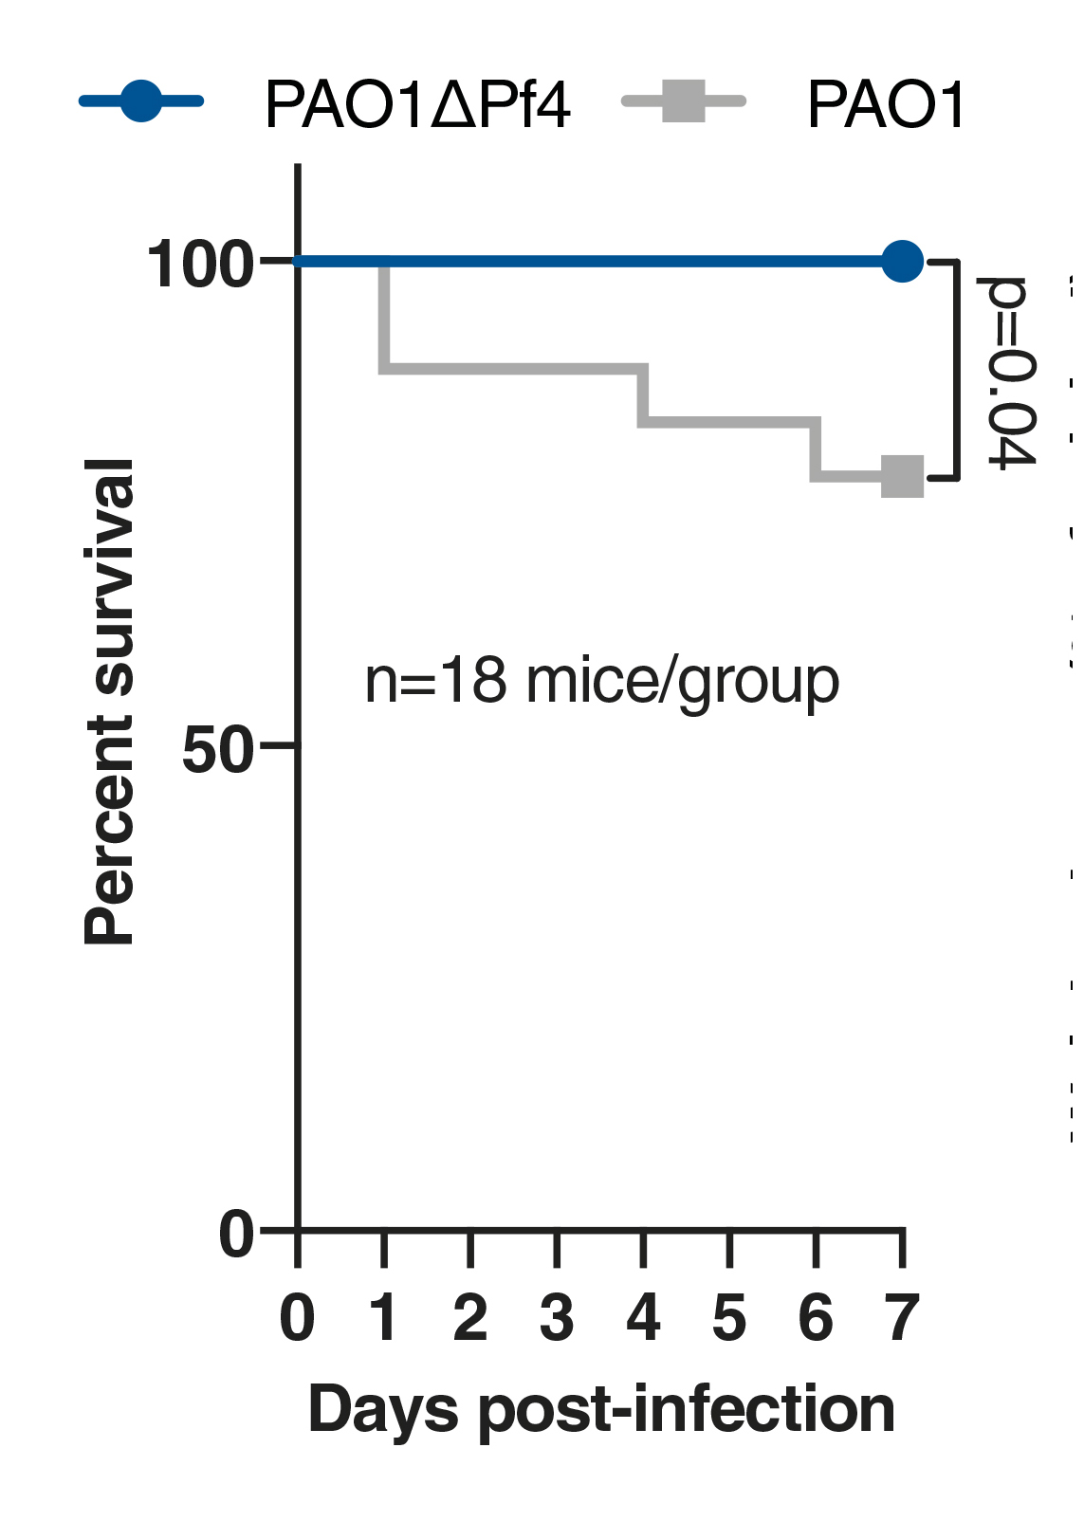
Pf phages increase infectivity and lethality of Pa
(Inoculation dose 10⁷ CFU/mL)
Sweere et al. Science 363(6434): 2019

Slide 22
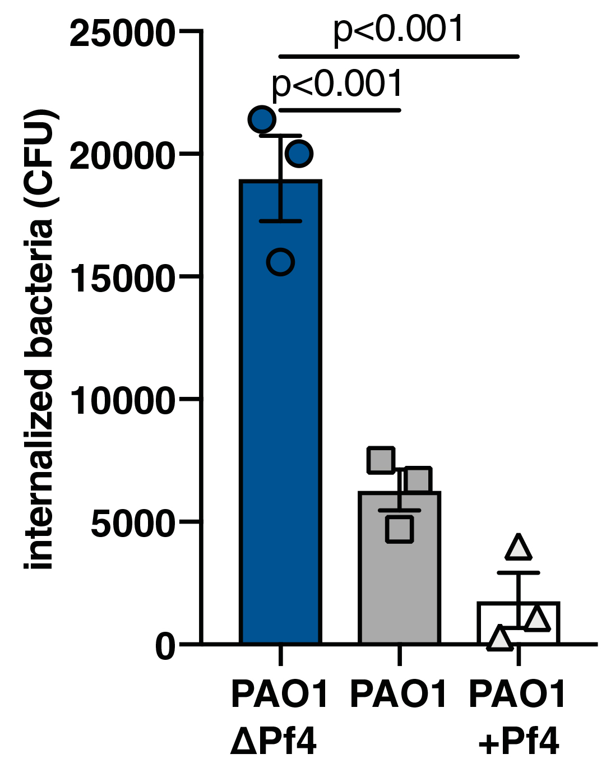
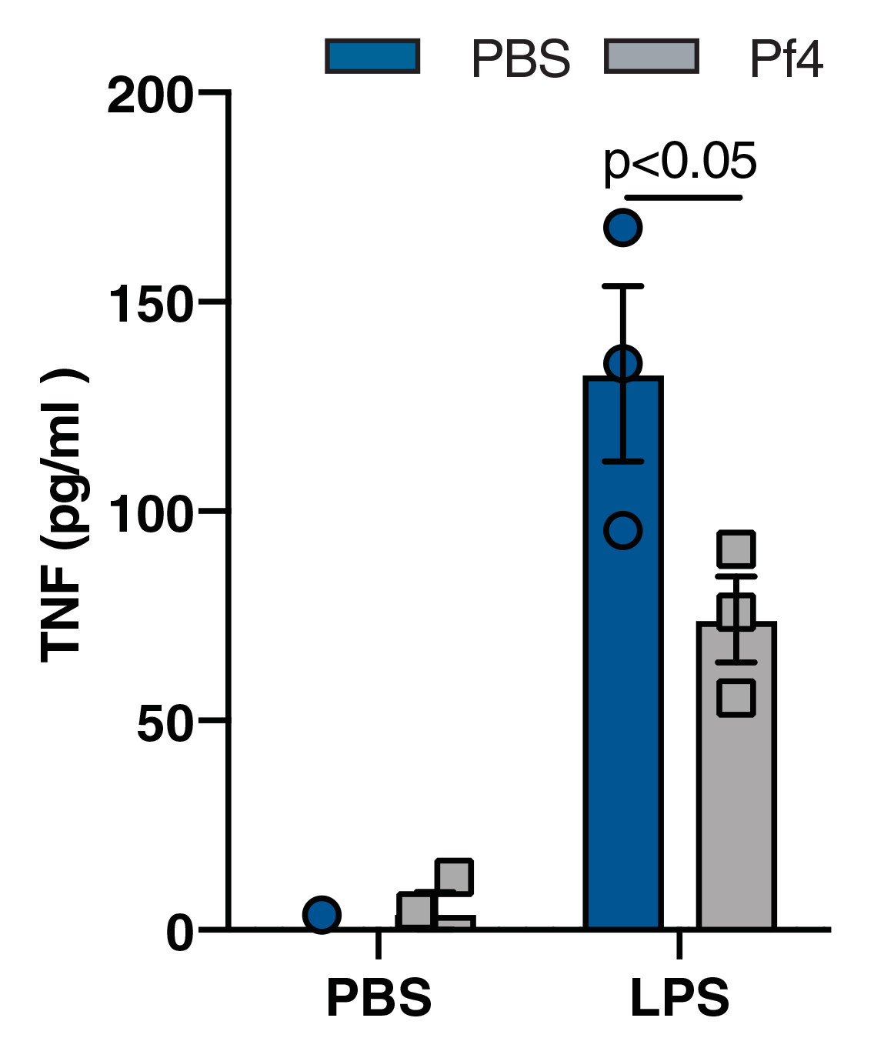
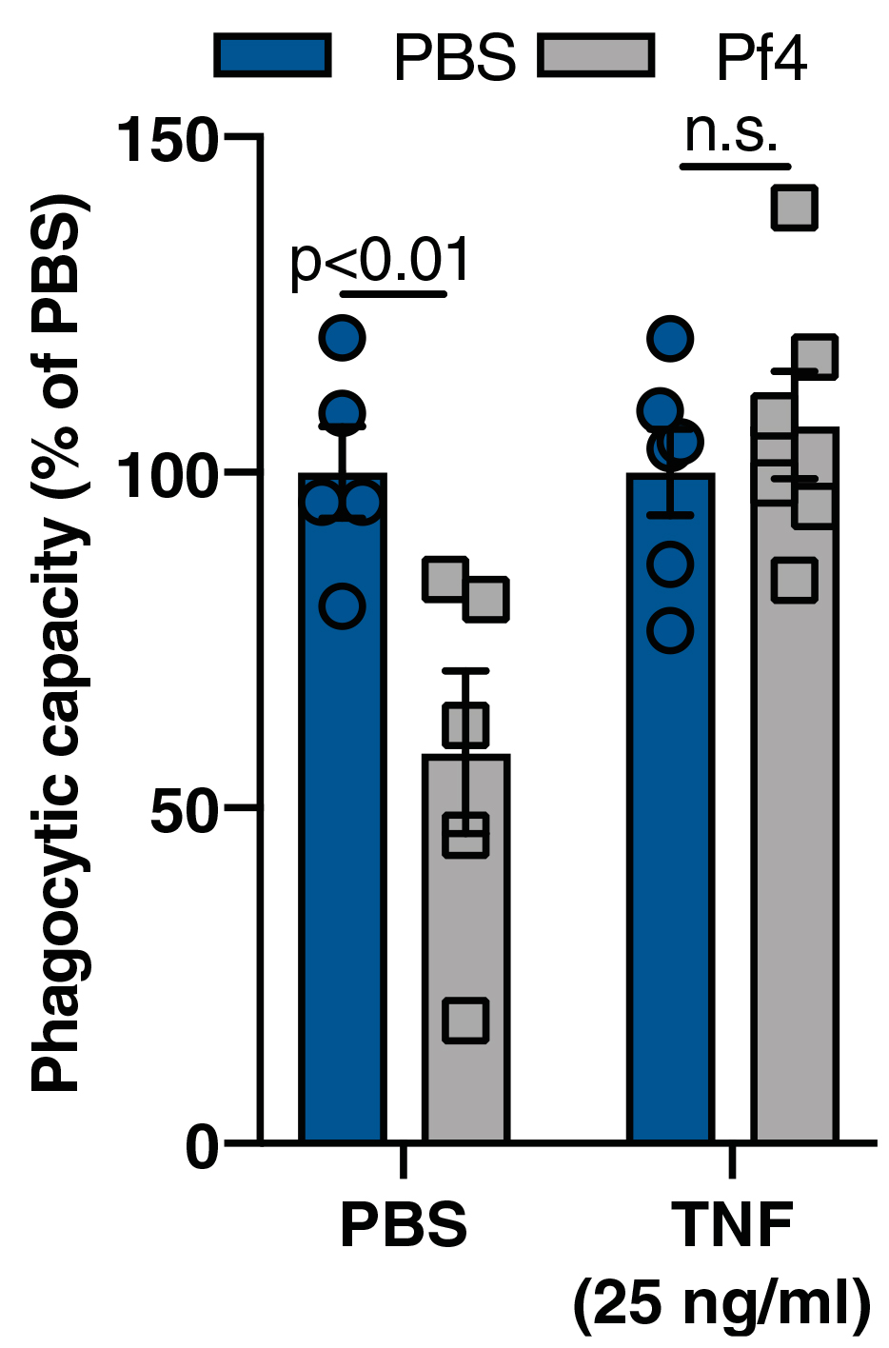
Pf Phage Triggers Antiviral Immunity and Impaired Bacterial Clearance Via TNF Inhibition
Pf decreases Pa phagocytosis in vitro
Pf leads to reduction in TNF after LPS administration
Pretreatment with TNF restores phagocytosis
Sweere et al. Science 363(6434): 2019

Slide 23
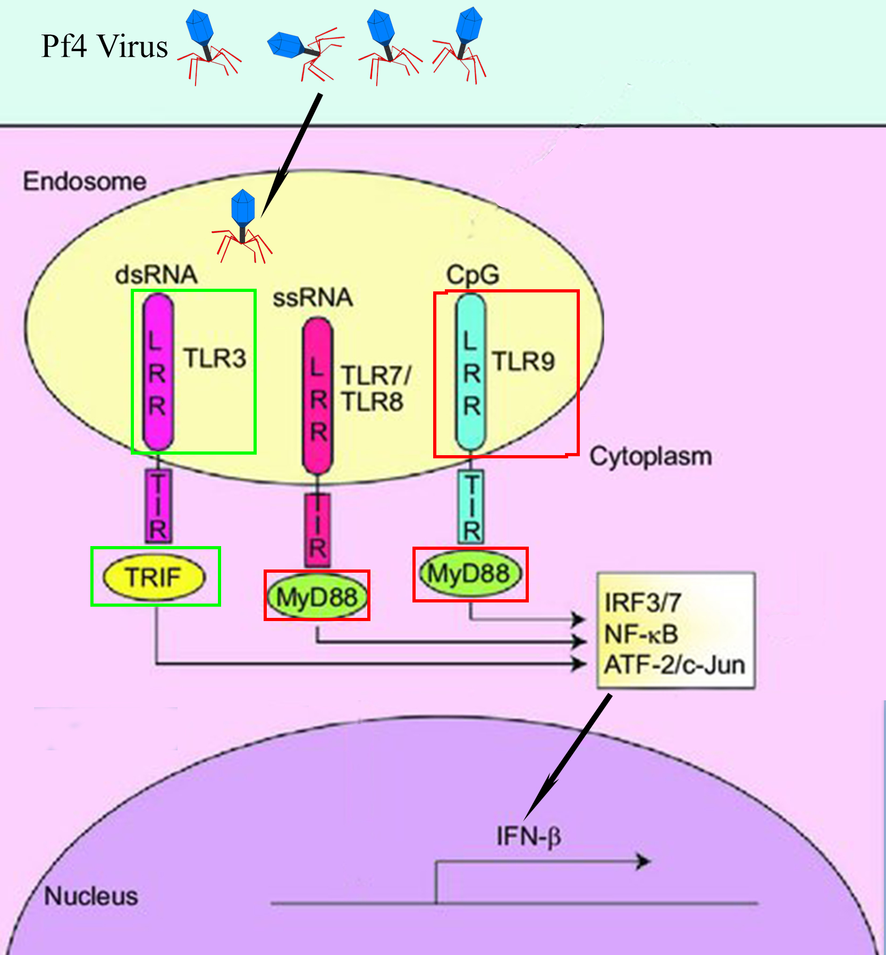
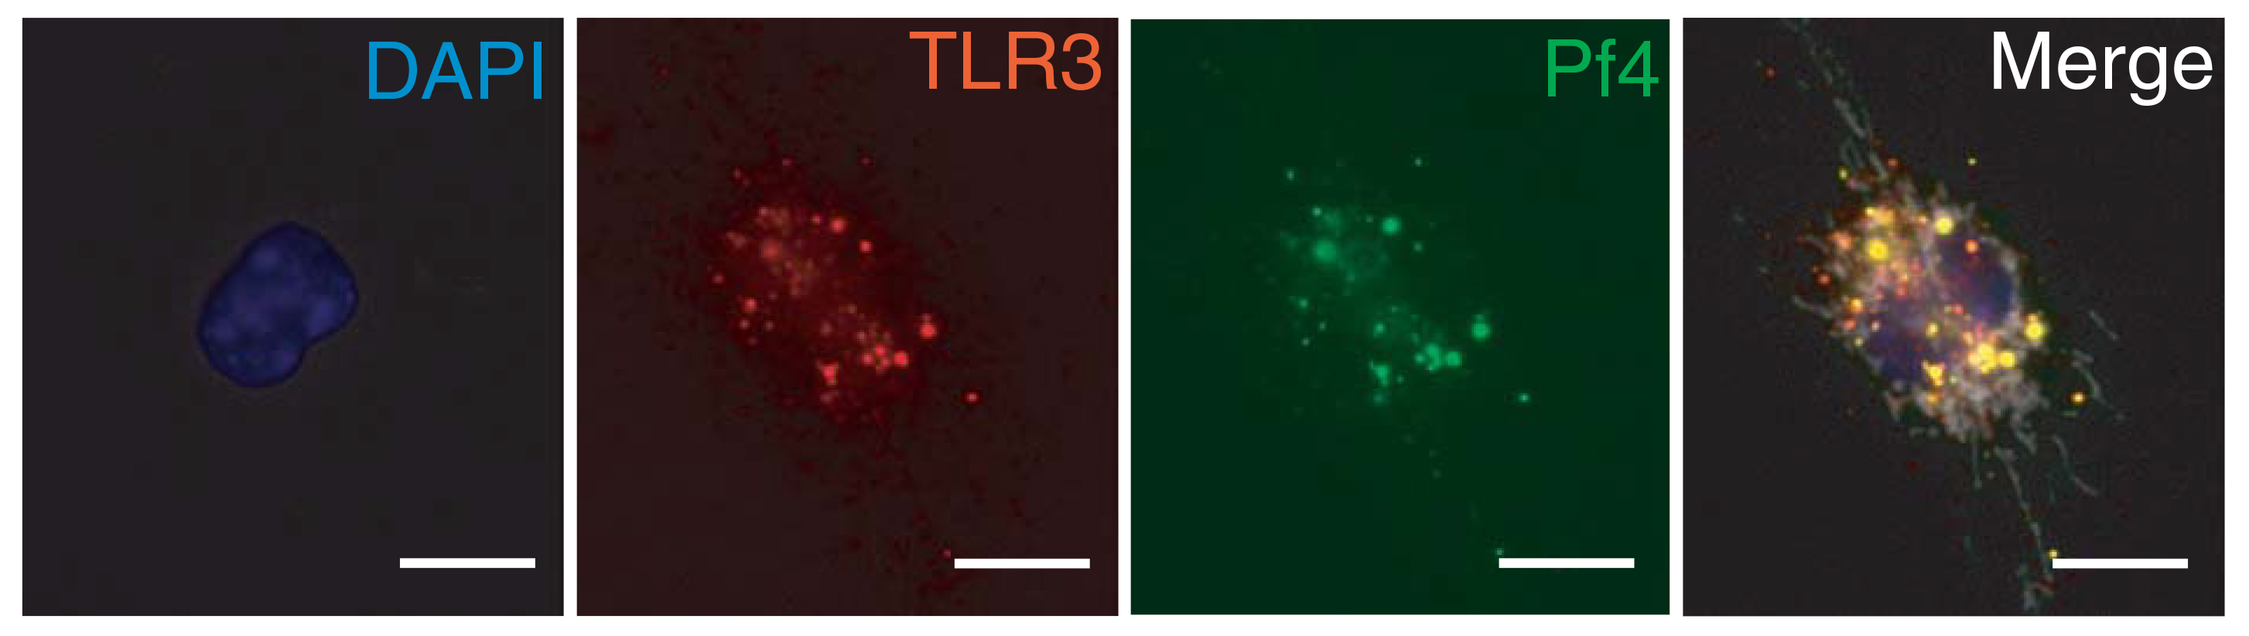
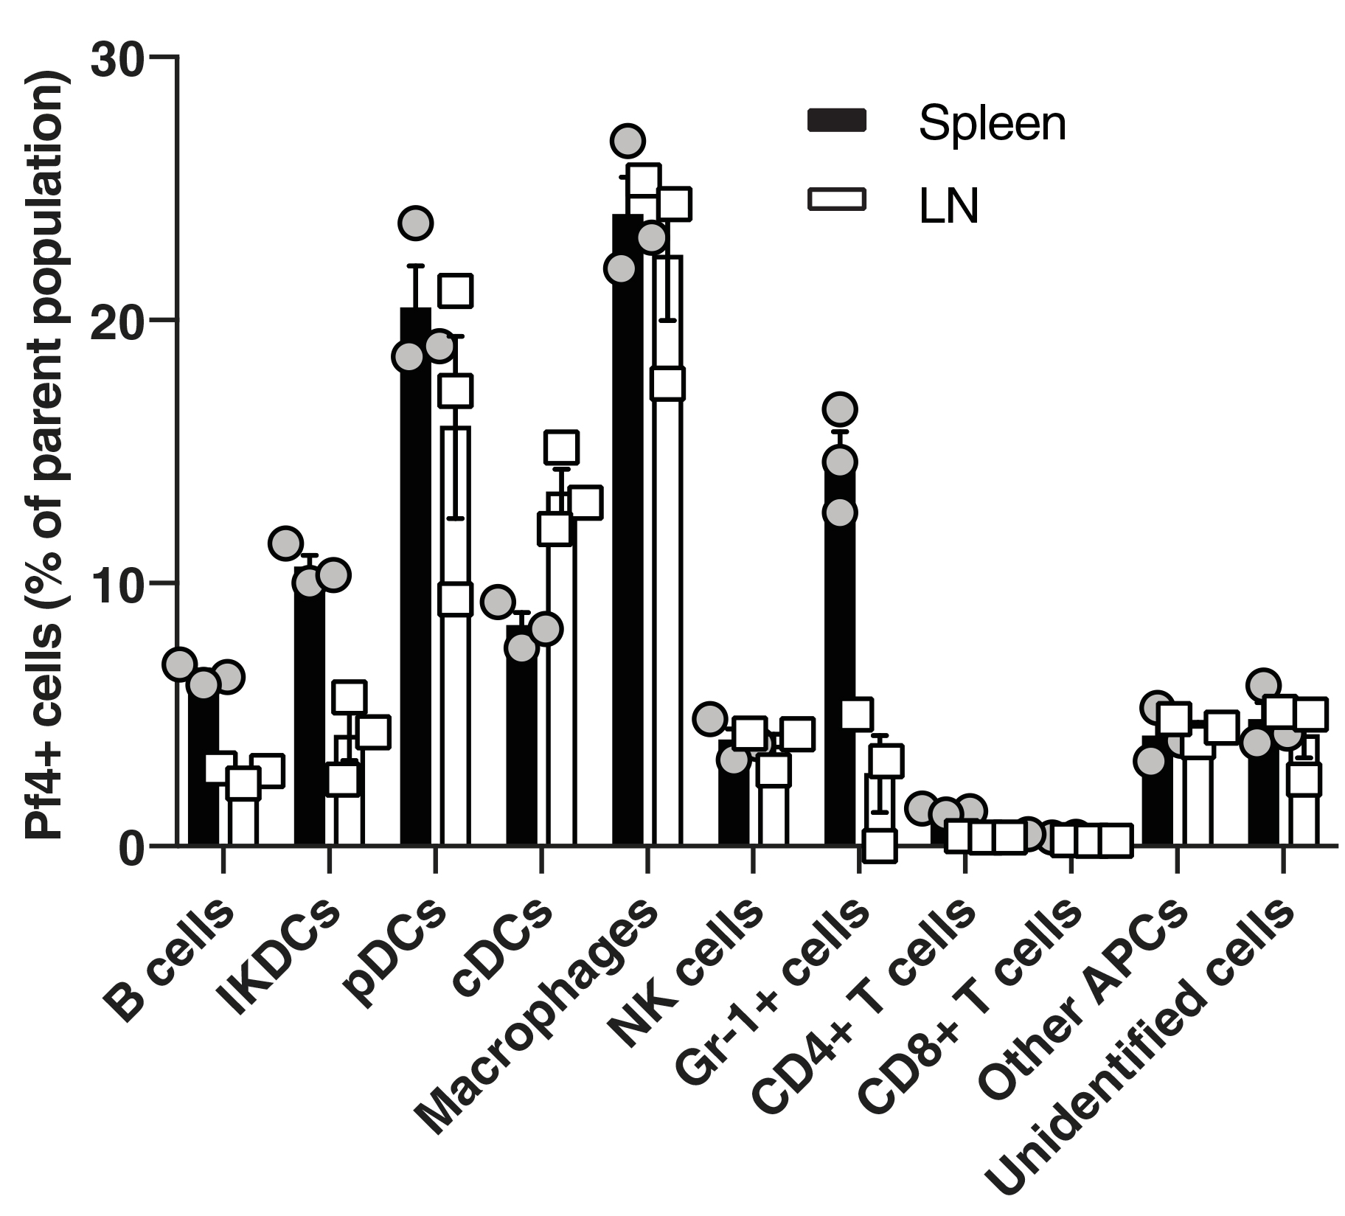
Pf Reduces TNF Translation via a TLR3 Dependent Increase in Type 1 Interferon
Adapted from Howard-Varona et al ISME J. 2017;11(7):1511–1520
Sweere et al. Science 363(6434): 2019

Slide 24
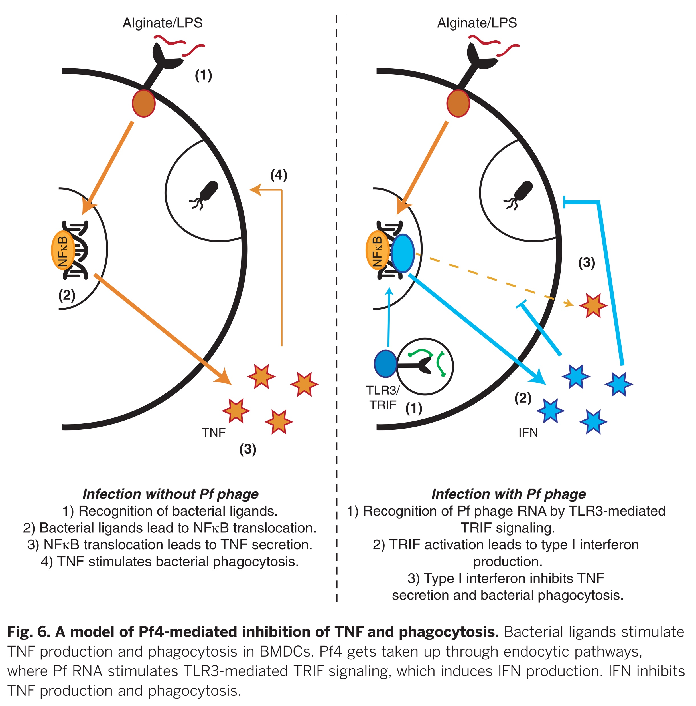
Pf Reduces TNF Translation via a TLR3 Dependent Increase in Type 1 Interferon
Sweere et al. Science 363(6434): 2019

Slide 25
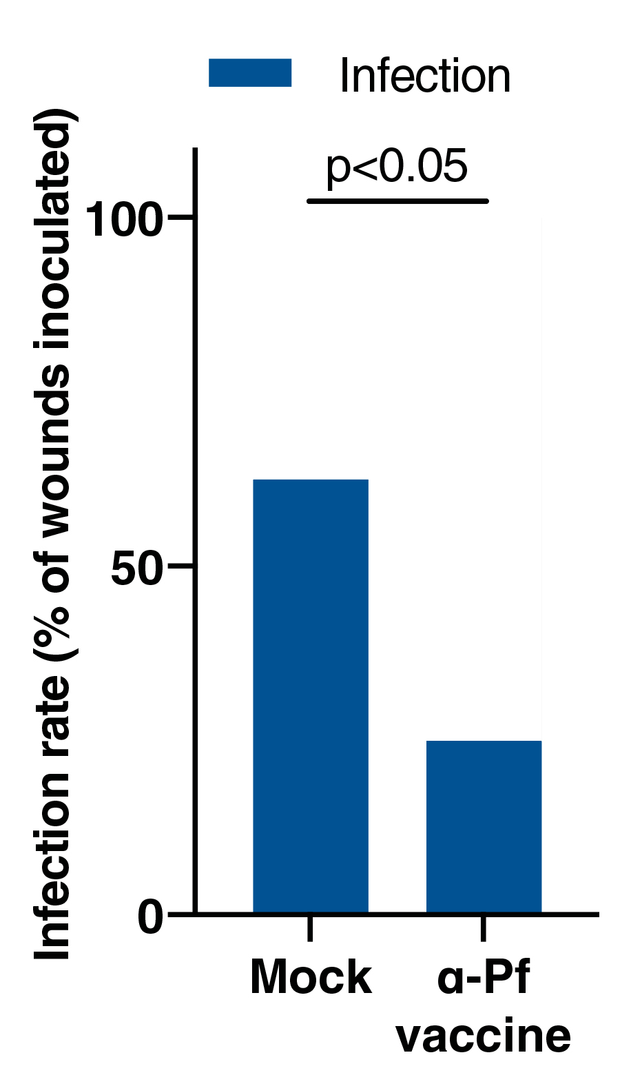
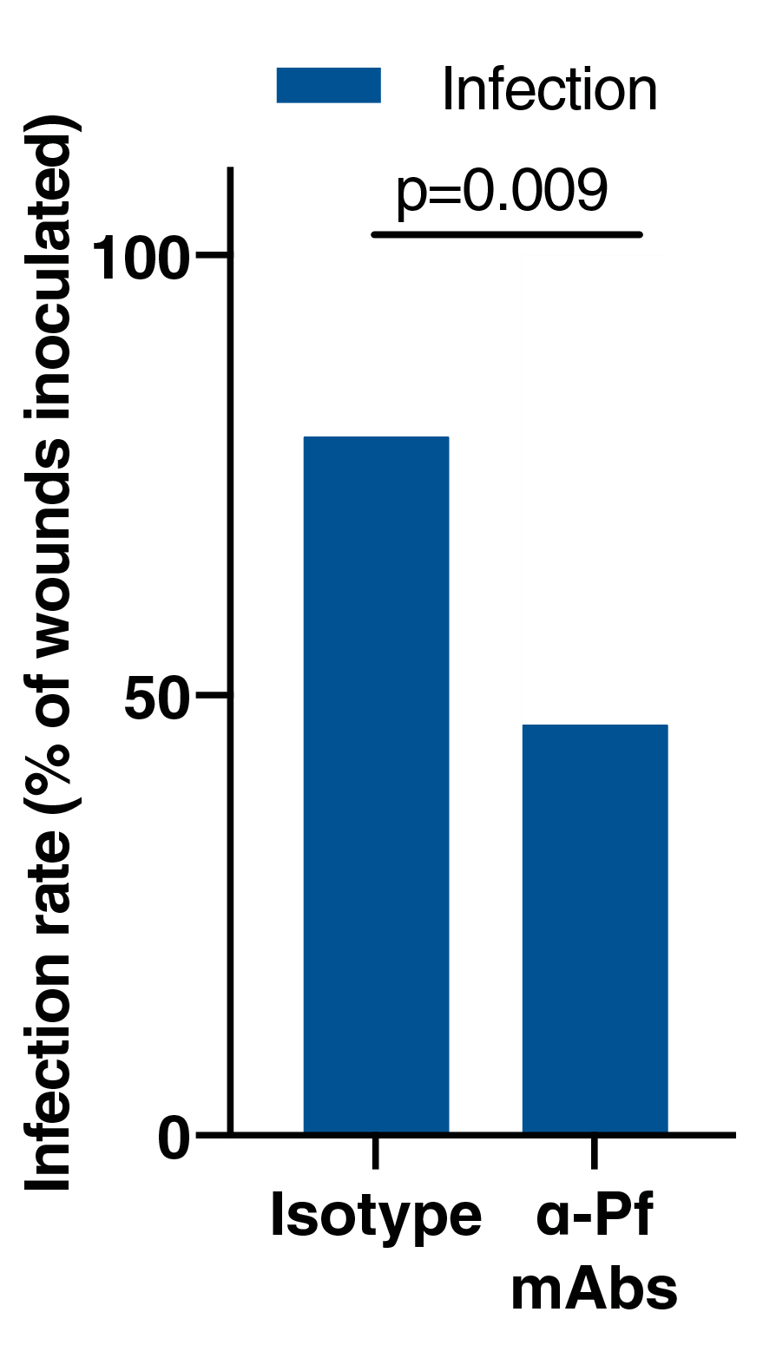
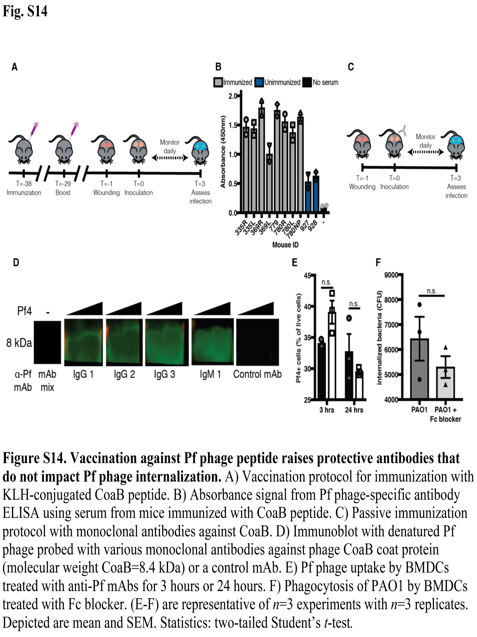
Vaccination Against Pf Is Protective Against Pa Infection
Identified a region of the viral coat “CoaB” which is broadly conserved and immunized mice against this protein
Sweere et al. Science 363(6434): 2019

Slide 26
Significance
Describes a novel mechanism by which temperate bacteriophages can play a pathogenic role in chronic bacterial infections, as well as a means to counteract this via immunization against the phage
  Internalized bacteriophages produced by Pseudomonas can trigger maladaptive antiviral responses, suppressing bacterial clearance and resulting in establishment of Psuedomonas infection
Many other bacterium have been identified as associated with temperate phages, so this strategy may have more broad reaching implications

Slide 27
Bacteria have been at this a lot longer than we have, but hopefully we are starting to catch up!

Slide 28



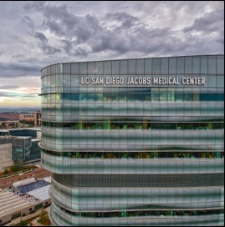
Photo Credit: Jenny Lam MD (Instagram: SuperJenny)
Acknowledgements
Thank you to the SIS for this opportunity as well as supporting my own research through the SIS Foundation Basic Research Training Fellowship

