Slide 1
Duration of antimicrobials for intraabdominal infection does not prevent treatment failure among high-risk patients
Taryn E. Hassinger MD,
Christopher A. Guidry MD MS, Robert G. Sawyer MD
Department of Surgery, University of Virginia Health System, Charlottesville VA

Slide 2
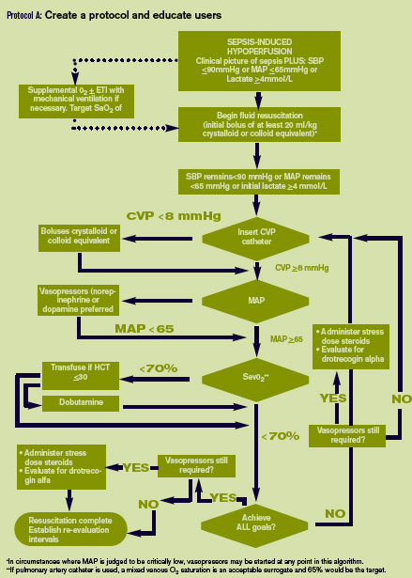
Treatment of Complicated IAIs
Complicated IAIs remain a prevalent and morbid problem
Current guidelines recommend 4-7 days of antimicrobial therapy
1. Solomkin JS, Mazuski JE, Bradley JS, et al. Diagnosis and management of complicated intra-abdominal infection in adults and children: guidelines by the Surgical Infection Society and the Infectious Diseases Society of America. Surg Infect (Larchmt) 2010; 11: 79-109.
Notes:
-After initial fluid resuscitation and stabilization, source control and antimicrobial medications remain the mainstays of treatment
-The recommended duration of antimicrobial therapy has recently come under scrutiny
-Current 2010 guidelines from the SIS and Infectious Diseases Society of America recommend 4-7 course of antimicrobial therapy for intraabdominal infections
-Despite these guidelines, no consensus exists among clinicians

Slide 3

Antimicrobial Morbidity
Drug-resistant organisms²
Alteration of the microbiome³
Clostridium difficile⁴
2. Tenover FC. Development and spread of bacterial resistance to antimicrobial agents: an overview. Clin Infect Dis 2001; 33: 108-15.
3. Jobe BA, Grasley A, Deveney KE, et al. Clostridium difficile colitis: an increasing hospital-acquired illness. Am J Surg 1995; 169: (480-3).
4. Langdon A, Crook N, Dantas G. The effects of antibiotics on the microbiome throughout development and alternative approaches for therapeutic modulation. Genome Med 2016; 8: 39.
Notes:
-While a vital and necessary part of the successful treatment of intraabdominal infections and sepsis, it is important to recognize the inherent morbidity associated with antimicrobial medications
-Including the increasing prevalence of Clostridium difficile secondary to alterations in gut flora and rising numbers of drug-resistant infections – both of which can be linked to the overuse of antimicrobial medications
-Additionally, these medications have a role in the alteration of the microbiome, with still unclear consequences

Slide 4
STOP-IT Trial
Outcomes in patients with complicated IAIs who receive a 4-day course of antimicrobial therapy are similar to outcomes in patients who receive antimicrobial therapy until resolution of signs/symptoms of sepsis

Slide 5
STOP-IT Trial
Outcomes in patients with complicated IAIs who receive a 4-day course of antimicrobial therapy are similar to outcomes in patients who receive antimicrobial therapy until resolution of signs/symptoms of sepsis
…but does this apply to high-risk patients?
  Pre-existing patient characteristics and severity of infection
  Lack of standardization in treatment of IAIs
5. Swenson BR, Metzger R, Hedrick TL, et al. Choosing antibiotics for intra-abdominal infections: what do we mean by “high risk”? Surg Infect (Larchmt) 2009; 10: 29-39.
Notes:
-Some may question whether these results can be generalized to patients considered high risk for treatment failure
-This recognition that certain patients are at an inherently increased risk of treatment failure based on pre-existing characteristics and severity of infection contributes to the lack of standardization in the duration of antimicrobial treatment for intraabdominal infections
-With this study, we set out to further investigate the generalizability of these results in a high-risk patient population

Slide 6
Methods
Determination of Risk Factors
Risk Stratification
Treatment failure
  Composite outcome of recurrent IAI, surgical site infection, death
Univariate analysis
  Kruskal-Wallis, Chi-Square, Fisher’s exact test
Defined as variable with positive association with composite outcome
Stratified by risk factors
  ‘Low risk’ = no risk factors
  ‘High risk’ = > 1 risk factor
Multivariate statistical regression controlling for number of risk factors and randomization group
Notes:
-First, we identified risk factors for the composite outcome, with a risk factor defined as a variable found to have a positive statistical association with the composite outcome
-Next, patients were stratified by risk factors
-Low risk patients were defined as those patients with zero risk factors
-High risk patients were defined as those patients with one or more risk factors
-Multivariate statistical regression was performed, controlling for number of risk factors and randomization group

Slide 7
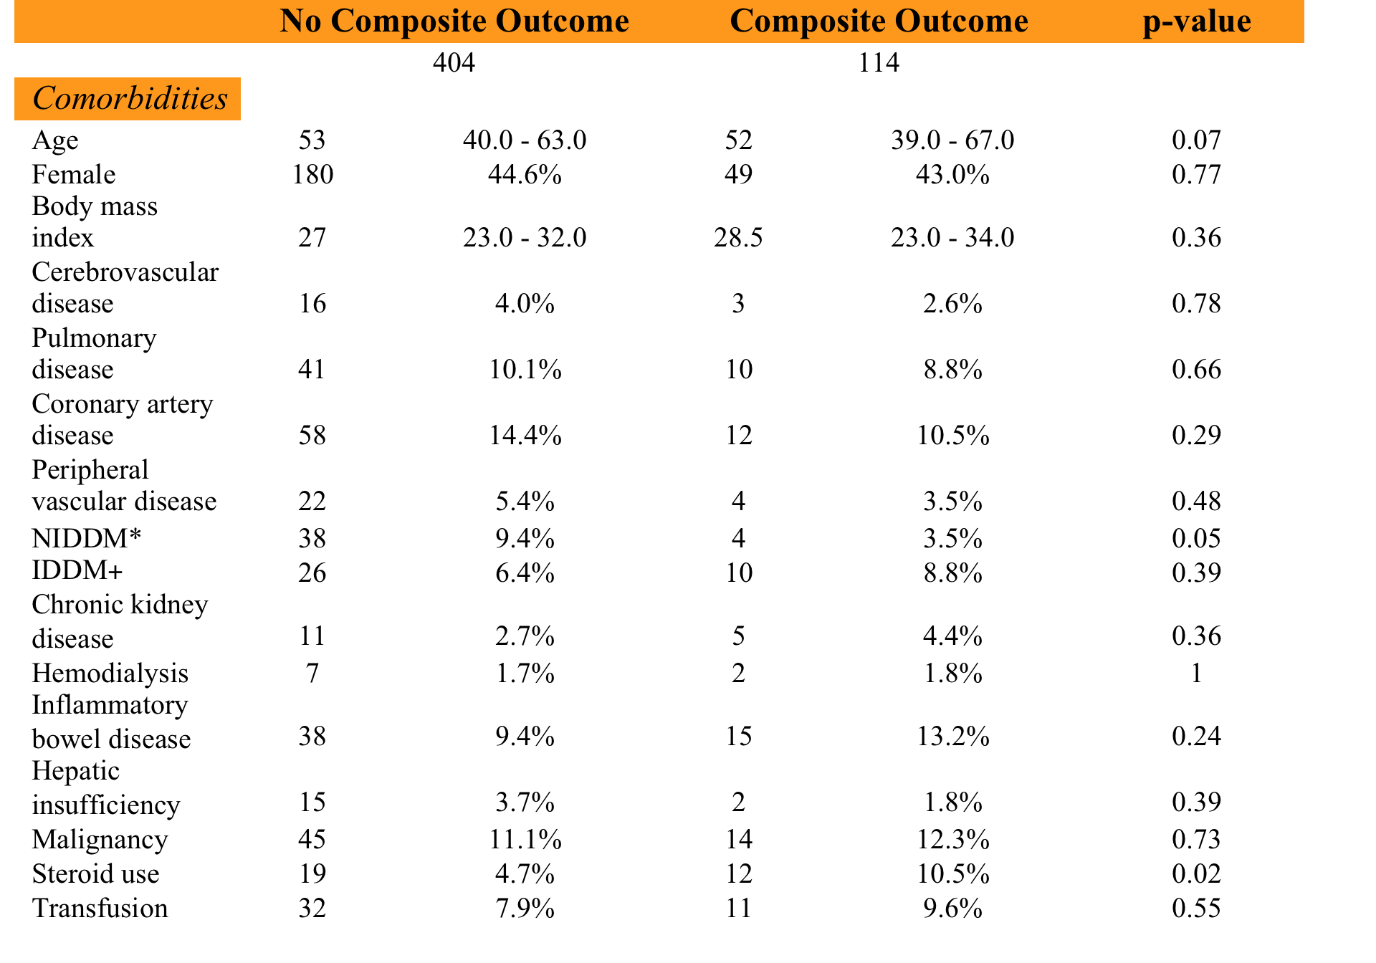
Baseline Demographics
Patient Demographics and Infection Characteristics Based on Presence of Composite Outcome
Notes:
-These next several tables denote the initial patient classification based on presence or absence of the composite outcome
-This classification was used to identify risk factors

Slide 8
Baseline Demographics
Patient Demographics and Infection Characteristics Based on Presence of Composite Outcome
Steroid use
Notes:
-As you can see, steroid use is the first risk factor to be identified

Slide 9
Baseline Demographics
Patient Demographics and
Infection Characteristics Based on
Presence of Composite Outcome

Slide 10
Baseline Demographics
Patient Demographics and
Infection Characteristics Based on
Presence of Composite Outcome
Steroid use
Hospital-acquired infection
Notes:
-Next, hospital-acquired infection was identified

Slide 11
Baseline Demographics
Patient Demographics and
Infection Characteristics Based on
Presence of Composite Outcome
Steroid use
Hospital-acquired infection
APACHE II > 15
Notes:
-Followed by an APACHE II score greater than 15

Slide 12
Baseline Demographics
Patient Demographics and Infection Characteristics Based on Presence of Composite Outcome

Slide 13
Baseline Demographics
Patient Demographics and Infection Characteristics Based on Presence of Composite Outcome
Steroid use
Hospital-acquired infection
APACHE II > 15
Colonic source of infection
Notes:
-Finally, a colonic source of infection was identified as the fourth and final risk factor

Slide 14
Baseline Demographics
Patient Demographics and Infection Characteristics Based on Presence of Composite Outcome
Steroid use
Hospital-acquired infection
APACHE II > 15
Colonic source of infection
Notes:
-A biliary source of infection was also found to be statistically significant, except this time it was positively associated with lack of the composite outcome
-We did not consider a biliary source of infection to be protective

Slide 15
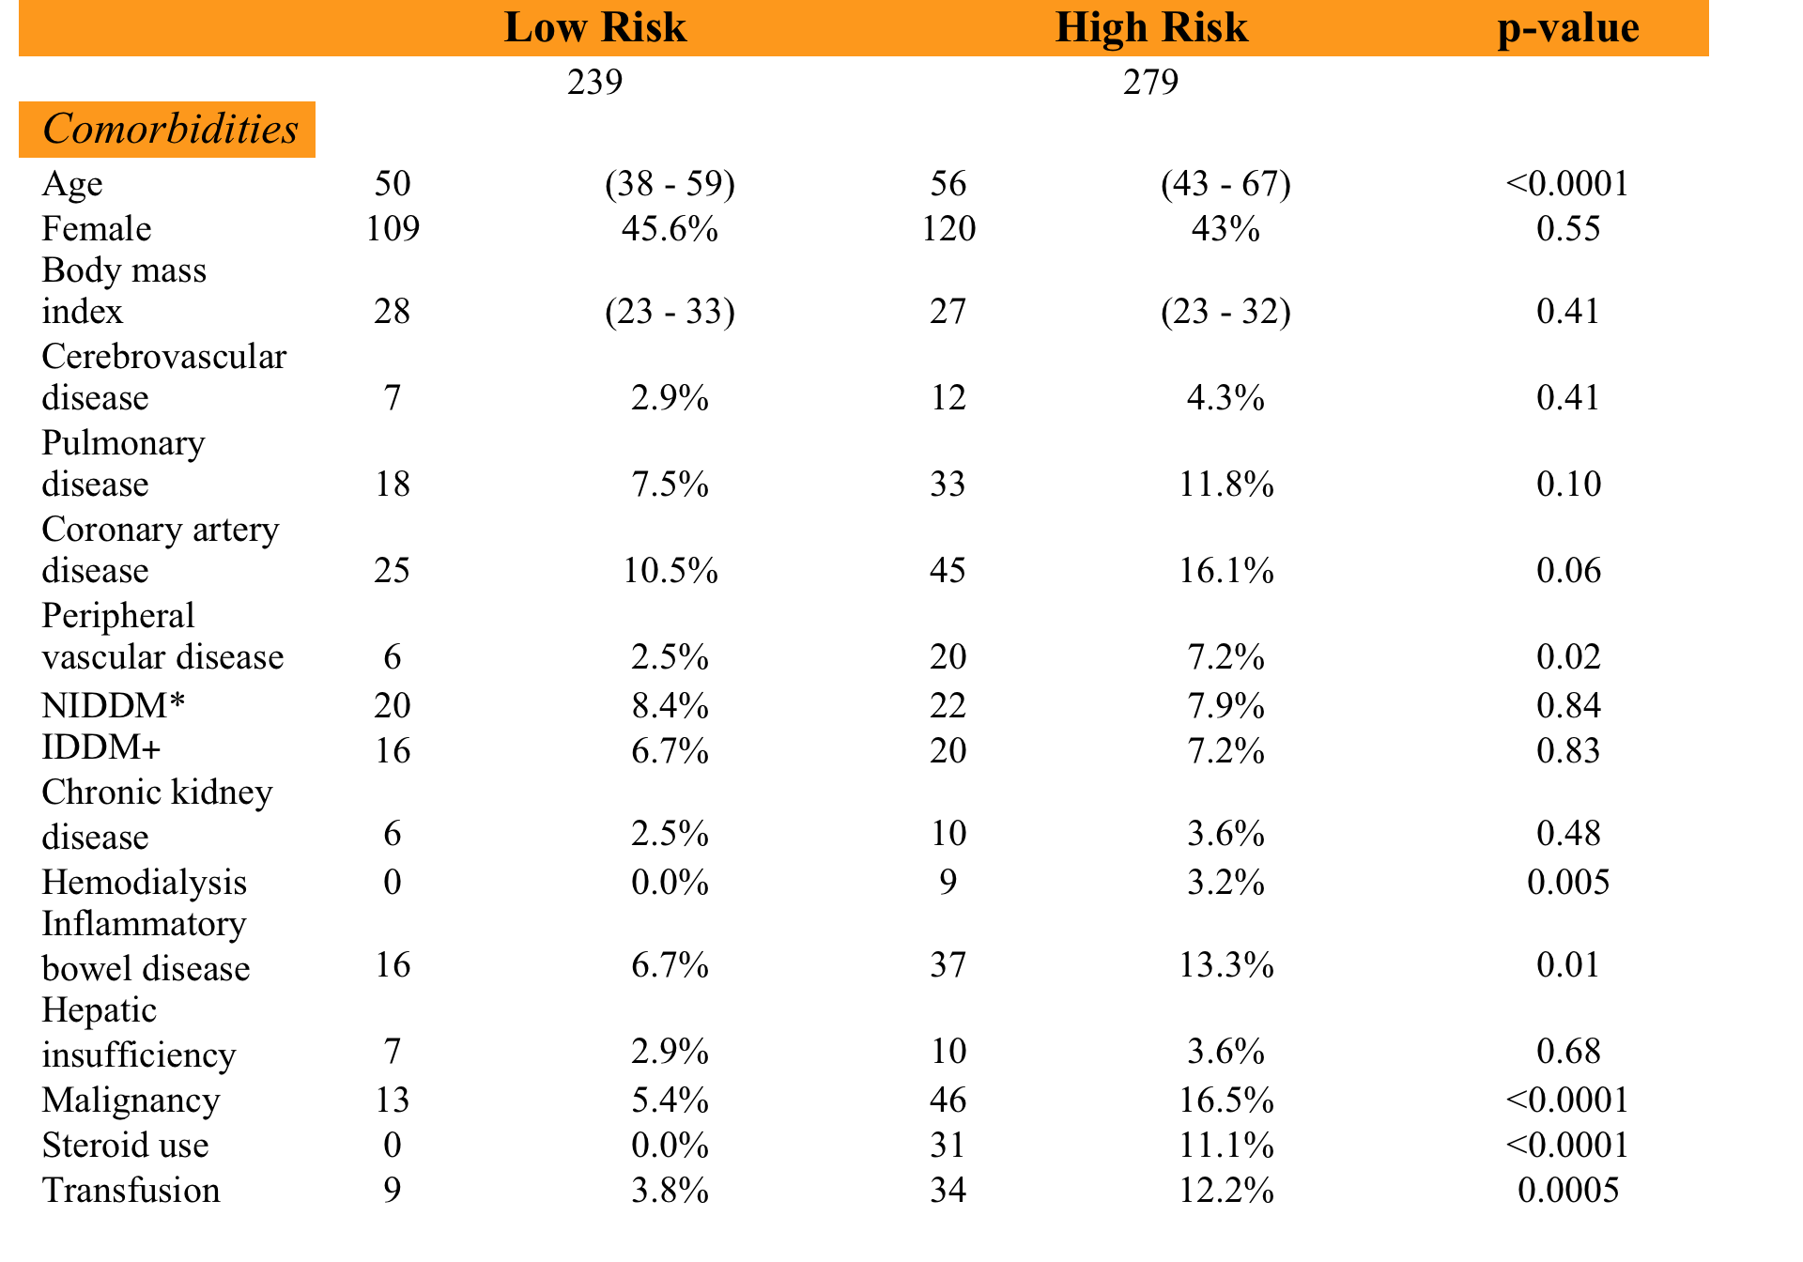
Risk Factor Stratification
Patient Demographics and Infection Characteristics Based on Presence of Risk Factors
Notes:
-Once risk factors were identified, patients were stratified based on presence or absence of risk factors

Slide 16
Risk Factor Stratification
Patient Demographics and Infection Characteristics Based on Presence of Risk Factors
Notes:
-Once re-organized by presence or absence of risk factors, many additional variables showed statistical significance
-Notably age, peripheral vascular disease, and malignancy

Slide 17
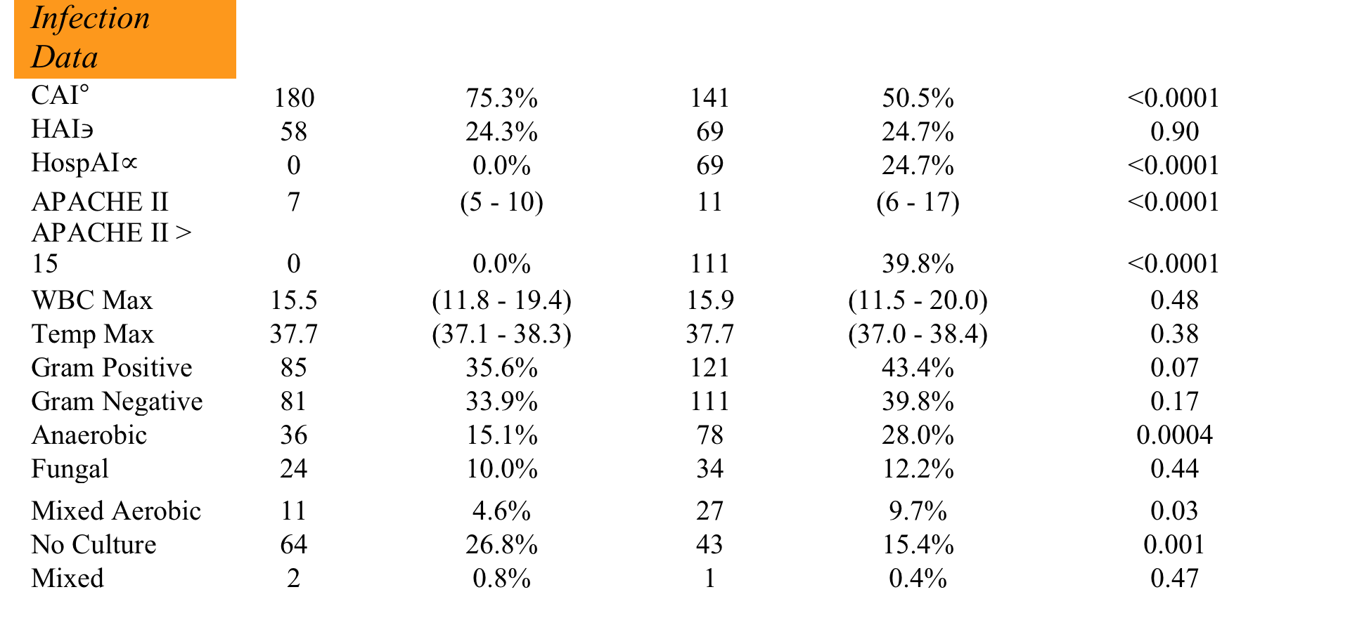
Risk Factor Stratification
Patient Demographics and Infection Characteristics Based on Presence of Risk Factors

Slide 18
Risk Factor Stratification
Patient Demographics and Infection Characteristics Based on Presence of Risk Factors
Notes:
-Anaerobic and mixed aerobic infections

Slide 19
Risk Factor Stratification
Patient Demographics and Infection Characteristics Based on Presence of Risk Factors
Notes:
-Not surprisingly, more patients in the low risk group were found to have community-acquired infections

Slide 20
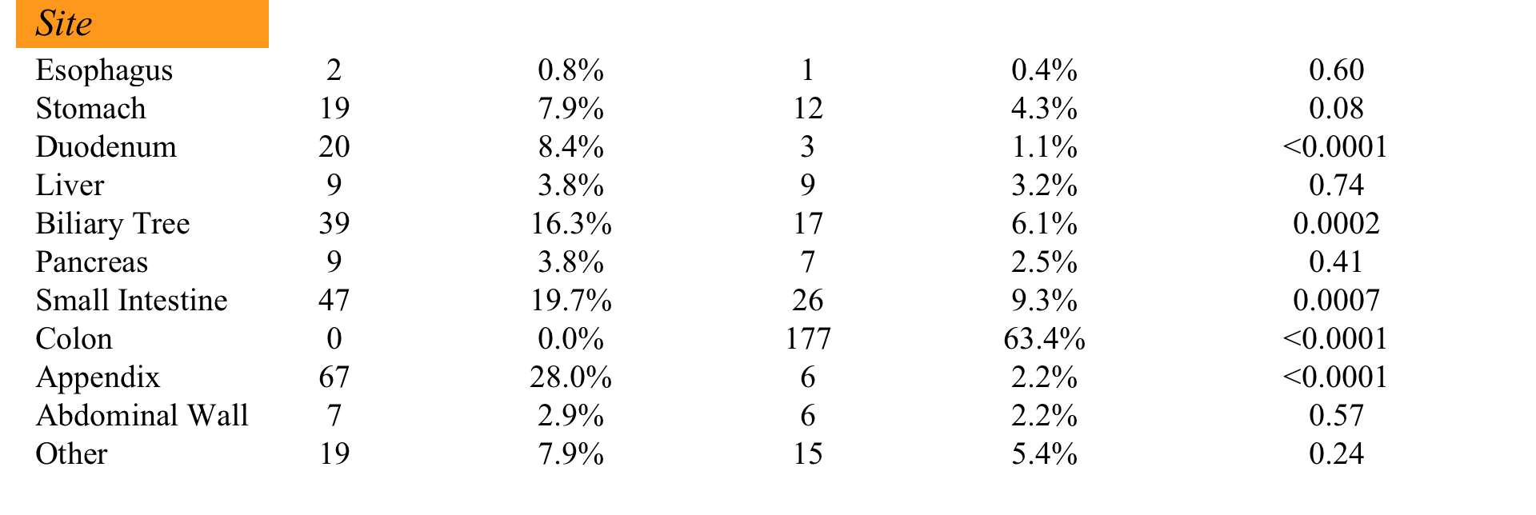
Risk Factor Stratification
Patient Demographics and Infection Characteristics Based on Presence of Risk Factors

Slide 21
Risk Factor Stratification
Patient Demographics and Infection Characteristics Based on Presence of Risk Factors
Notes:
-Colonic infections remained more prevalent in the high risk group

Slide 22
Risk Factor Stratification
Patient Demographics and Infection Characteristics Based on Presence of Risk Factors
Notes:
-While other enteral tract infections were more prevalent in the low risk group

Slide 23
Risk Factor Stratification
Number of Risk Factors and Composite Outcome in Control versus Experimental Groups
Notes:
-There was no difference in composite outcome between the control and experimental groups when further grouped by specific number of risk factors
-However, as the number of risk factors increased, the raw percentage of the composite outcome increased

Slide 24
Multivariate Analysis
Overall Rates of Composite Outcome

Slide 25
Multivariate Analysis
Overall Rates of Composite Outcome
Notes:
-Multivariate statistical regression revealed an increasing association between the composite outcome and increasing number of risk factors, regardless of original randomization group

Slide 26
Discussion
Patients at high-risk of treatment failure may be destined to fail initial therapy regardless of treatment length
  Benefit of recognizing treatment failure early
Source control possibly more important than duration of antimicrobial therapy^{6,7}
Excessive duration of antimicrobial therapy
  Associated with extra-abdominal infection and mortality⁸
  Reduction in C. Difficile colitis with reduction in total therapy⁹
6. Burnham JP, Lane MA, Kollef MH. Impact of sepsis classification and multidrug-resistance status on outcome among patients treated with appropriate therapy. Crit Care Med 2015; 43: 1580-6.
7. Bloos F, Thomas-Ruddel D, Ruddel H, et al. Impact of compliance with infection management of guidelines on outcome in patients with severe sepsis: a prospective observational multi-center study. Crit Care 2014; 18: 42.
8. Riccio LM, Popovsky KA, Hranjec T, et al. Association of excessive duration of antibiotic therapy for intra-abdominal infection with subsequent extra-abdominal infection and death: a study of 2,552 consecutive infections. Surg Infect (Larchmt) 2014; 15: 417-24.
9. Valiquette L, Cossette B, Garant MP, et al. Impact of a reduction in the use of high-risk antibiotics on the course of an epidemic of Clostridium difficile-associated disease caused by the hypervirulent NAP1/027 strain. Clin Infect Dis 2007; 45: 112-21.
Notes:
-The increasing percentage of composite outcome with increasing number of risk factors suggests that patients at high risk of treatment failure may be destined to fail initial therapy regardless of treatment length
-A shorter course of antibiotics in these patients would allow for earlier recognition of treatment failure
-Additionally, several studies have suggested that time to source control is more important than time to initiation of antimicrobial therapy, which may suggest that source control is perhaps more important than the duration of antimicrobial therapy, as well
-Recent literature has also associated increased duration of antimicrobial therapy with increased rates of extra-abdominal infection and mortality
-A reduction in the rates of C. Difficle colitis has also been seen with a reduction in total antimicrobial therapy highlighting the additional benefit of a shorter course of treatment

Slide 27
Strengths
Limitations
Relatively large sample size
Well-matched control and experimental groups
Small number of immunocompromised patients
Exclusion of patients without source control
Small number of patients in highest risk subgroup
Notes:
-Strengths of our project include the STOP-IT trial’s relatively large sample size and well-matched control and experimental groups
-Limitations include the small number of immunocompromised patients and the exclusion of patients without source control
-It remains unclear whether or not these populations would benefit from a longer duration of therapy
-Additionally, the highest risk subgroup of patients, or those with 3-4 risk factors, contained only 16 patients
-While this could be due to sample size, it may also signify how rarely these patients are encountered
-With patients having 1-2 risk factors making up the majority of our higher risk patients

Slide 28
Conclusions
Able to identify risk factors for treatment failure
No difference in the composite outcome between randomization groups in high-risk patients
Patients at high risk of treatment failure do not benefit from increased duration of antimicrobial therapy

Slide 29

Thank you!

