Slide 1
Acute Diverticulitis: Lavage or Resect? Anastomose or Divert?
Christine S. Cocanour, MD UC Davis Medical Center
Lillian Kao, MD
UTHSC-Houston

Slide 2
Acute Diverticulitis: Lavage Anastomose
Christine S. Cocanour, MD, FACS, FCCM
University of California Davis Medical Center

Slide 3
Acute Diverticulitis: Lavage Anastomose
Christine S. Cocanour, MD, FACS, FCCM
University of California Davis Medical Center
I have no disclosures

Slide 4
Acute Diverticulitis
7.6 cases per 1,000 hospitalized patients
Free diverticular perforation: 1.5%
Diverticular abscess: 9.6%
3rd most common GI disorder requiring hospitalization
$2.6 billion per year in the US

Slide 5
Acute Diverticulitis with Perforation
Hinchey Stage 3:
Generalized purulent peritonitis from abscess rupture into peritoneal cavity
Hinchey Stage 4:
Generalized fecal peritonitis from free perforation of colonic diverticulum
Historically treated with Hartmann’s Procedure

Slide 6
Hartmann’s Procedure
No one wants a colostomy
Hartmann takedown is a morbid procedure
Overall complication rate 29%
In-hospital mortality rate 2%
7% required diverting ileostomy
Garber et al, Am J Surg 2014; 207:60
28 – 81% never undergo colostomy reversal

Slide 7
Laparoscopic Lavage
Open lavage:
1907 (Mayo), 1970 (Killingback)
Laparoscopic lavage 1996 Ireland
Patient selection variable
Prospective, randomized studies
LADIES trial (Dutch) stopped at interim analysis for increased complications in LL group
LapLAND and SCANDIV ongoing
DILALA (Sweden/Denmark): short term results published

Slide 8
Laparoscopic Lavage Comparison of Lap Lavage to Lap Hartmann’s
Laparoscopic Lavage
Laparoscopic Hartmann’s
47 patients
Hinchey III:IV = 36:6
Op time: 100 + 40 min
EBL: 34 + 21 cc
Mortality: 0%
Morbidity: 4.3%
Reoperation: 2
Length of stay: 6.7 + 2 days
41 patients
Hinchey III:IV = 31:7
Op time: 182 + 55 min
EBL: 210 + 171 cc
Mortality: 2.4%
Morbidity: 17.1%
Reoperation: 1
Length of stay: 16 + 10 days
Liang S, Russek K, Franklin ME. Surg Endosc 2012; 26:2835

Slide 9
Laparoscopic Lavage
Total patients: 301
Most Hinchey III
Afshar S, Kurer MA. Colorectal Dis 2012 Feb;14(2):135

Slide 10
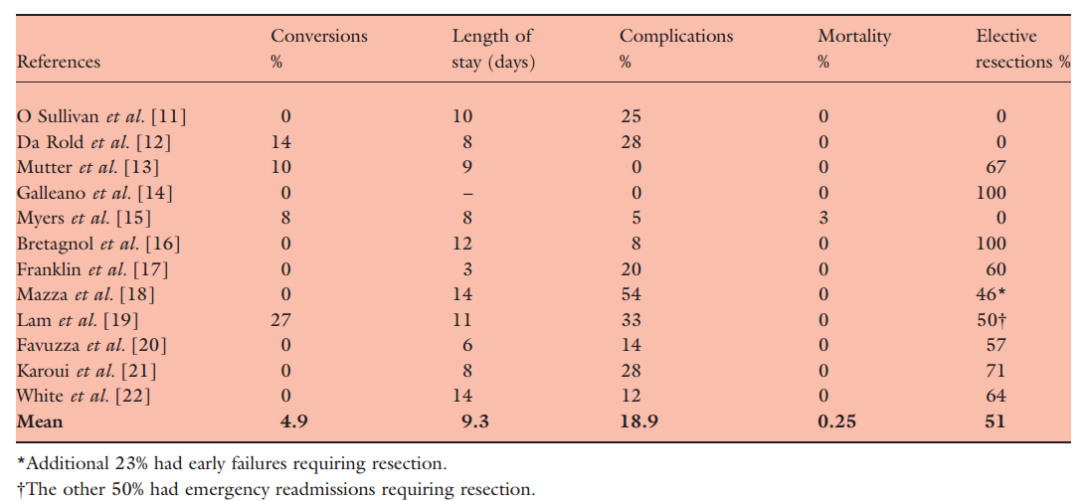
Conversions: 4.9%
Length of stay: 9.3 days
Complications: 18.9%
Mortality: 0.25%
Afshar S, Kurer MA. Colorectal Dis 2012 Feb;14(2):135

Slide 11
Laparoscopic Lavage
Risk of reintervention highest:
High preoperative CRP
> ASA 3
Age greater than 80
Immunosuppression
High Mannheim Peritonitis Index score
Surgeon selection
Adequate laparoscopic skills

Slide 12
Laparoscopic Lavage
Diverticulitis—Laparoscopic Lavage vs resection (Hartmann procedure) DILALA trial
Hinchey Grade III randomized 1:1, n=39:36
Primary endpoint: # reoperations/12 months
No conversions from randomization
Significantly shorter operating time and LOS
No difference in mortality 7.7% vs 11.4%
No difference in morbidity

Slide 13
Laparoscopic Lavage
Avoids laparotomy
Avoids stoma and need for takedown
Allows bridge to elective resection if indicated
Included in perforated diverticular disease management strategy:
European Association of Endoscopic Surgeons
Danish guidelines

Slide 15
Primary Anastomosis with or without diverting ileostomy
Meta-analysis of 15 studies of PA vs HP
(13 retrospective, 2 prospective, 1984-2004)
Mortality reduced with PA in those with emergency operation and with abscess
Mortality equivalent for Hinchey III and IV
Post op wound infections, abscesses and peritonitis trended to less with PA
Anastomotic leak approximately 6%
Operative time not significantly different
Dis Colon Rectum. 2006;49:966

Slide 16
Primary Anastomosis with or without diverting ileostomy
NSQIP database of acute diverticulitis
1314 patients, 75.4% HP, 21.7% PA, 2.9% PAPD
30 day mortality: 7.3%, 4.6%, 1.6%
Surgical site infections: 19.7%, 17.9%, 13.2%
Adjusted outcomes showed no difference between PA and HP
J Trauma Acute Care Surg. 2013;74: 1385

Slide 17
Primary Anastomosis with or without diverting ileostomy
Non Colorectal surgeons more likely to do HP than PA
68% vs 41%
LOS, time to stoma reversal, ICU days lower for colorectal surgeons
Post op complications for HP twice the complications of PA
22% vs 10.5% for noncolorectal surgeons
9% vs 5.7% for colorectal surgeons
J Am Coll Surg 2014;218:1156

Slide 18
Primary Anastomosis with or without diverting ileostomy
Study | PA (n) | H (n) | Mortality (%) | Morbidity (%) | LOS (days) | Reversal (%) | AE after reversal
Oberkofler et al | 32 | 30 | 9 vs 13 | 84 vs 80 | 16 vs 18 | 90 vs 57
Binda et al | 34 | 56 | 2.9 vs 10.7 | 35.3 vs 46.4 |  | 64.7 vs 60 | 4.5 vs 23.5
Oberkofler, et al and Binda, et al both PRCT
No difference between groups: age, Hinchey stage, ASA, Charlson Index, Mannheim Peritonitis index
No difference in outcome between PA and HP
Binda et al stopped early because centers opted out---did not want to enroll patients in the Hartmann arm

Slide 19
Primary Anastomosis with or without diverting ileostomy
Morbidity and mortality are comparable to Hartmann’s
Ileostomy reversal easier than Hartmann’s reversal
decreased hospital costs, shorter LOS, and operative time
Ileostomy reversal more likely than Hartmann’s reversal
2006 American Society of Colon and Rectal Surgeons have added PA as an option
Italian consensus guidelines support PA with or without diversion

Slide 20
Acute Perforated Diverticulitis
Laparoscopy
Hinchey III
Hinchey IV
Lavage & Drain
Primary Anastomosis
w/ or w/o diversion
Fails to improve
Poor operative risk:
consider permanent Hartmann’s
Unstable patient Damage Control laparotomy

Slide 22
Acute Diverticulitis: Hartmann’s Procedure
Lillian S. Kao, MD, MS, FACS
@LillianKao1
I have no disclosures.

Slide 23
What is this?
Notes:
A survey suggests that ~50% of Americans think that smartwatches are a passing fad.
A passing fad. What is a fad? A fad is an intense and widely shared enthusiasm for something, especially one that is short-lived and without basis in the object’s qualities: a craze
Is laparoscopic lavage a passing fad?

Slide 24
Lavage: An old fad that has passed?
Notes:
I would argue that in fact, lavage in general is an old fad that has already passed.
Intra-abdominal lavage has been used in multiple disease including abdominal sepsis and appendicitis, pancreatitis, and even elective abdominal cases. However, multiple trials have demonstrated no benefit. A 3-arm randomized trial in 1990 found no differences in outcome with no lavage, lavage with saline, and lavage with antibiotics. A more recent trial involving laparoscopy in 2014 in children with perforated appendicitis found no benefit to lavage over suction alone. And a 2015 trial in elective liver resections found an increase in organ/space surgical site infections with lavage versus no lavage.

Slide 25
PRO LAVAGE
AGAINST LAVAGE
Morbidity, mortality, length of stay less
No need for ostomy with subsequent takedown.
This data is derived from non-randomized trials with significant selection bias and often as-treated analyses.
Need for ostomy not most important outcome. Recurrences after non-resectional therapy are common and increase the risk of mortality with subsequent episodes. No long-term data on LL outcomes.
Notes:
Dr. Cocanour argued that lavage resulted in less morbidity, mortality, and length of stay and no need for ostomy with subsequent takedown.
However, the data on outcomes is derived from non-randomized trials with significant selection bias and often as-treated analyses. In other words, patients who were converted from lavage to resection were analyzed as resection patients.
Furthermore, the need for an ostomy is not the most important outcome. Recurrences after non-resectional therapy are common and increase the risk of mortality with subsequent episodes. No long-term data on laparoscopic lavage outcomes are available.

Slide 26
Risk factors for mortality with recurrences after non-resectional therapy
Among medically treated patients, 16% suffer a second diverticulitis episode.
Predictors of mortality with recurrence:
Age more than 50 years
Previous tobacco use
Complicated initial presentation with obstruction, fistula, abscess (2.18, 95% CI 1.60-2.97) , peritonitis (3.14, 95% CI 1.99-4.97), and sepsis (1.88, 95% CI 1.29-2.73).
Notes:
We do not know, however, the long term outcomes of non-resectional therapy or medically treated patients. We might extrapolate from those results.
Analysis of a longitudinal database from the California Office of Statewide Health Planning and Development from 1995 to 2009 evaluated over 200,000 patients. Thy identified complicated initial presentation including peritonitis as a risk factor for mortality with recurrent episodes.

Slide 27
267 patients with diverticulitis admitted
139 patients included and laparoscopy performed
56 not considered Hinchey III
83 Hinchey III – randomized
43 laparoscopic lavage
40 Hartmann’s procedure
36 patients operated
39 patients operated
DILALA Trial:
DIverticulitis with
LAparoscopic
LAvage
Angenete E et al.
Ann Surg 2014.
Notes:
There has only been one randomized trial that has not completed data collection but for which an interim analysis was performed.

Slide 28
DILALA Trial: Similar outcomes between lavage and Hartmann’s
 | Laparoscopic Lavage (n-39) | Hartmann’s Procedure (n=36)
Required intensive care | 5/39 (12.8%) | 4/36 (11.1%)
Postoperative hospital stay, d* | 6 (2-27) | 9 (4-36)
Reoperation within 30 days | 5/38 (13.2%) | 6/35 (17.1%)
Mortality within 30 days | 3/39 (7.7%) | 0/36 (0%)
Mortality within 90 days | 3/39 (7.7%) | 4/36 (11.4%)
Readmission within 30 days | 0/38 | 2/35 (5.7%)
More than 1 readmission within 30 days | 0/38 | 1/35 (5.7%)
*p<0.05
Notes:
No differences in outcome except for a shorter length of post-operative stay. Not shown here, but no differences in complications according to Clavien-Dindo classification or by number of complications per patient.

Slide 29
RCTs: Results not forthcoming
RCT | Patients | Intervention | Comparison | Primary outcome | Sample size (allocation ratio)
SCANDIV | Perforated diverticulitis | LL | HP or PRA | Morbidity (90 days) | 150 (1:1)
LADIES: LOLA arm | Purulent peritonitis | LL | HP or PRA | Major morbidity and mortality | 264 (2:1:1)
DIVA arm | Fecal peritonitis | HP | PRA | Stoma-free survival (1 year) | 212 (1:1)
DILALA | Hinchey III | LL | HP | Reoperation (1 year) | 80 (1:1)
Lap LAND | Hinchey III | LL | HP or PRA | Morbidity and mortality | 300 (200 Hinchey III)
Estimated completion date March 2017
Closed in 2013 for safety issues
Estimated completion date December 2015
Notes:
One might argue that we will know the answer from ongoing randomized trials. However, these results are not forthcoming. The Scandinavvian trial is not estimated to be completed until March 2017, and the LOLA arm of the LADIES trial closed in 2013 for safety issues. LapLAND is not estimated to be completed until December 2015.

Slide 30
“…until results of expected randomized trials become known, there is insufficient evidence to recommend laparoscopic lavage as an alternative to resection in patients who fail nonoperative management”
Notes:
A systematic review in JAMA Surgery in 2014 concluded…”that…”

Slide 31
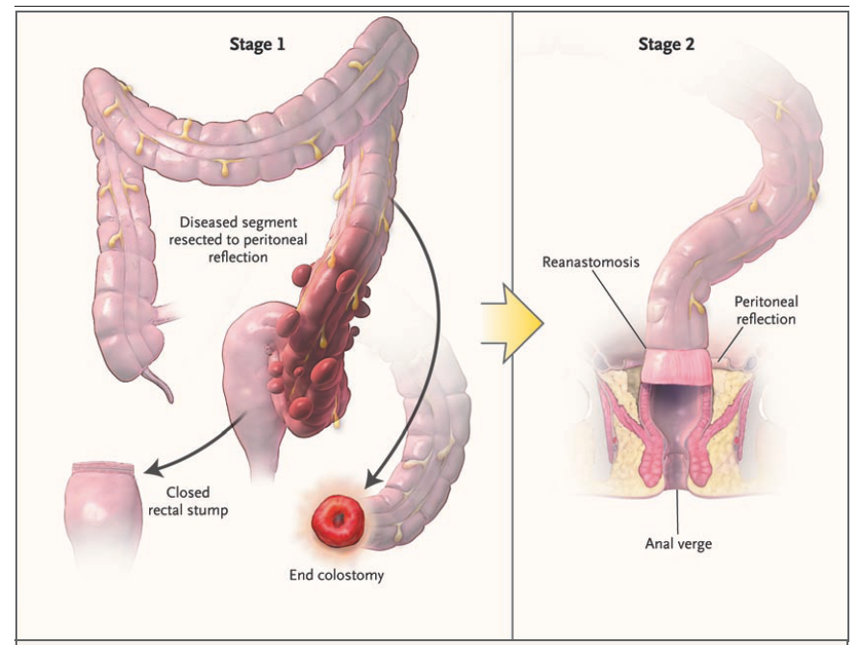
Avoids anastomosis in inflamed, infected area
Removes the diseased colon
Serves as a “bail out” strategy
Notes:
The Hartmann’s procedure was first described by Henri Hartmann in 1921 at the 30th meeting of the French Surgical Association; the operation was originally performed on two patients with obstructing sigmoid carcinomas and was intended to be definitive without plans for performing an anastomosis. This procedure replaced the three stage procedure developed by Mayo, Rankin and Brown.
Describe benefits.

Slide 32
Hartmann’s vs. Primary Anastomosis + ileostomy (w/ reversal)
Randomized (n=62)
Hartmann’s procedure (n=30)
29 received
Primary anastomosis (n=32)
29 received
Died post-op (n=4)
Stoma reversal (n=15)
Died post-op (n=3)
Stoma reversal (n=26)
≥ 18 yo
Left-sided perforated diverticulitis
Hinchey III and IV
Notes:
Dr. Cocanoiur would suggest to you that primary anastomosis with diverting ileostomy results in more patients undergoing ostomy reversal and fewer complications associated with the second procedure. She cited this randomized trial.

Slide 33
Outcomes | Hartmann’s Procedure | Primary Anastomosis | OR (95% CI) | p
Any complication (grade I-V), n (%)
Combined | 24/30 (80%) | 27/32 (84%) | 0.74 (0.20-2.74) | 0.764
Serious complications (grades IIIb-V), n (%)
Combined | 15/30 (50%) | 14/32 (44%) | 1.29 (0.47-3.50) | 0.80
Hospital mortality
Combined | 4/30 (13%) | 3/32 (9%) | 0.67 (0.14-3.29) | 0.70
Hospital length of stay (d), median (IQR) | 24 (16-40) | 22 (15-32) |  | 0.521
In-hospital cost (USD), median (IQR) | 76,248 (55,319- 94,679) | 60,926 (42,256- 84,744) |  | 0.557
Notes:
I would suggest to you that the authors selectively reported those outcomes that appeared favorable to primary anastomoses.
Other than more patients undergoing stoma reversal in the PA group, outcomes were similar in terms of any complication (Clavien-Dindo 1-5), serious complications (Clavien-Dindo IIIb-V), mortality, length of stay, and costs.

Slide 34
Methodological flaws/ statistical manipulations
Stopped early at interim analysis
Risk of overestimation of treatment effect with low event rates
Stopping rules not defined
No difference in primary, only secondary outcome
Unlikely to have been adequately powered even if enrolled 68/group
Notes:
The original power calculation estimated an absolute difference in overall complication rate of 25%. The data showed only a 4% difference, with more complications overall in the PA group. Thus, the study would likely not have been adequately powered even if 68 patients were group were enrolled as intended.

Slide 35
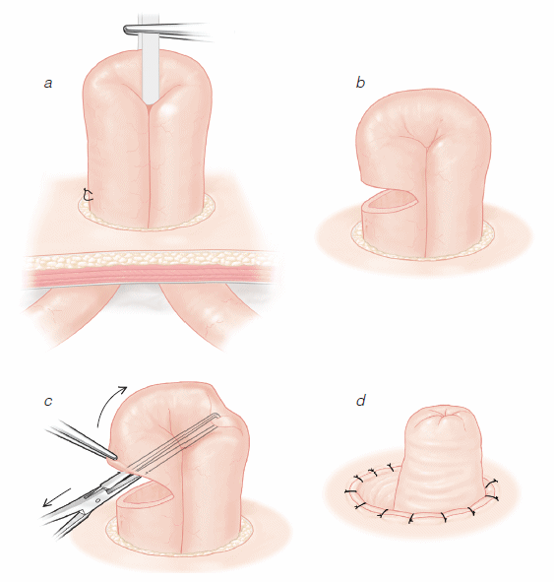
“Impracticable” trials
Binda et al: only randomized 90 patients over 9 years at 14 centers
Oberkolfer et al: 52 patients not even assessed for eligibility by surgeons (of which 40% received HP and 52% PA), 4 cross-overs, only 6 patients enrolled in 2009
Notes:
The answer is unlikely to be forthcoming. These are the only two randomized trials that have been published, and both had difficulty enrolling patients.
One multi-center trial performed at 14 centers only randomized 90 patients after 9 years (averages to less than 1 per center per year). The other trial had 83 patients assessed for eligibility and 52 patients not assessed at all due to surgeon preference. Of those, 40% received HP and 52% received PA. After randomization, 4 patients crossed over (1 from the HP group and 3 from the PA group). Enrollment in this multi-center trial also dwindled to 6 in 2009.

Slide 36
“…the clinical factors to inform decision making in this [acute] setting are not well defined, leaving surgeons to make case-by-case decisions according to the suitability of the rectum for anastomosis, the clinical condition of the patient in the operating room, and the degree of pelvic and peritoneal inflammation around the intended anastomosis.”

Slide 37
Summary
Laparoscopic lavage
Passing fad (cannot even complete randomized trials)
Flawed data
No long-term outcomes
Primary anastomosis
Based on surgeon preferences not data

Slide 38
Conclusions
Routine use of laparoscopic lavage or primary resection with anastomosis in patients with complicated diverticulitis with peritonitis is not warranted.
Hartmann’s procedure still remains an important “go-to” technique for patients with complicated diverticulitis.

Slide 39
Questions? Lillian.s.kao@uth.tmc.edu @lillianKao1

Slide 40
Summary
Laparoscopic lavage is safe and effective
Appropriate patient selection
Appropriate surgeon laparoscopic skills
Primary anastomosis in the setting of peritonitis is safe and equivalent to HP
Diversion decreases risk
Eliminates/decreases the risks and costs of Hartmann’s reversal

Slide 41
Acute Perforated Diverticulitis
Laparoscopy
Hinchey III
Hinchey IV
Lavage & Drain
Primary Anastomosis
w/ or w/o diversion
Fails to improve
Poor operative risk:
consider permanent Hartmann’s
Unstable patient Damage Control laparotomy

Slide 43
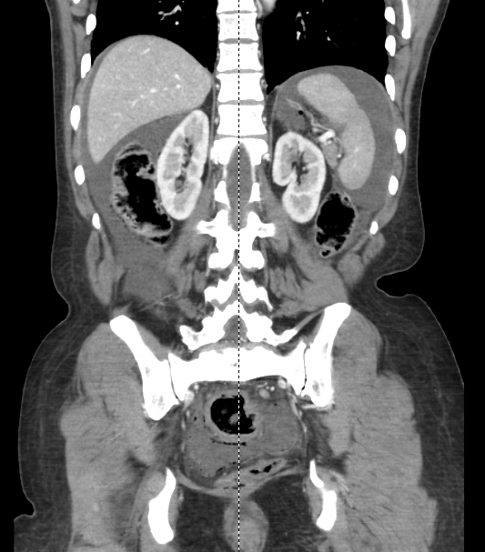
It is 2 am and you are with a junior resident, what would you do?
Hx: 55 year old female presented with diffuse abdominal pain, nausea, and vomiting.
VS: 98 F, 104, 110/76, 20, 98%
Exam: rigid abdomen, involuntary guarding
WBC: 2.6
CT abdomen/pelvis: diverticulitis, pneumoperitoneum and free fluid

Slide 44
Are you willing to risk failure of laparoscopic lavage and delay to definitive treatment?
Are you willing to do a primary anastomosis (with ileostomy) which is technically challenging and at high risk for failure in the middle of the night with a junior resident?
Are you willing to accept the complications of a failed anastomosis even with a “protecting” ileostomy?
Notes:
Do your theoretical answers match your “real world” answers?

Slide 45
If your answers are “no”, then JUST SAY NO to laparoscopic lavage and primary resection with anastomosis!!

