Slide 1
Acute Appendicitis:
Treatment in 2015
Therese M. Duane MD FACS FCCM
Vice Chair for Quality and Safety
Medical Director Acute Care Surgery Research
John Peter Smith Health Network
Fort Worth, Texas

Slide 2
To Cut is to Cure?
Not necessarily

Slide 3
Why not just operate?
Risks associated with OR
  Anesthetic risk
  Surgical Site infections
  Intra abdominal abscess
  Readmission

Slide 4
All Appendicitis is Not Created Equal
Role of Antibiotics alone as First Line Therapy
  It is not for everyone
  Excludes the septic patient
  Excludes the patient with complicated disease
  Specific for acute uncomplicated
  Defining the patient population who can benefit is important

Slide 5
All Appendicitis is Not Created Equal
Definition of uncomplicated
Retrospective review of 742 patients
  Independent predictors of complicated disease:
Finding | P value | OR
WBC > 20,000 | 0.00 | 2.717
Guarding | 0.031 | 1.649
Fecolith | 0.00 | 2.939
Periappendiceal fluid | 0.005 | 3.273
Zhao YG, Yin JZ. Treatment with antibiotics for uncomplicated acute appendicitis: strategy and its value.
Beijing Da Xue Xue Bao. 2014 Oct 18;46(5):715-9

Slide 6
All Appendicitis is Not Created Equal
  None of 4 factors = uncomplicated acute appendicitis
    46 UAA patients met criteria
    44(95.65%) were treated successfully with antibiotics
    2(4.35%) patients were unexpectedly identified to have complicated appendicitis at surgery
    5(11.36%) had recurrence after 6 months
Zhao YG, Yin JZ. Treatment with antibiotics for uncomplicated acute appendicitis: strategy and its value.
Beijing Da Xue Xue Bao. 2014 Oct 18;46(5):715-9

Slide 7
The Uncomplicated Acute Appendicitis
Objective: To compare the safety and efficacy of antibiotic treatment versus appendectomy for the primary treatment of uncomplicated acute appendicitis
Design: Meta-analysis of randomized controlled trials
Population: Randomized controlled trials of adult patients presenting with uncomplicated acute appendicitis, diagnosed by hematological and radiological investigations
Interventions: Antibiotic treatment versus appendectomy
Varadhan KK, Neal KR, Lobo DN. Safety and Efficacy of antibiotics compared with appendectomy for treatment of uncomplicated acute appendicitis: meta-analysis of randomized controlled trials. BMJ 2012

Slide 8
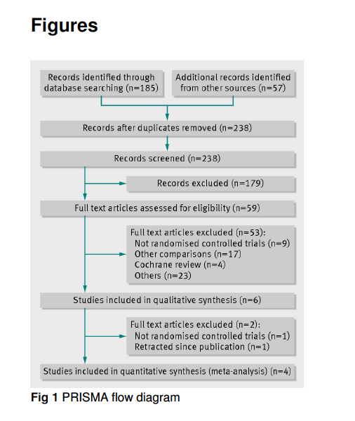

Slide 9
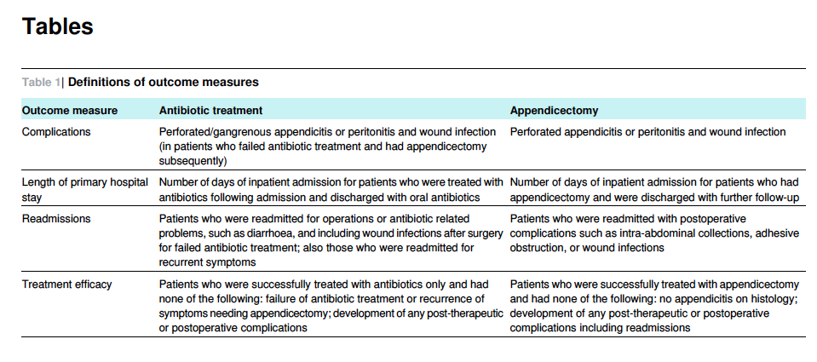
Outcome Measures
Varadhan KK, Neal KR, Lobo DN. Safety and Efficacy of antibiotics compared with appendectomy for treatment of uncomplicated acute appendicitis: meta-analysis of randomized controlled trials. BMJ 2012

Slide 10
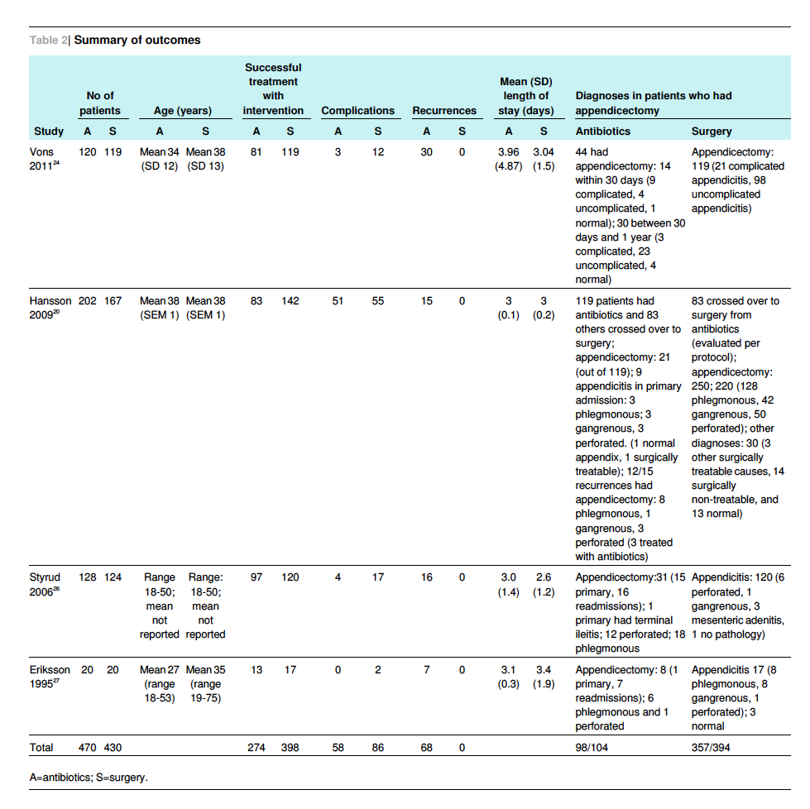

Slide 11
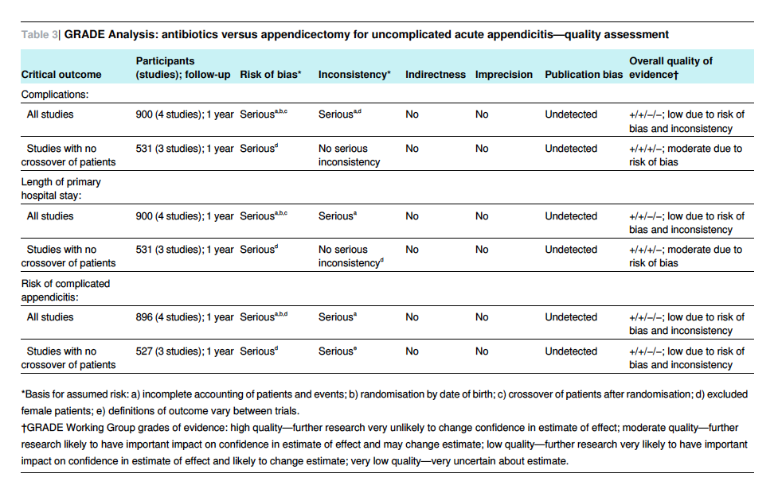

Slide 12
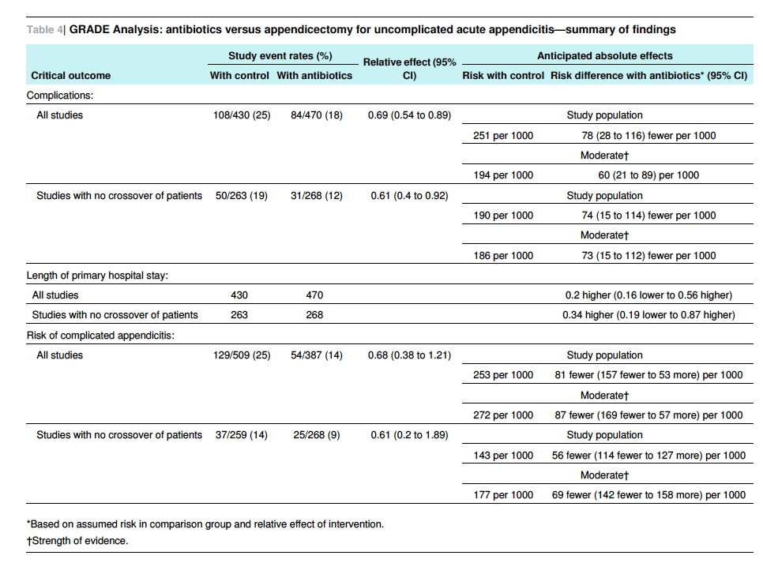

Slide 13
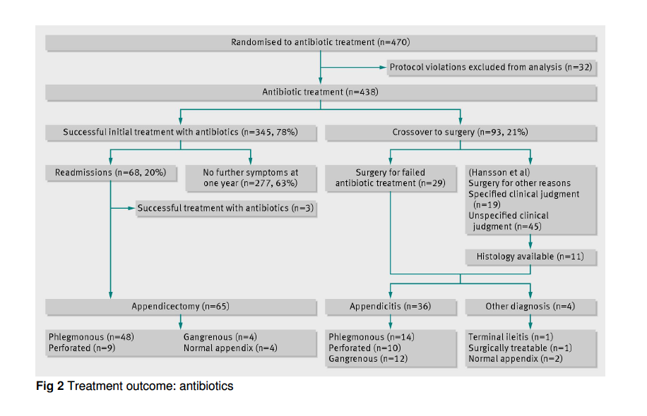

Slide 14
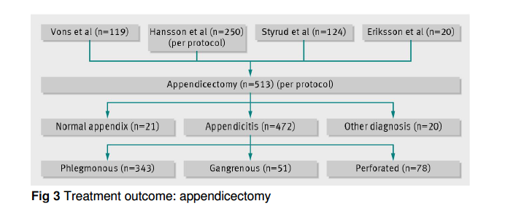

Slide 15
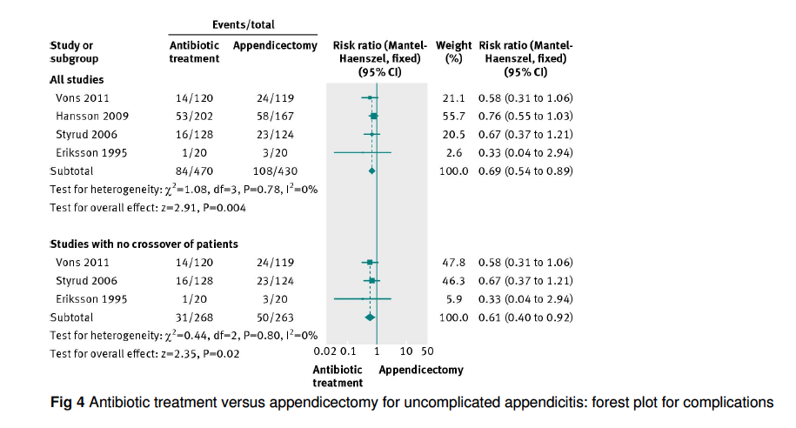

Slide 16
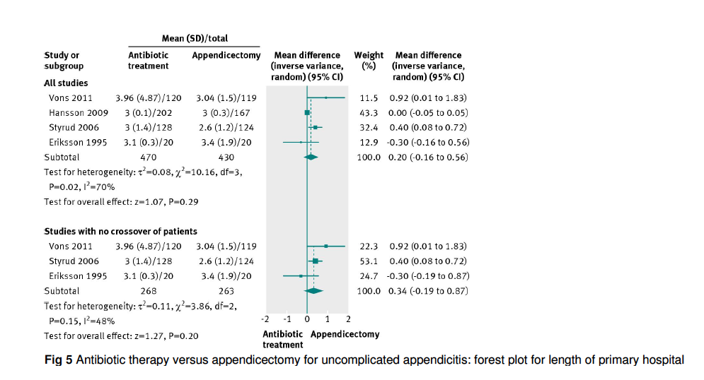

Slide 17
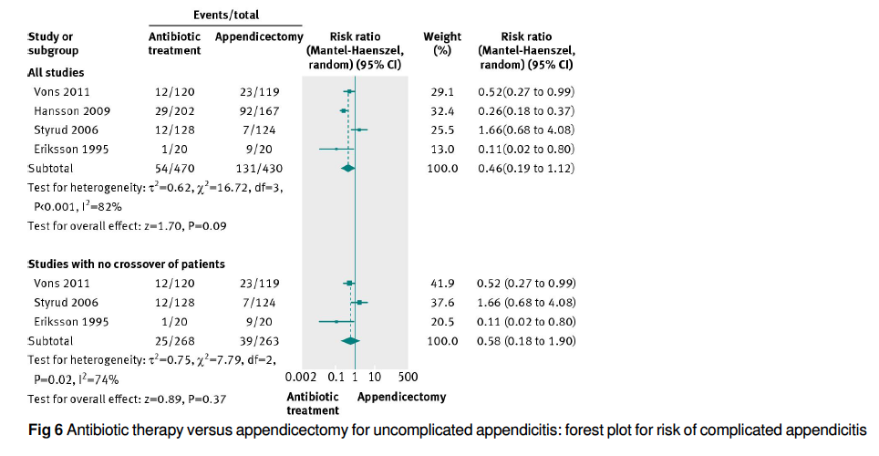

Slide 18
Conclusion
Antibiotics are effective and safe as a first line therapy for uncomplicated acute appendicitis
It merits consideration as a primary treatment option
Patients treated with antibiotics initially should be appropriately educated on risks and benefits

Slide 19


Charles Heber McBurney, MD
Harvard alumni
Published first paper on appendicitis
in 1889
Introduced the use of rubber gloves during operations to improve aseptic technique
Pre dates antibiotics
E. Patchen Dellinger, MD
Harvard alumni (trained under McBurney)
Published his first paper circa 1900
Also uses rubber gloves in the OR (and
rubber duckies in the bathtub)
Never met an antibiotic he ever liked

