Slide 1



Matthew R. Rosengart, MD MPH
16 April 2015
Departments of Surgery and Critical Care Medicine
Notes:
Good afternoon. A warm thank you for the opportunity to talk today. I have purposely made this talk very interactive, and I do hope you will accept my offer to turn this into more of a conversation than invited lecture.

Slide 2

Immunologic response to sepsis
Resolution
Immune Response
Severe infection-sepsis
Immuno-
metabolic
Response
Microbial
Invasion
Neuroendocrine
Response
Severe sepsis-septic shock
A Handshake
Altered
homeostasis
Death or
PCI

Slide 3
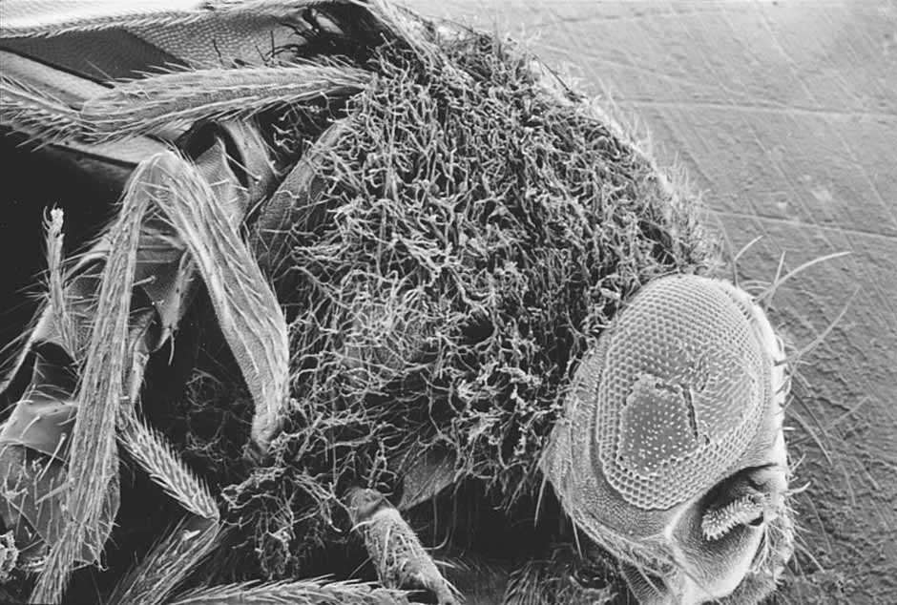
Toll-/-
Lemaitre, et al. Cell
Vol 86, 1996

Slide 4
Endotoxin recognition
“The Handshake”
Poltorak, Beulter
Science, 1998
LPS
CD14
TLR4
Plasma Membrane
Lipid Raft
Single
amino acid
mutation
TIR
Domain
Hej
mouse
Macrophage
Signaling

Slide 5
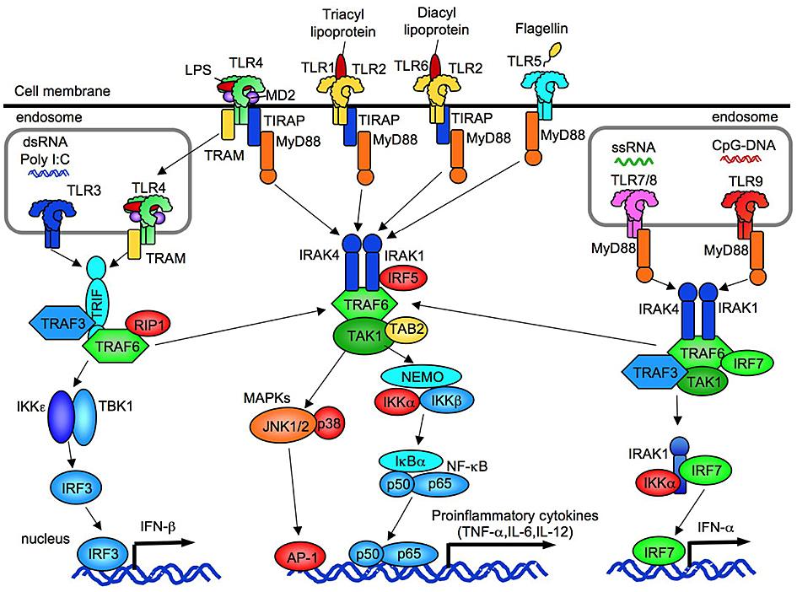

Toll-like Receptors as PAMP Sensors
(Pathogen Associated Molecular Patterns)

Slide 6
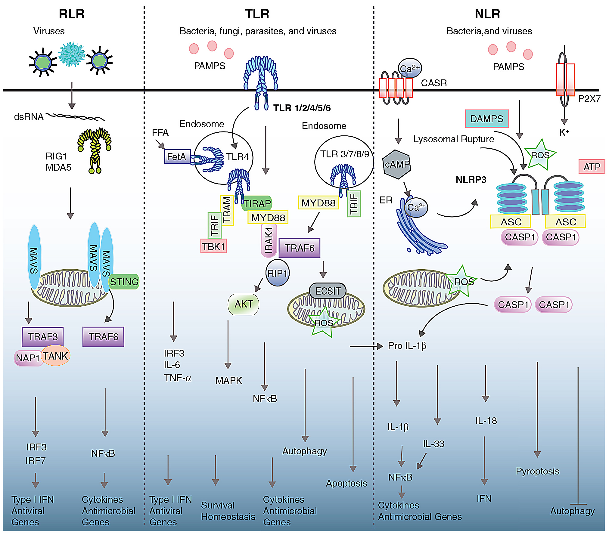
Multiple PRR families contribute to immune responses
Broz et al, Nature Reviews Immunology, 2013

Slide 7


Toll like receptor family: TLR4 unique
HSP22, 60, 70, 72, Gp96
HMGB 1
b-defensin 2
Antiphospholipid antibodies
Surfactant A, D
Fibrinogen
Tanascin C
Biglycan
Hyaluronic acid fragments
Lactoferrin
S100A8/A9
Serum Amyloid A
LDL
Saturated Fatty Acids
Der p 2
b-defensin 3
DNA
IgG chromatin complexes
TLR 1
HSP60, HSP70, Gp96
HMGB1
b-defensin 3
Antiphospholipid Abs
Surfactant A, D
Biglycan
Serum amyloid A
Hyaluronic acid fragments
TLR 9
TLR 2
Antiphospholipid Abs
ssRNA
TLR 4
TLR 3
dsRNA
TLR 7&8

Slide 8



Sources of Endogenous Danger Signals
(Damage Associated Molecular Pattern (DAMP) Molecules)
Damaged or Dying Cells
DAMPs
Pattern Recognition Receptor
Secreted From Stressed Cells
Protease
PMN
Degradation of Tissue Matrix

Slide 9
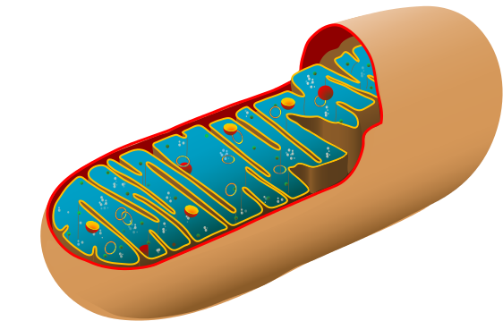
Compartment-specific sources of DAMPs
Mitochondrial DAMPs:
Tfam
Formyl peptides
DNA (oxidized)
Matrix DAMPs:
Biglycan
Heparan sulfate
Hyaluronic acid
Cytosolic DAMPs:
HSP
ATP
RNA
Nuclear DAMPs:
HMGB1
Histones
DNA

Slide 10
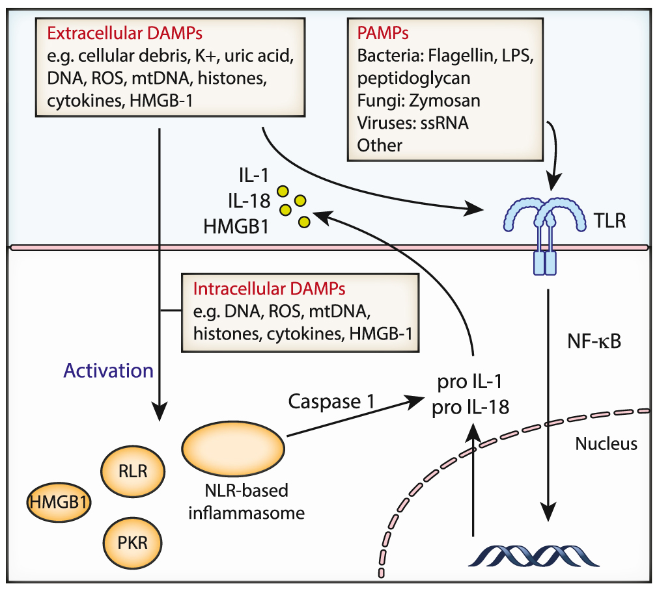
Both extracellular and intracellular DAMPs drive persistent inflammation in sepsis
Deutschman & Tracey, Immunity, 2014

Slide 11
Classes of molecules initiating innate immune response responses through PRR
Pathogen-associated Molecular Patterns
(PAMPs)
Exogenous molecules expressed or released by invading microorganisms that are structurally unique to the pathogen.
Damage-associated Molecular Patterns (DAMPs):
Endogenous molecules that are normally unavailable to the immune system that are released and recognized by immune cells following tissue injury.

Slide 12






Parenchymal Cells Express Functional TLR4
LPS
Uptake
TLR4
Cytokines
TLR4
LPS
LPS
Uptake
Kupffer Cells
(Nonparenchymal Cells)
TLR4
Hepatocytes
(Parenchymal Cells)

Slide 13
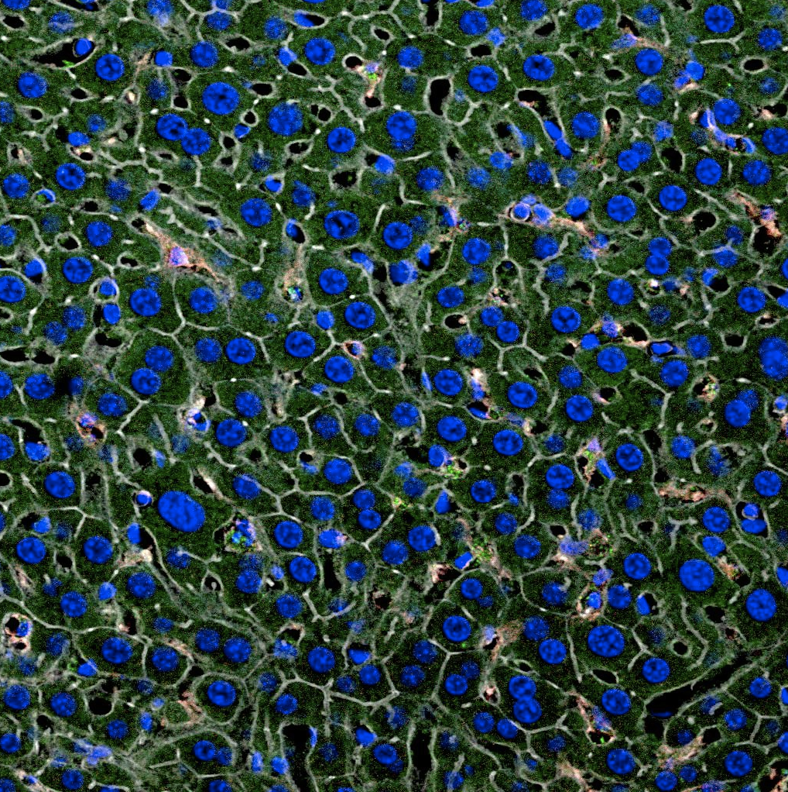
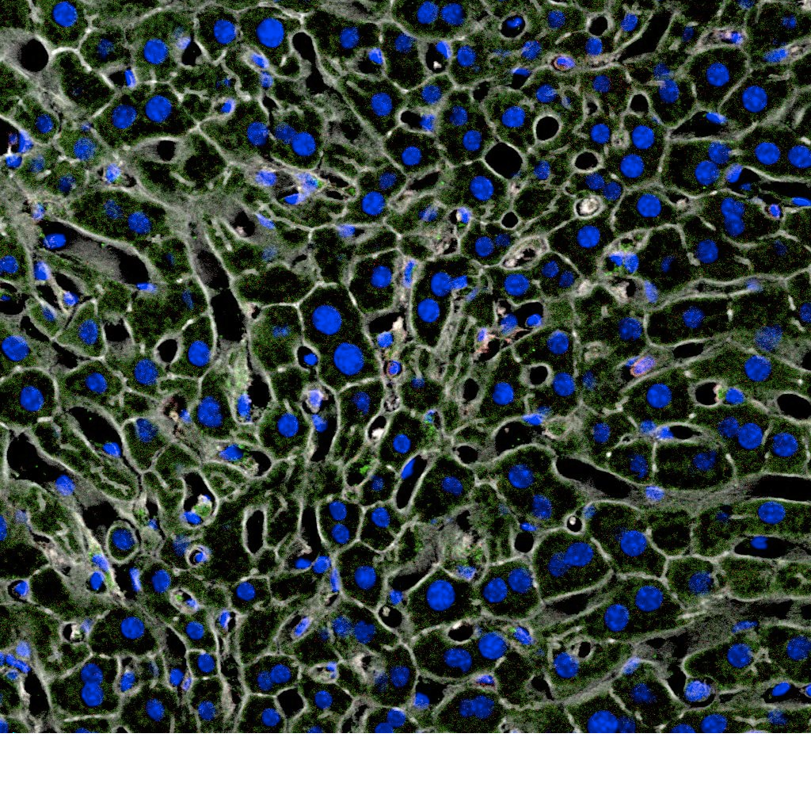
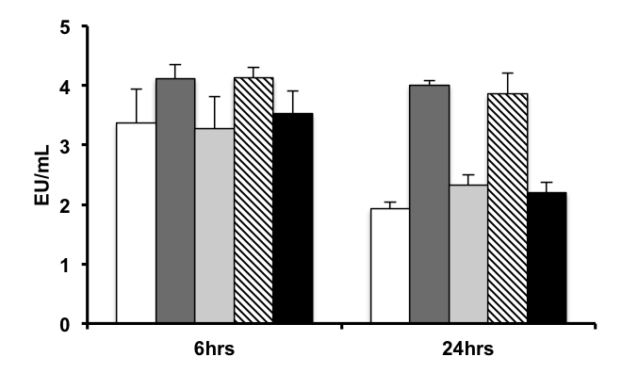
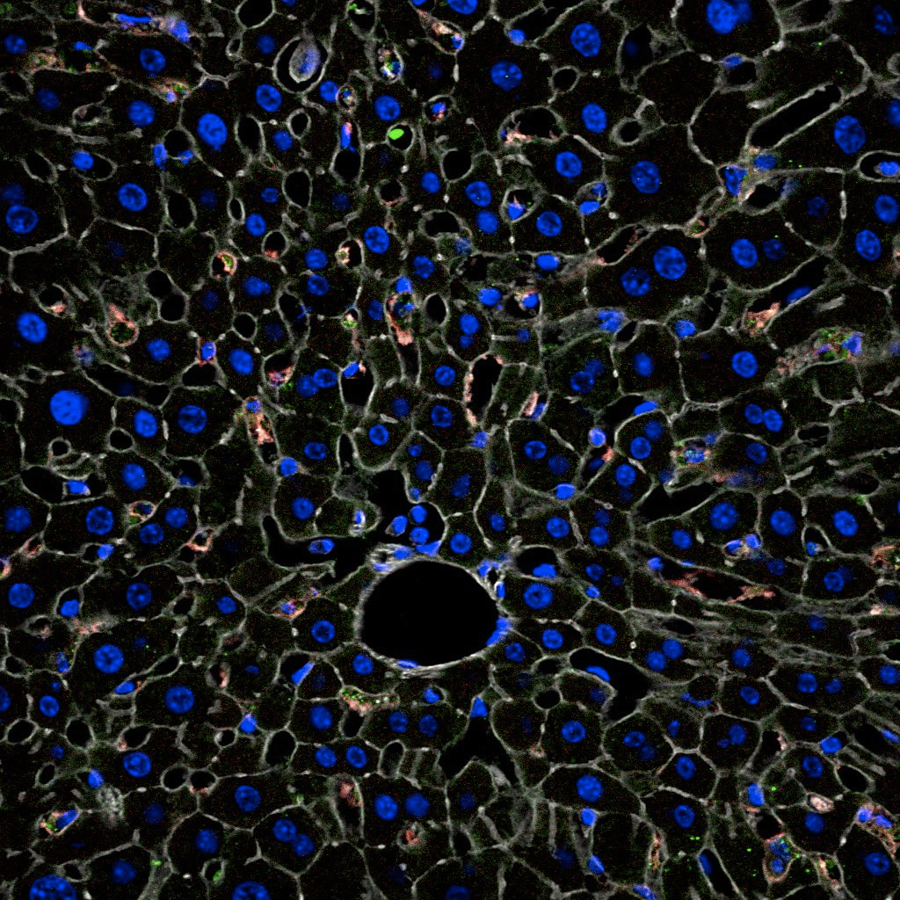
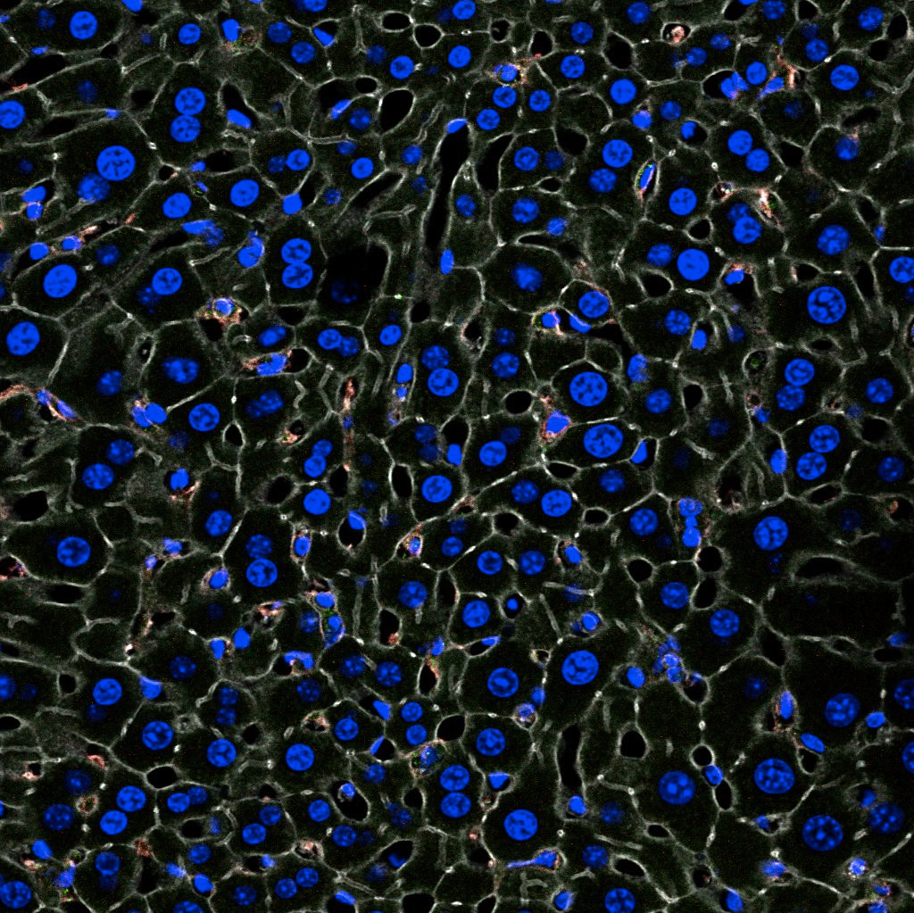
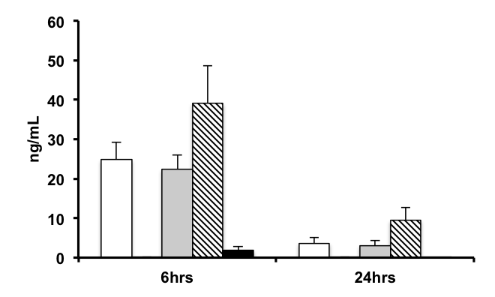
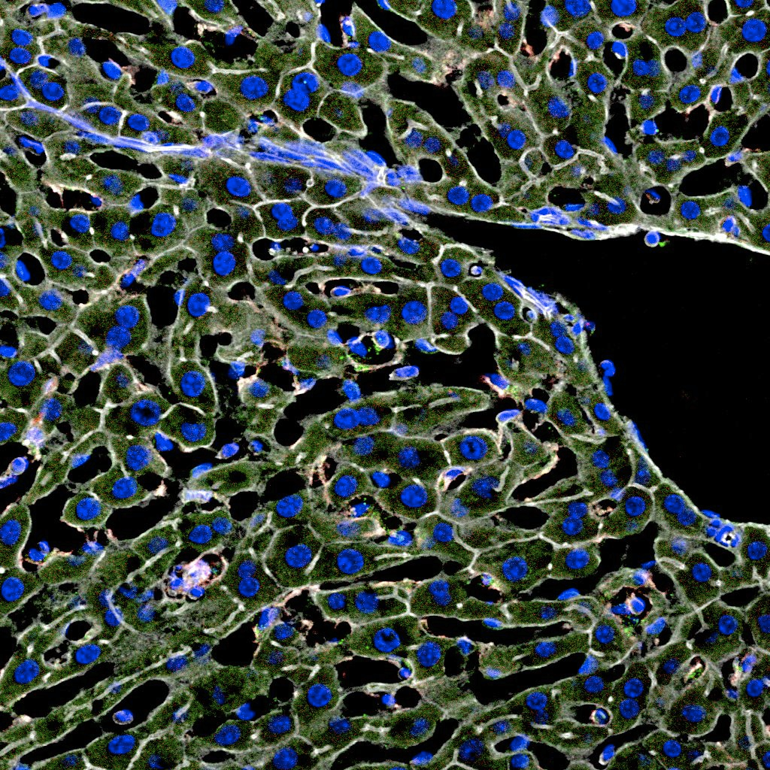
LPS Clearance depends of hepatocyte TLR4
Cytokine production depends on leukocyte TLR4
WT
Flox
Plasma LPS Levels
TLR4KO
HCTLR4KO
Plasma IL-6 Levels
WT:
MΦTLR4KO
TLR4KO:
Green=LPS
Flox:
HCTLR4KO:
MØTLR4KO:
Blue=Dapi
White=Elastin
Deng, et al. J Immunol, 2013

Slide 14
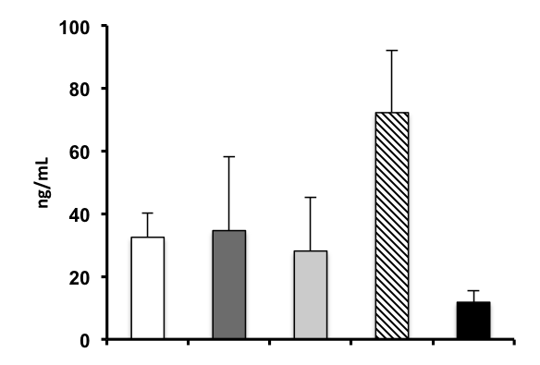
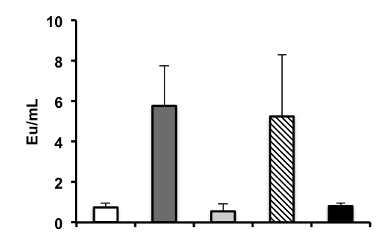
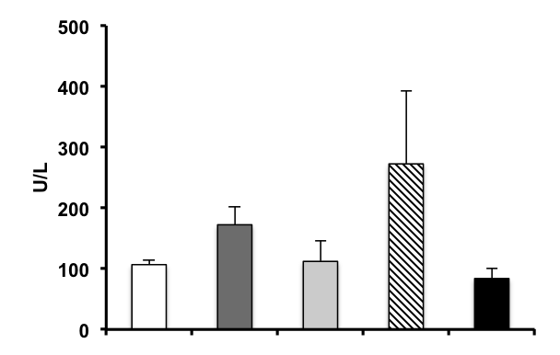
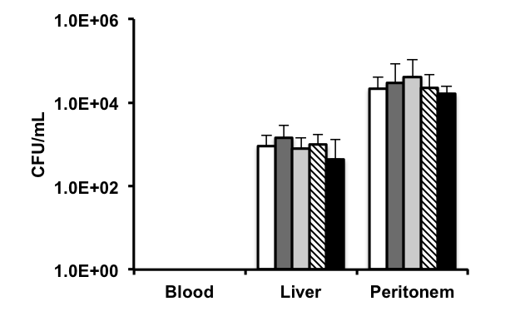
Efficiency of LPS and Bacterial Clearance dictate inflammation and organ injury during CLP
CLP-With antibiotics
*
Plasma LPS
Levels
Plasma IL6
Levels
*
*
*
WT
TLR4KO
Flox
HCTLR4KO
MΦTLR4KO
WT
Flox
TLR4KO
HCTLR4KO
MΦTLR4KO
Bacterial
Counts
Plasma ALT
Levels
*
*
ND
*p<0.05
WT
TLR4KO
Flox
HCTLR4KO
MΦTLR4KO
Deng, et al. J Immunol, 2013

Slide 15
Loss of TLR4 on hepatocytes leads to higher LPS levels, increased cytokine production and enhanced phagocytosis
LPS
Uptake
Phagocytosis
TLR4
Cytokines
LPS
LPS
Uptake
Kupffer Cells
other leukocytes
TLR4
Hepatocytes
(Parenchymal Cells)

Slide 16
DAMP-PAMP paradigm of critical illness
Infection
PAMPs:
LPS
LTA
Microbial DNA/RNA
Pattern Recognition Receptors (toll-like
receptors)
Activation
of
Innate
Immune System
Systemic Inflammatory Response
DAMPs:
DNA
HMGB1
HSP
Hyluronan
Injury

Slide 17
The Search for a Mediator of Sepsis
Death
HMGB1
TNF
IL-1
//
Hours
Days
Infection
Wang et al., Science, 1999
Notes:
In the early 1990’s we still did not know what had caused Janice’s sepsis; there was no causative agent known that fulfilled Koch’s postulates as a necessary and sufficient mediator of severe sepsis. In 1993, I decided to implement an alternative approach to the problem of sepsis, based on the hypothesis that a previously unrecognized, putative mediator might fulfill Koch’s postulates as a causative molecular agent in lethal sepsis without shock. We started by considering the kinetics of cytokine production in lethal sepsis, wondering whether we could reduce this complex problem to an issue of timing. Experimental animals with a surgically created bowel perforation develop a lethal disease that progresses slowly over 3-7 days, indeed similar to patients with severe sepsis, a syndrome that kills long after TNF has resolved.
In September of 1992 my colleague Ona Bloom and I began to search for previously unrecognized cytokine-like molecules released by macrophage cultures into the medium. We focused on proteins that were released 18 hours or more after TNF, hoping to identify a putative mediator that functioned significantly later in the cascade.

Slide 18
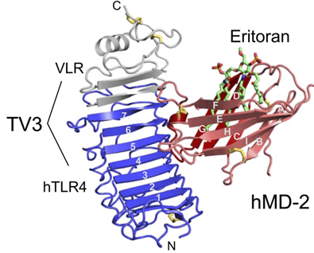
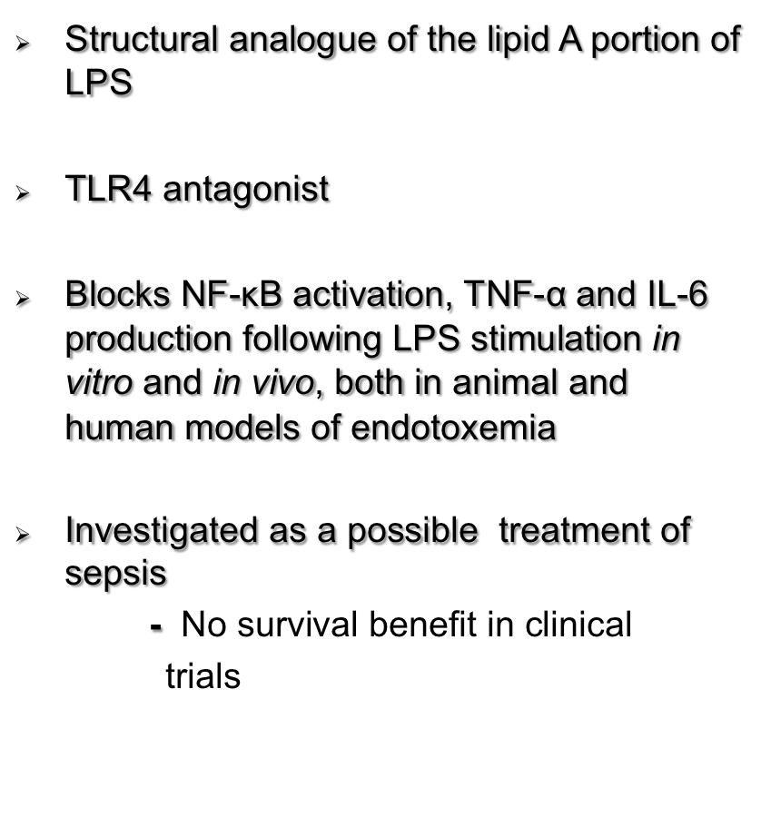
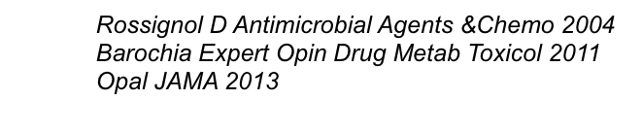
Eritoran tetrasodium (E5554)

Slide 19
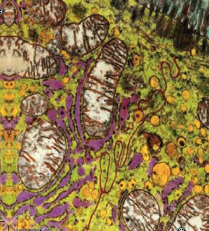
Mitochondria and Sepsis
“Powerhouse of cell”
Mitochondria are pivotal in orchestrating cellular events.
Cell signaling, innate immune responses, nuclear gene expression

Slide 20
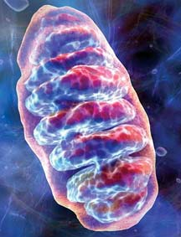
Mitochondria and Sepsis
Mitochondria induce cell signaling responses to numerous stimuli including pathogen and damage associated molecular pattern molecules, or hypoxia.
In sepsis, shutdown of mitochondrial respiration, resulting in cellular and organ dysfunction, may be a protective response to prevent cell death and irreversible damage
Notes:
There is a significant amount of literature examining the etiology of sepsis induced organ dysfunction and most of it points to mitochondria and mitochondrial dysfunction.
When we look at mitochondria in sepsis there are structural and functional impairments that occur in a severity dependent manner with sepsis.
With this mitochondrial dysfunction there is the inefficient production of ATP which drive many cellular processes.
With this hypometabolic state there are several protective mechanisms that are induced to prevent the development of bioenergetic failure and subsequent cellular death- but at the expense of cellular function

Slide 21
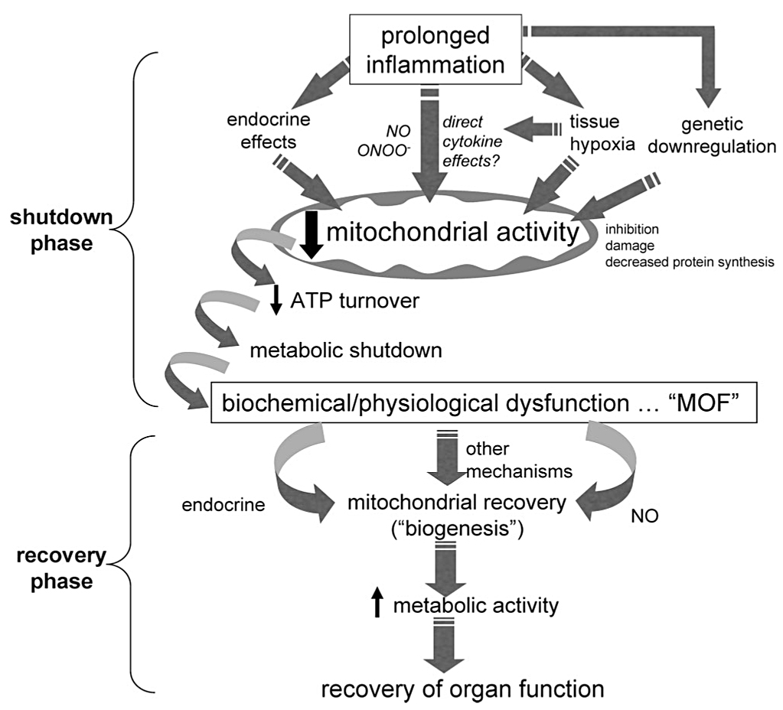
Mitochondrial Dysfunction as a basis for altered homeostasis in Severe Sepsis
Failed mitophagy
Singer, M. Crit Care Med, 2007
Singer, M. Virulence, 2014

Slide 22
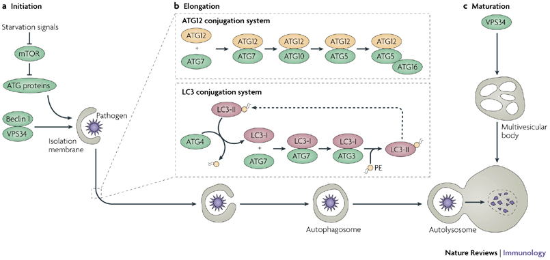
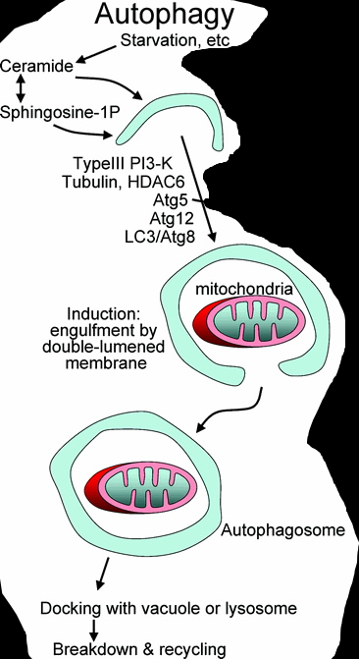
Autophagy: “Self-eating”
An ancient and evolutionarily conserved cytoplasmic biomass quality and quantity control system.
  Basal activity maintains cellular homeostasis
Endows cells with the ability to sacrifice and reuse portions of their cytoplasm to support vital functions during periods of stress, prototypically starvation.
Induced under stress = cell survival
Delgado, Immun Rev 2009
Autophagosome
Notes:
Autophagosome: “morphological hallmark”

Slide 23
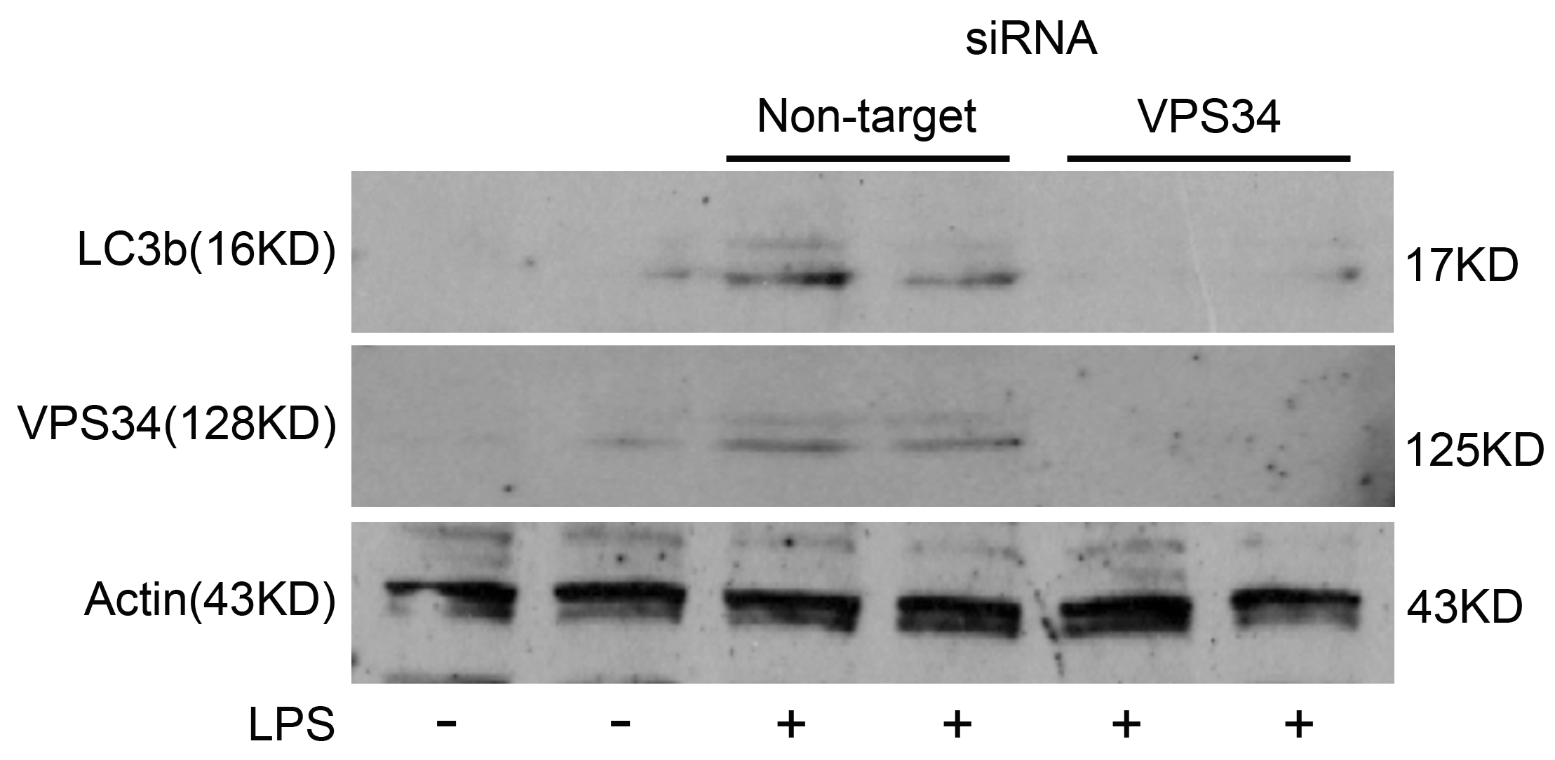
RNAi of VPS34 exacerbates AKI during sepsis
RNAi in vivo
NT
VPS34
LPS 5 mg/kg IP
18h, autophagy
48h, function
Renal cortex
IF
VPS34 (red)
punctate LC3 (red)
IB
LC3B pAb
 | NT RNAi | VPS34 RNAi | P value
BUN (mg/dl) | 29 | 133 | 0.02
Cystatin (mg/ml) | 636 | 1367 | 0.02

Slide 24

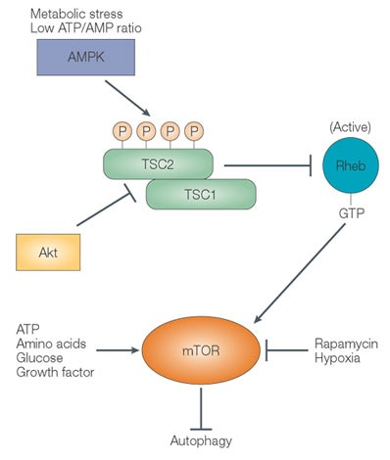
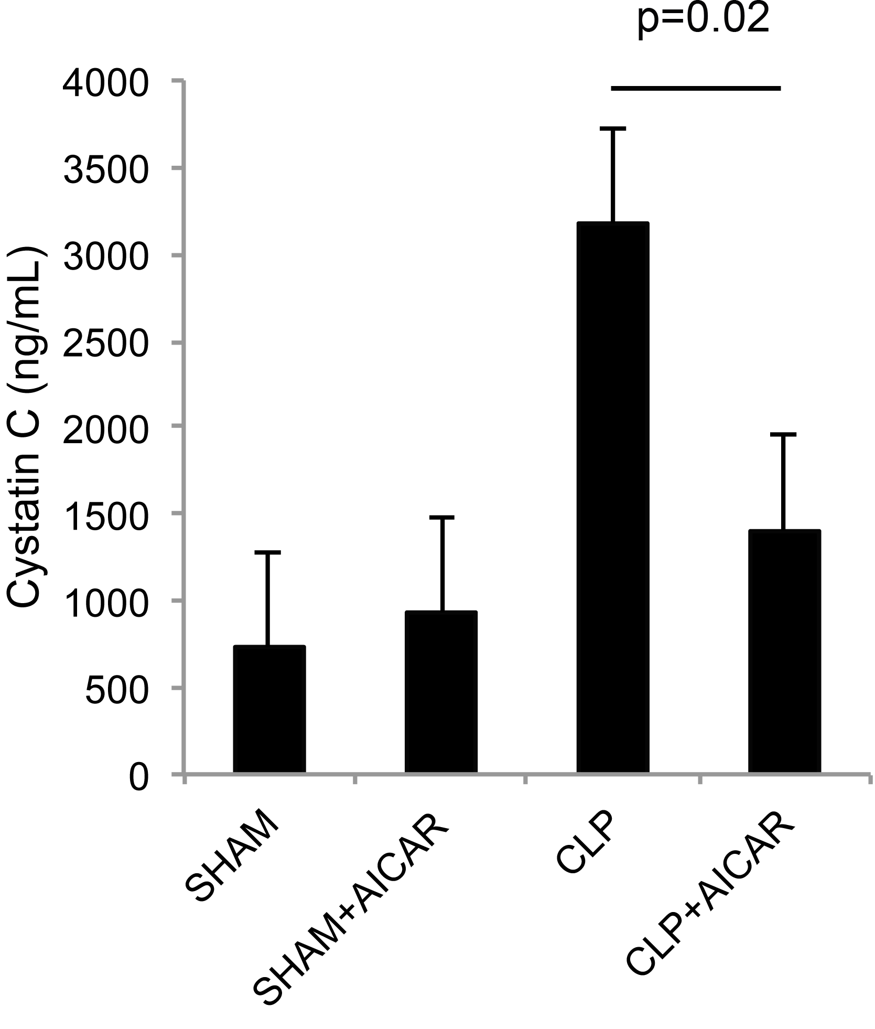

Slide 25
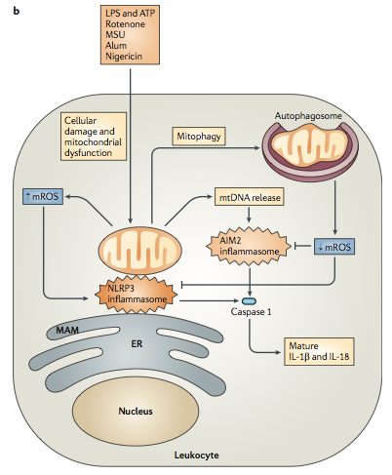
Mitochondria and Sepsis
Mitophagy prevents mitochondrial DNA release and mito ROS production to limit activation of inflammasome in leukocytes
Nakahira et al. Nat. Immunol. 2011 vol 12 (3). 222-230.
West et al. Nat Rev Immunol. 2011 vol 11(6). 389-402.

Slide 26
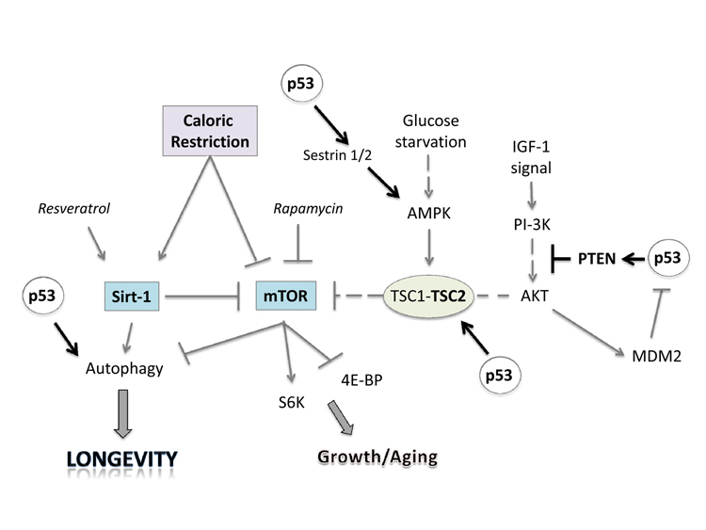
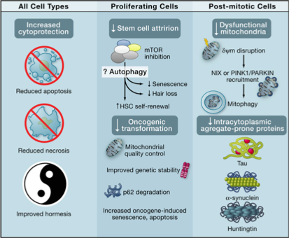
Sepsis, Autophagy and Aging
Rubinsztein et al, Cell, 2011

Slide 27
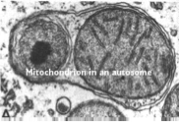
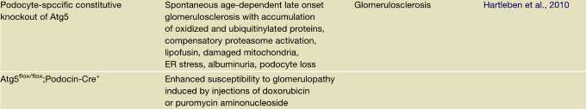
Mitophagy, AKI, and Aging
Autophagic induction (flux) cytoprotective in AKI¹
AKI affects mitochondria-rich proximal tubule cells
Recovery requires elimination of damaged mitochondria (apoptotic mediators, ROS)
¹Kimura et al, JASN, 2011
²Rubinsztein et al, Cell, 2011
³Cui et al, Age, 2011

Slide 28
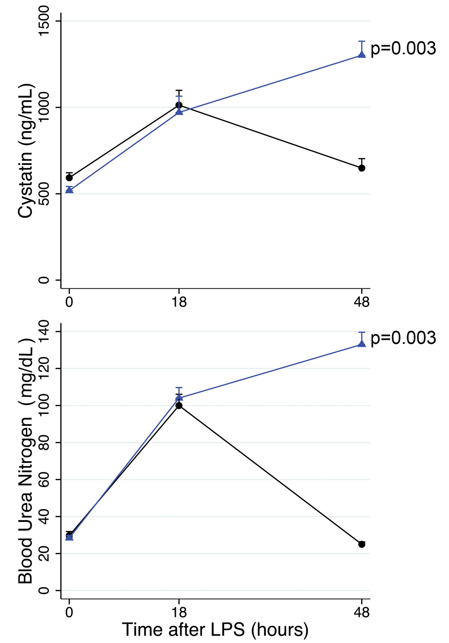
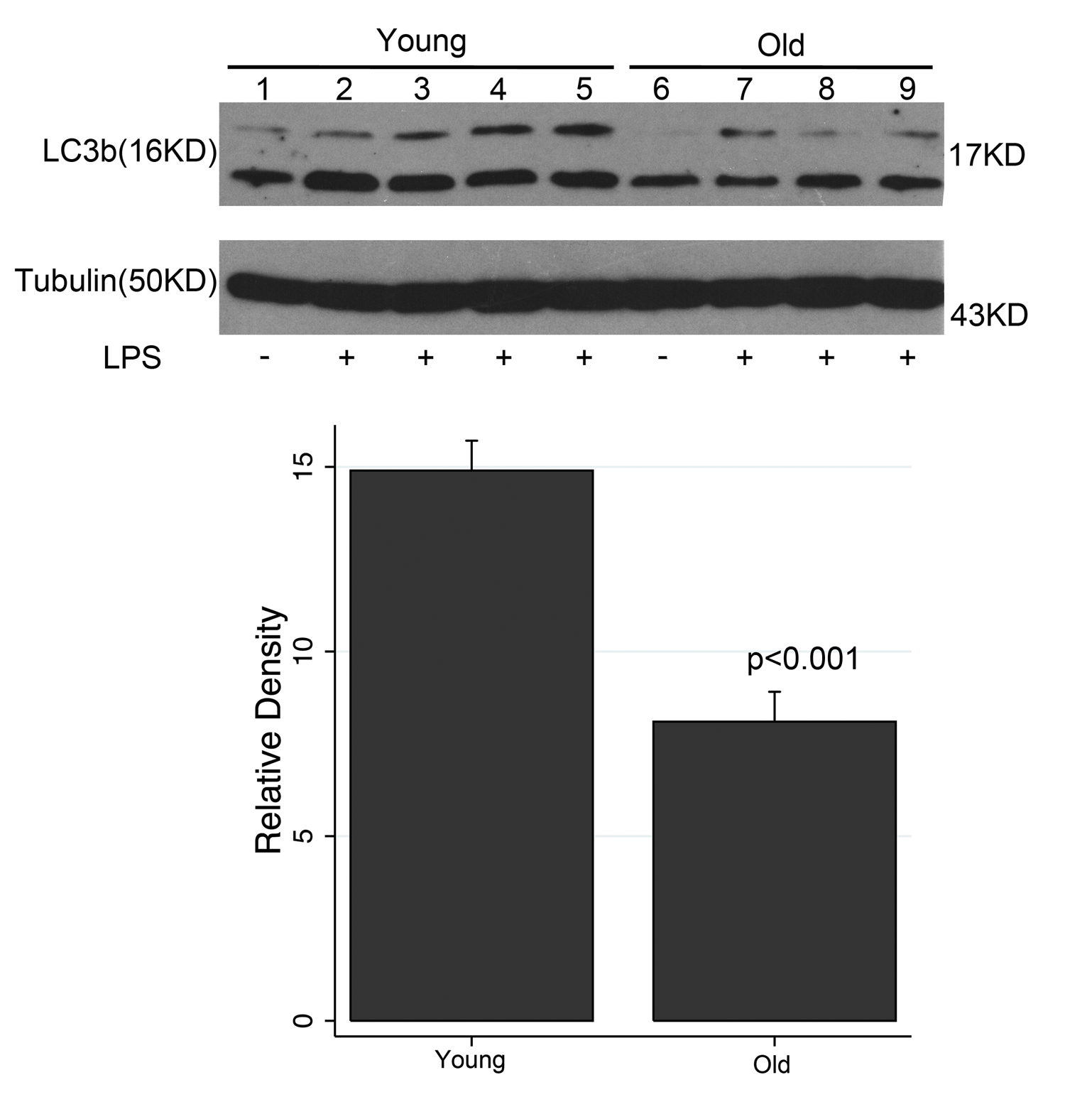
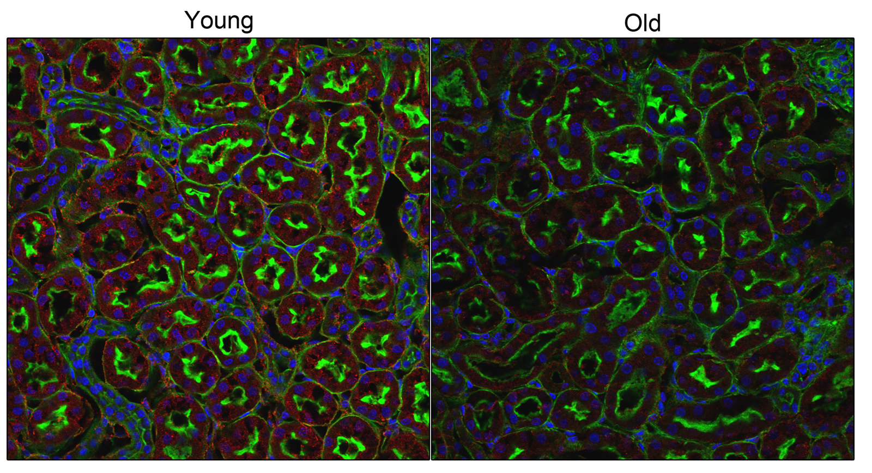
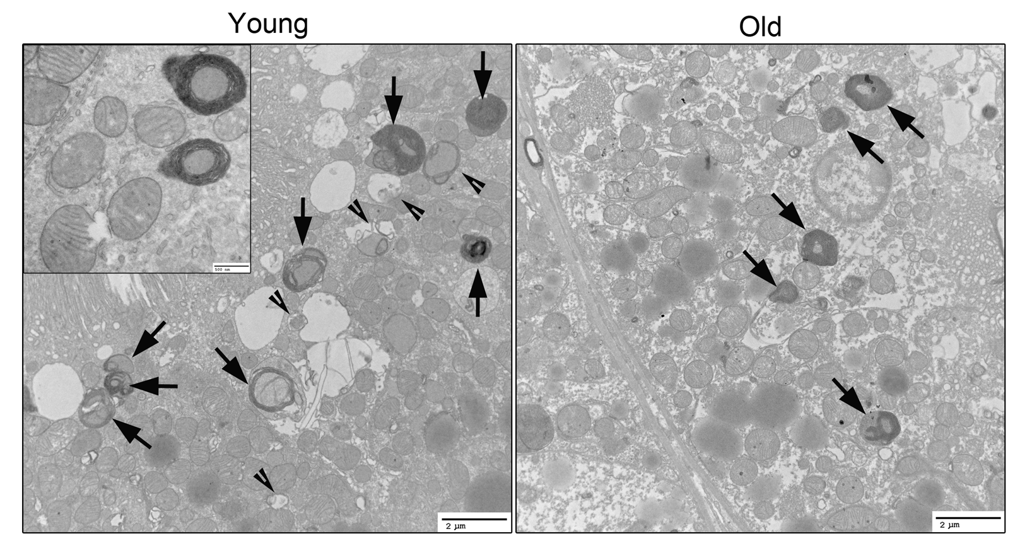
Mitophagy declines with aging
LPS 5mg/kg IP, 18 hrs
IB:LC3B pAb
IF: punctate LC3 (red)
EM: 10,000X
Notes:
We began our studies by exploring the adaptive responses in the kidney to an acute insult such as LPS and found that LPS consistently induced autophagy both in vivo as demonstrated by increased LC3b expression, immunofluorescence for LC3 and autophagosomes in the top images, and in vitro, as can be seen by increased LC3 expression in the bottom image.

Slide 29
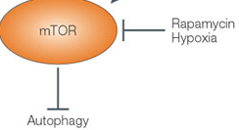
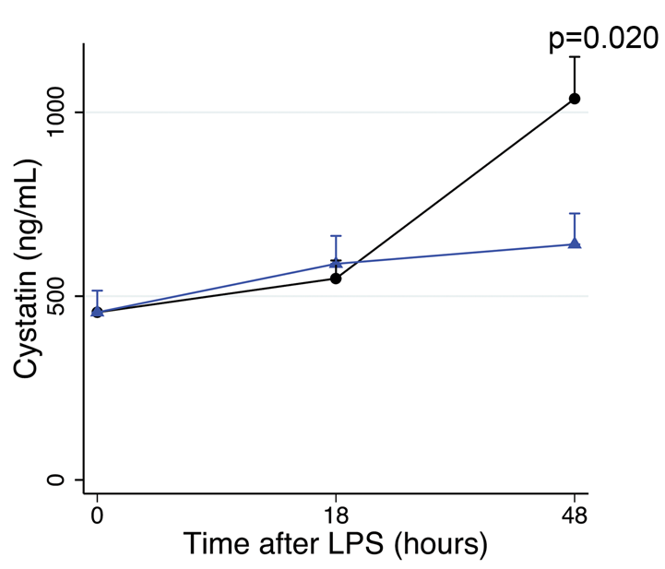
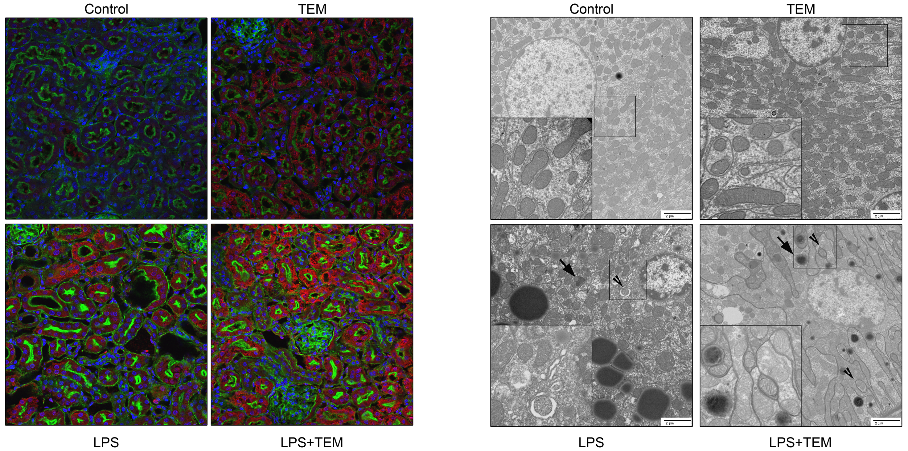

Temsirolimus 5mg/kg, 1hr
LPS 1.5 mg/kg IP, 18hrs
Renal cortex
IF: punctate LC3 (red)
EM: 10,000X
Inset: 50,000X

Slide 30

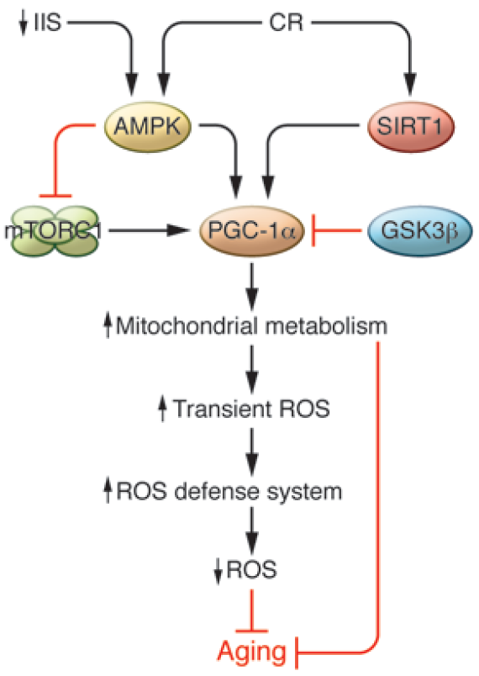
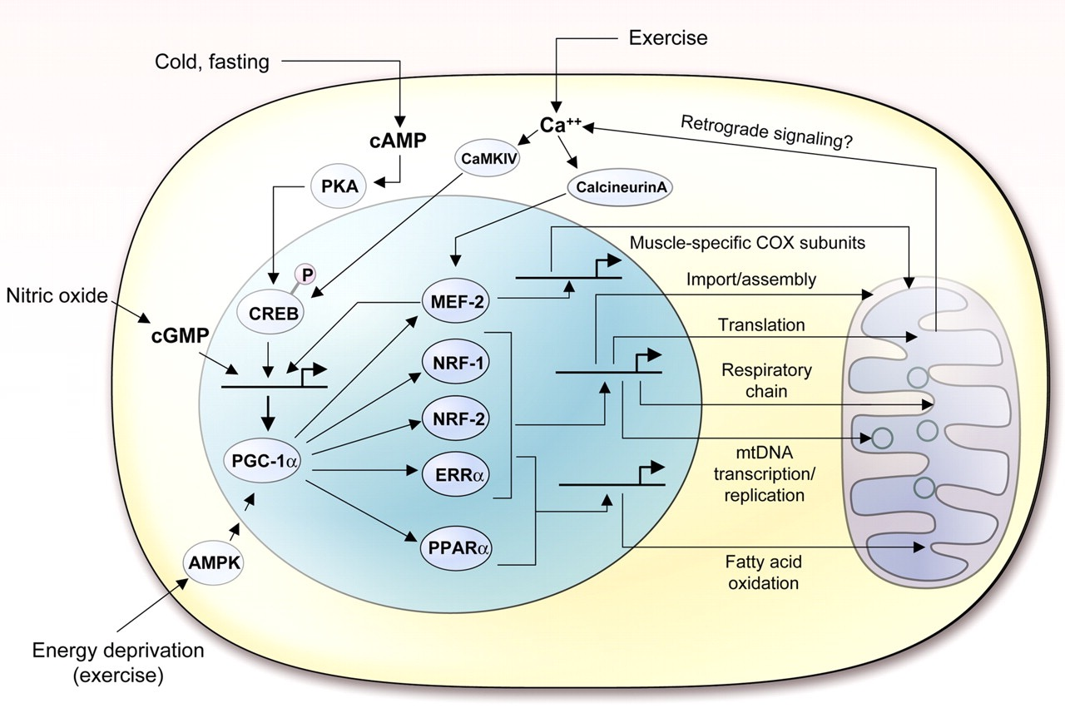
Mitochondrial Biogenesis
In animal models of sepsis, enhanced biogenesis is shown to improve survival, and inhibition of mitochondrial biogenesis worsens outcome.
In human study, eventual survivors of severe sepsis were observed to respond early to critical illness with mitochondrial biogenesis.

Slide 31
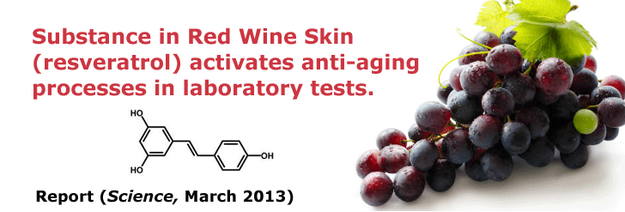
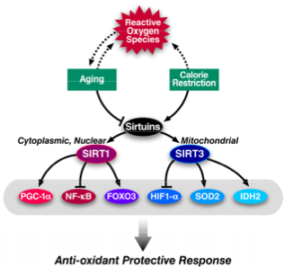
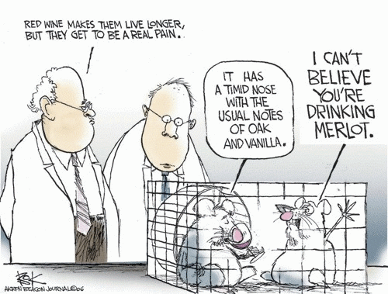
Sirtuins (SIRT1)
SIRT1 induces the expression of stress response genes.
Promotes mitochondrial biogenesis by inducing PGC1α
Inactivates NFκB
Notes:
Sirtuins are NAD+-dependent histone/protein deacetylases that catalyze the removal of acetyl groups from the side chain amin group of lysine residues, and there are considerable data linking sirtuins to oxidative stress and mitochondrial health.
SIRT1 mediates an oxidative stress response by directly deacetylating several transcription factors that regulate antioxidant genes.
It activates several members of the FOX family of transcription factors which promote the expression of stress response genes including SOD2, thereby protecting against oxidative stress.
It promotes mitochondrial biogenesis by activating peroxisome proliferator-actived receptor coactivator 1alpha, which in addition to increasing mitochondrial mass, also regulates the expression of several oxidative stress genes.
And it inactivates the p65 subunit of NFKB, which suppresses inducible nitric oxide synthase and nitrous oxide production and thus may lower ROS load.
Mice genetically modified to overexpress SIRT! Mimic a caloric restriction phenotype, and SIRT1 KO mice fail to respond to CR.
Similarly SIRT3 boosts SOD2 activity and may mitigate oxidative stres, and SIRT3 KO mice are more susceptible to cancer..

Slide 32
Trials: Resveratrol/Sirtuin agonists
NCT01150955: Potential Beneficial effects of Resveratrol
  Molecular biology underpinning the interplay between calorie restriction, SIRT1, IGF-1 axis
NCT01842399: Resveratrol and Cardiovascular Health in the Elderly
Effect of SIRT1 agonists on Endotoxin-Induced Inflammation
  NCT01262911: SRT2379
  NCT01014117:SRT2104

Slide 33
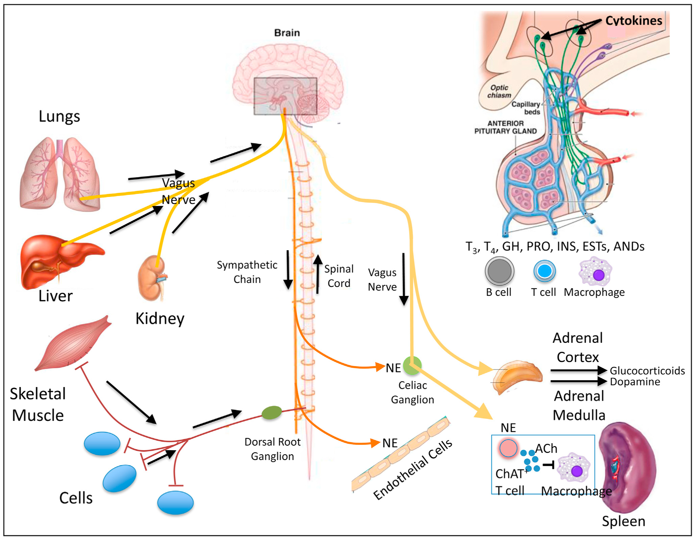
The neuroendocrine and immune systems interface at multiple levels
Deutschman & Tracey, Immunity, 2014

Slide 34
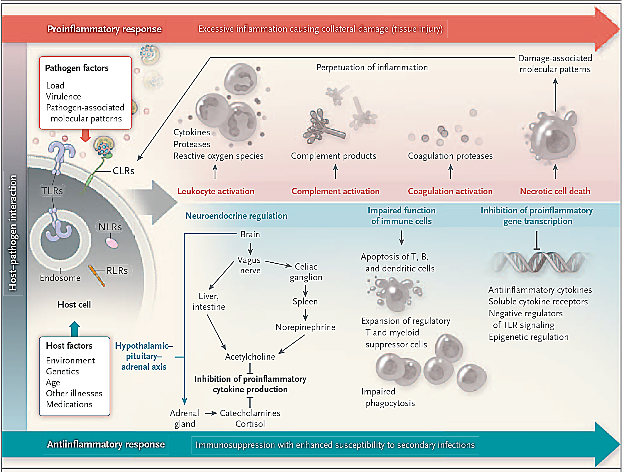
Summary: The Biology of Sepsis
Angus and van der Poll, NEJM, 2013

Slide 35
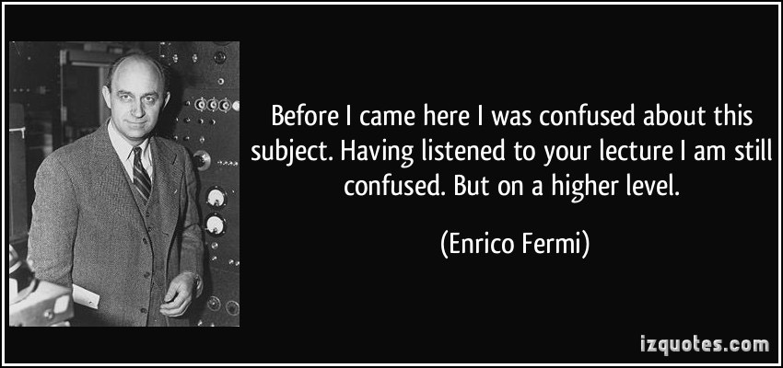
Thank you!

